Slide 1



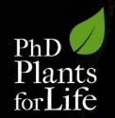
Plant Breeding across times:
- challenges and achievements
Susana Lopes
“Plants for Life” International PhD Program – 2016
(course “Plant Biotechnology for Sustainability and Global Economy”)

Slide 2

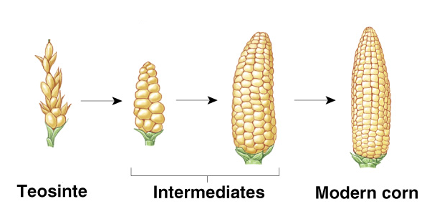
Plant Breeding Concept
Plant breeding is the process by which humans change certain aspects of plants over time in order to introduce desired characteristics
Increase crop productivity
Notes:
- Plant breeding is the process by which humans change certain aspects of plants over time in order to introduce desired characteristics.
These desired characteristics can vary according to the specific needs of each farmer or region, but the ultimate goal is to increase crop productivity and quality.
This can be achieved by increasing improving yield traits, improving adaptation to environmental conditions (drought, cold, salinity…) and resistance to pests and pathogens.

Slide 3
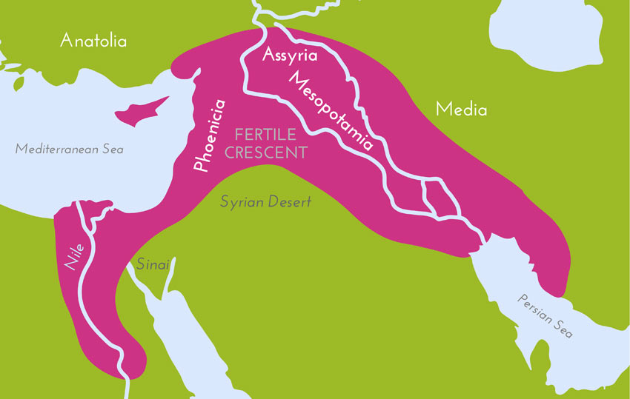
Domestication
Plant Breeding activities began at least 10.000 years ago in the Fertile Crescent with plant domestication
Challenges: transition from nomadic to a sedentary lifestyle
Increase plant yield
Increase number of edible plants
(reduce toxicity)
Notes:
Plant breeding activities began at least 10.000 years ago, in the Fertile Crescent, with plant domestication.
Plant domestication is the selection process carried out by men to adapt plants to their own needs.
At that time the biggest challenge was the transition from nomadic to sedentary lifestyle, and the need to obtain more resources to feed the local population.
By saving the seeds (of wild relatives of present crops) to use in the following year, primitive farmers, knowing nothing about genetics or plant breeding, succeeded to rescue desirable traits and gradually increase plant yield in the following season.
They were also capable of increasing the number of edible plants, by reducing the toxicity of some of them. A good example is cassava, that has edible varieties but also others that are very toxic and cannot be eaten.

Slide 4
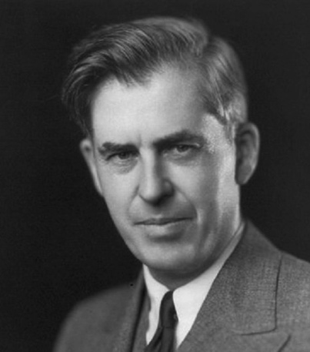
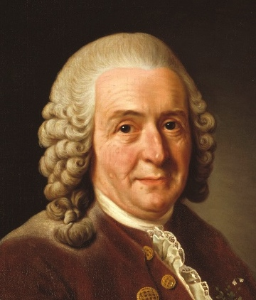
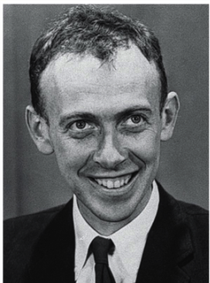
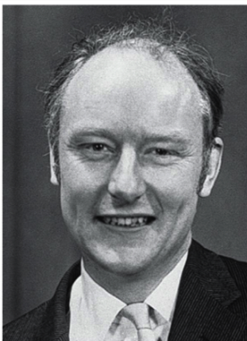
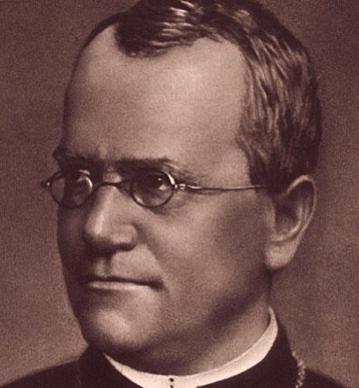
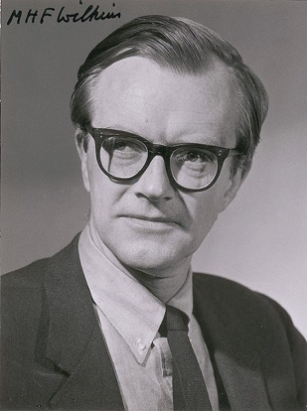

Landmarks in Plant Breeding
Watson, Crick, Wilkins & Rosalind Franklin
model for DNA
structure
Mendel
Empirical evidence
on heredity
1694
1866
1923
1953
Camerarius
crossing as a method to obtain new plant types
Wallace
First commercial
hybrid corn
Notes:
Although relatively recent, there are many important ladmarks related to plant breeding and it is important to highlight some of them:
- In 1694 Camerarius suggested crossing as a method to obtain new plant types
- In 1866 Mendel provide empirical evidence on heredity, by conducting hybridization experiments in garden peas
- In 1923 the first commercial hybrid corn was developed by Wallace
- In 1953 a model for DNA structure was proposed, by Watson, Crick and Rosalind Franklin, opening the way to numerous breeding improvements.

Slide 5
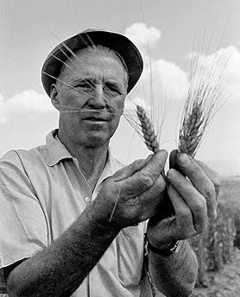
“The Green Revolution” (1960)
Challenge: improve wheat and maize to meet the production needs of developing countries
High yielding semi-dwarf, lodging resistant wheat varieties
Norman Borlaug
Notes:
- 1960 is the time of the biggest landmarks in the green revolution. The green revolution began in Mexico, at an international research centre (CGIAR), with the challenge of improving wheat and maize to meet the production needed of the developing countries where population was exponentially growing.
- Dr Norman Borlaug and his team used key technological strategies to develop high yielding varieties of wheat, and developed an appropriate agronomic package (fertilizer, irrigation, tillage, pest control) to optimize the yield potential of the varieties.
- With this program it was possible to produce high yielding semi-dwarf, lodging resistant wheat varieties that were introduced into other parts of the world, including Pakistan, India, and Turkey, with equally outstanding results.

Slide 6
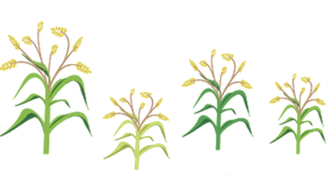

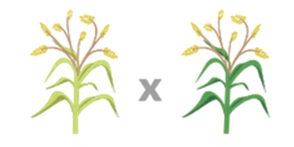
Plant Breeding Methods
Conventional breeding
Mutation or crossing to introduce variability
Selection based on morphological characteres
Growth of selected seeds
Challenge: reduce the time needed to complete a breeding program
Notes:
- Until this point, plant breeding was based on traditional/conventional methods, in which the breeders induced mutations or performed crosses between different varieties (in order to generate variability), and then applied selection based on morphological characteristics. The plants were selected to grow future generations.
- However, for annual crops, the period needed to complete a breeding program is estimated as approximately 7-12 years (or longer).
- To address the population needs, the challenge was then to develop tools that could allow reducing the time needed to complete a breeding program.

Slide 7
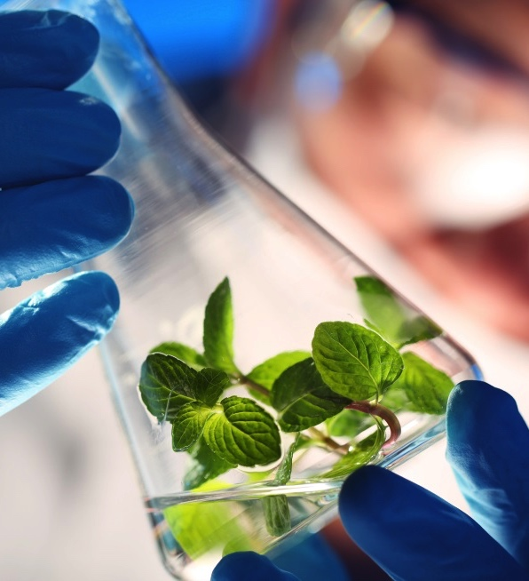
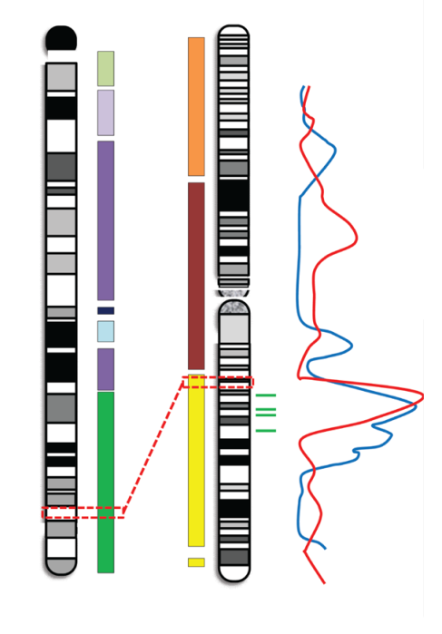
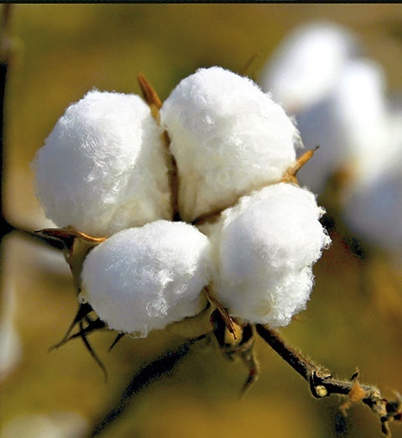
Modern Breeding Tools
In vitro culture
Genomic tools
Genomic engineering
Increase of breeding effectiveness and efficiency
Notes:
With the scientific progress and biotechnology tools being developed, a great number of new technologies have emerged.
Among them we have:
In vitro culture that allows to grow plants in very controlled conditions.
Genomic tools, such as DNA sequencing and molecular markers were developed providing increasing specific information about plant genes and traits, thus guiding breeders in informed decisions about which parents to use in controlled crosses, and helping to screen the offspring and identify the candidates for the next generation.
Genomic engineering is a set of technologies that allow increasing the level of precision needed to improve a specific trait. One successful case of genomic engineering was the introduction of a variety of cotton that is resistant to insect pests. This improvement made it possible to increase yield and substantially reduce the environmental pollution associated to insecticide use.
The use of modern breeding technologies further enhances breeding effectiveness and efficiency, reducing the amount of time needed to breed a better crop and increasing the number of valuable traits.

Slide 8

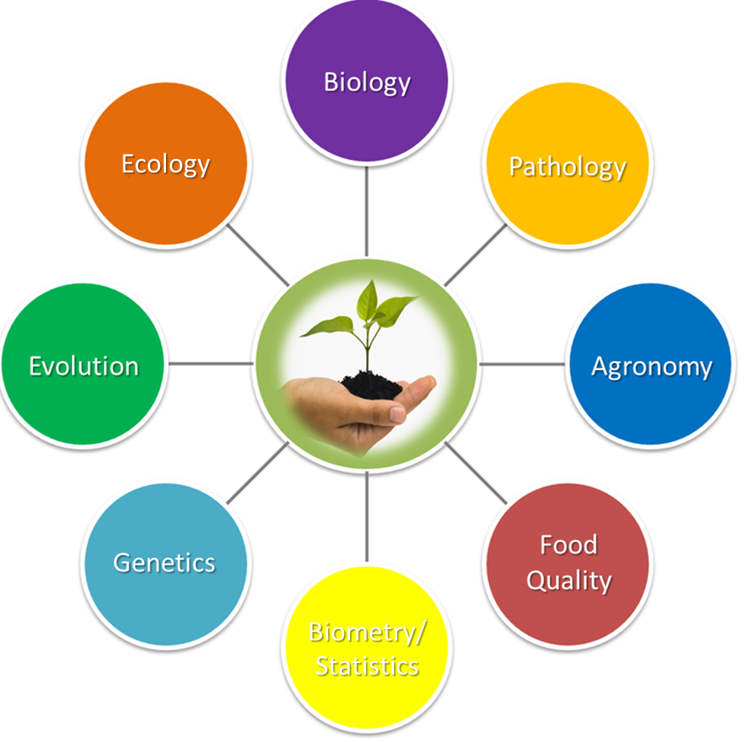
Future Challenges
Multidisciplinary Field
Pathology
Challenge: Increase of human population by 60-80%, requiring to nearly double the global food production
Biometry/
Statistics
Notes:
- Within the next 50 years, the world population is likely to increase by 60-80%, making it crucial to nearly double global food production.
- Moreover, climate changes, are aggravating the challenge and increasing the need to improve crop adaptation to biotic and abiotic stresses in order to prevent or reduce production losses.
- Taking into account that the arable land is reducing, it is imperative to achieve increased food production per unit area.
- Profiting from conventional and modern technologies, and supported by molecular tools, plant breeding nowadays combines a multitude of different research topics (eg.: Biology, Pathology, Agronomy, Food quality, Biometry and Statistics, Genetics, Evolution, Ecology… among many others).

Slide 9

Take-Home Message
Research Institutes, Universities, Governmental Services, Private Companies, Non-Governmetal Organizations, Breeders, Farmers…
….are working hard to breed plants for a better agriculture with less environmental impacts

Slide 10
References
Koornneef M. and Stam P. (2001) Changing paradigms in plant breeding. Plant Physiology, 125(1):156-9.
Borém A., Guimarães E.P., Federizzi L.C., and Toledo J. (2002) From Mendel to genomics, plant breeding milestones: A review. Crop Breeding Applied Biotechnology, 2: 649–58.
Semagn K., Bjornstad A. and Ndjiondjop M.N. (2006) An overview of molecular marker methods for plants. African Journal of Biotechnology, 5 (25): 2540–2568.
Xu Y. (2010) Molecular Plant Breeding, CAB International.
Acquaah G. (2012) Principles of Plant Genetics and Breeding (2nd Edition), Wiley Blackwell.

