Slide 1



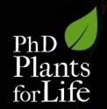
Plant Biotechnology:
- why and how...
Hélia Sales
“Plants for Life” International PhD Program – 2016
(course “Plant Biotechnology for Sustainability and Global Economy”)

Slide 2
Biotechnology – what is it?
All the techniques that can be used to genetically improve and/or exploit living systems for the benefit of humanity
Biotechnology
Biology
Chemistry
Engineering
Notes:
- To talk about biotechnology, first we must know what it is!
- So in simple words, biotechnology can be defined as all the techniques that can be used to genetically improve and/or exploit living systems for the benefit of humanity.
- Biotechnology necessarily networks with other areas such as Biology, Chemistry and Engineering.

Slide 3
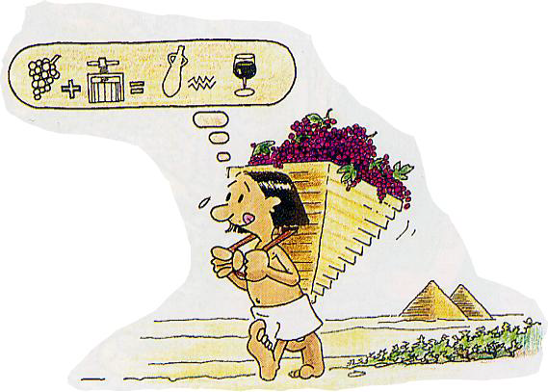

Biotechnology – is it something new?
In prehistoric times some microorganisms were already used for processes like fermentation:
Wine
Beer
Cheese
Current biotechnology
Based on a better knowledge of the organism and better tools
Beer
Notes:
- The origin of biotechnology can be traced back to prehistoric times, when microorganisms were already used for processes like fermentation (for instance wine, beer, cheese).
- So the current biotechnology is only based on a better knowledge of the organism and better tools.

Slide 4
Plant Biotechnology
Plants are crucial for life on earth
They supply 90% of human calorie intake and 80% of the protein intake (the remainder coming from animal products)
Current problems
Increase of diseases
Less land for agriculture
Malnutrition
Population rise
Solutions
Plants with higher yield /productivity
Resistance to diseases
More nutrients
Notes:
- Plants are crucial for life on earth. They supply 90% of human calorie intake and 80% of the protein intake (the remainder being derived from animal products, although these animals must also get their nutrition from plants).
- Considering the rising population, the increasing diseases, less land per capita available for agriculture and numerous areas with high levels of malnutrition, solutions must be found and plant biotechnology may be extremely helpful.
- Biotechnology may be used in breeding to generate plants with higher yields/productivity, to achieve resistance to diseases or other stresses, or to increase/improve nutrient accumulation in edible parts.

Slide 5
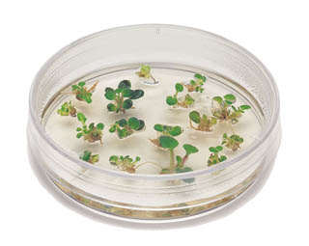
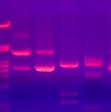
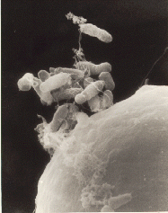
Tools of Plant Biotechnology
To face the current challenges, plant biotechnology uses several tools
In vitro culture
Genomic analysis
Genome manipulation
Notes:
To face those current challenges, plant biotechnology uses several tools, for instance in vitro culture, genomic analysis and genome manipulation.

Slide 6

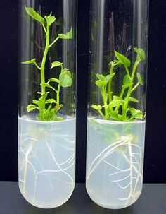
In vitro culture
Plant cells have totipotency
Potential of a cell to differentiate into an unlimited number of specialized cell types
In vitro culture uses controlled conditions (light and temperature, culture media, in containment)
Biotechnological production of plant material
Notes:
- The plant cells have totipotency which is the potential of a cell to regenerate new organs and sometimes even a whole plant.
- For instance, if we place some leaves of African violet in water, they will start developing new roots.
- So, taking advantage of this capacity, we may use controlled environments (defined light, temperature, culture media) in axenic conditions (avoiding contaminating organisms, like bacteria or fungi) to regenerate plant organs or proliferate whole plants.

Slide 7
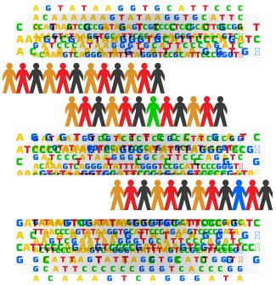

Genomic analysis
Sequencing of the human genome =>
=> detection of some diseases
Several plants already have their genome sequenced
Genome sequencing
Helps identifying traits of interest in each individual (eg.: resistance to pests and diseases, improved nutritional value, increased post-harvest value…)
Notes:
- Regarding genomic analysis, as we all know, the human genome was sequenced. This was quite important for instance for the detection of some diseases.
- Just like the humans, also several plants already have their genome sequenced.
- Genome sequencing is like a bar code, that allows to identify different traits in each individual, for instance resistance to pests and diseases, improved nutritional value, increased post-harvest quality, etc.

Slide 8
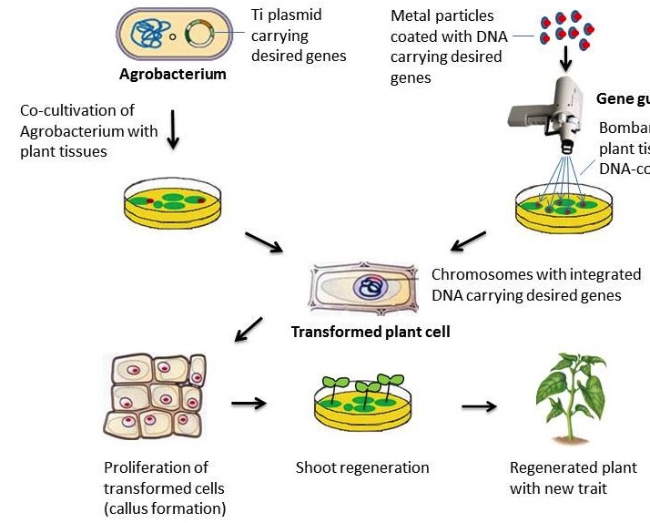
Genome manipulation - Agrobacterium
Agrobacterium tumefaciens is a soil bacterium, “cousin” of Rhizobium (which is able to fix atmospheric N2)
Agrobacterium provides new tools to obtain plants with higher productivity, disease resistance, or tolerance to environmental stress
Other techniques avoiding the use of the biological vector Agrobacterium are also effective (eg.: biolistics, or direct gene transfer)
in Curr Pharm Biotechnol. 2015;16(11):1002-2011.
Notes:
The natural soil bacterium Agrobacterium has been transferring its DNA to the host plant cells for millions of years, and scientists found how to take advantage of this capacity and explore it to transfer relevant traits
Agrobacterium tumefaciens can be used as a vector in plants, under controlled conditions, to transfer genes responsible for the expression of the desired traits. The mechanism of plant cell colonization by Agrobacterium, is similar to that of another soil bacterium of the same family (Rhizobium, the bacterium that establishes symbiotic nodules with legume roots and fixes atmospheric nitrogen).
- The strategy uses in vitro culture and promotes the contact between plant tissues and Agrobacterium.
- There are other methods widely used to transfer genes into plants and avoiding the need of a biological vector like Agrobacterium. That is the case of biolistics or direct gene transfer.

Slide 9
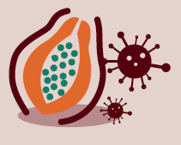
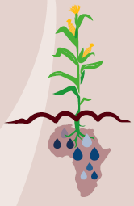

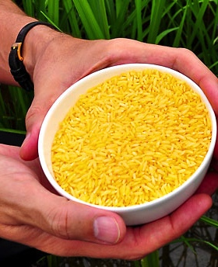

Research delivers biotech solutions
Virus resistant papaya
Drought-tolerant maize
Gluten-free wheat
Bananas enriched in vitamin A
Golden rice (enriched in β-carotene)
Notes:
So, profiting from all these tools, we are now able to develop biotechnological innovations that can help to address several of the current challenges, including ensuring food security in developing regions and developing more sustainable agricultural solutions. Here we show a few cases that may help:
fighting malnutrition (eg.: golden rice and vit. A bananas),
reducing food allergies/intolerances (eg.: gluten-free wheat)
preserving crop production in drought-prone areas (eg.: drought-tolerant maize)
recovering local economy (eg.: virus-resistant papaya that helped recovering the farmers’ income)

Slide 10

Plant Biotechnology- benefiting our world
Progress rural communities
Biotech crops such as maize and soybean increase farm incomes and food security, while
alleviating poverty
Preservation of natural habitats
By helping farmers to grow more on less land, natural habitats are better preserved
Reduce damage to the environment
Herbicide-tolerant crops like glyphosate-resistant corn, cotton and soybean reduce the need for tillage, helping to keep carbon in the soil
Notes:
And with these solutions, we can really benefiting our world.
For instance, we can:
- Progress rural communities, where biotech crops such maize and soybean increase farms income and food security, while alleviating poverty;
- Preserve our natural habitats, by allowing farmers to grow more on less land, natural habitats are preserved;
- Reduce damage to the environment where herbicide-tolerant crops (eg.: glyphosate-resistant corn, -cotton or –soybean) allow reducing the need for tillage, keeping carbon in the soil, and where insect resistance plants (eg.: maize resistant to the stem borer caterpillar) require much less pesticide applications.

Slide 11




Some further improvements urgently needed
Despite all biotechnology solutions, there is still an urgent need of new varieties with increasing resilience to adverse environments, resulting in increased productivity, profitability and sustainability, as for instance:
Nitrogen-use efficient
Tolerant to environmental stress (drought, salinity)
Resistant to pests and diseases
More nutritious and higher yielding
Notes:
Despite all biotechnology solutions available, there is still much work needed to develop new varieties that continue to build resilience to climate changes and other threats, resulting in increased productivity, profitability and sustainability.
For instance, we still need varieties that are:
Nitrogen-use efficient
Environment stress- tolerant (drought, salinity)
Resistant to pests and diseases
More nutritious and higher yielding

Slide 12
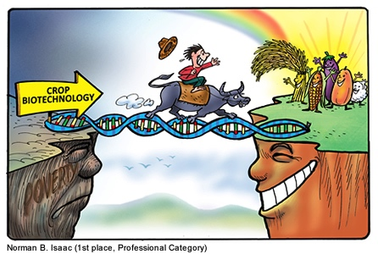
Thank you for your attention!
From crops that enable farmers to maximize productivity and ensure food security, to foods that enhance consumer diets and reduce health risks…
… the potential of plant biotechnology is limitless!

Slide 13
Some key references
Chawla H., 2010. Introduction to Plant Biotechnology (3ª Ed). Science Publishers, Inc. Enfield, NH, USA
Pauls K. P., 1995. Plant Biotechnology for Crop Improvement. Biotechnology Advances, Vol. 13, No. 4, pp. 673-693
Contributions of Agricultural Biotechnology in Alleviation of Poverty and Hunger. Pocket K. collaborative initiative among the National Council for Science and Technology (NSCT), Ministry of Agriculture, Program for Biosafety Systems (PBS -IFPRI) and ISAAA AfriCenter
http://www.isaaa.org/resources/publications/pocketk/foldable/Pocket%20K30%20%28English%29.pdf
InternatIonal ServIce for the acquisition of agrI-biotech applIcatIons - http://www.isaaa.org/kc/
Plant Biotechnology 101 Answering Your Questions
https://croplife.org/wp-content/uploads/pdf_files/CL_Biotech101_A4_Book_WEB_Single.compressed-min.pdf
www.croplife.org

