Slide 1
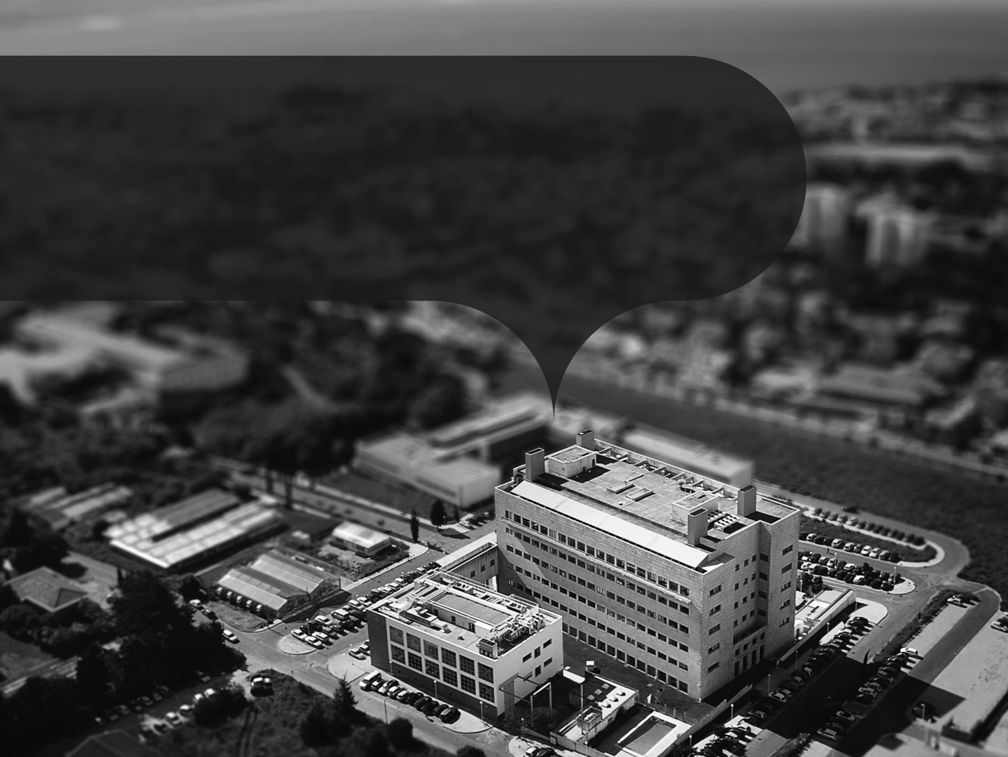


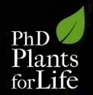
Molecular Farming
- basics of green living factories…
André Folgado
“Plants for Life” International PhD Program – 2016
(course “Plant Biotechnology for Sustainability and Global Economy”)

Slide 2
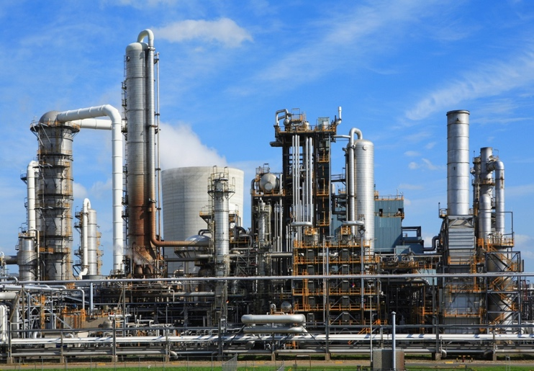
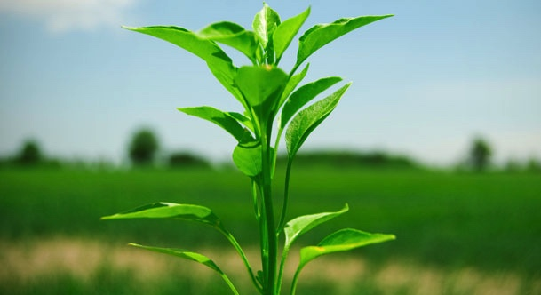
What is Molecular Farming?
The manufacturing of valuable pharmaceutical or industrial recombinant proteins using plant-based production systems
Notes:
Molecular farming is turning plants into factories in a sense that we use the molecular machinery of plants in order to produce a desired protein with economic interest.

Slide 3
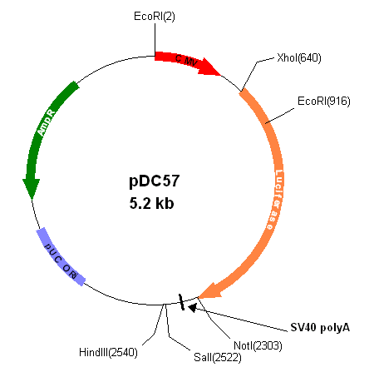

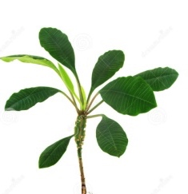
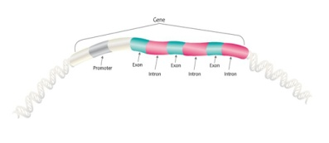
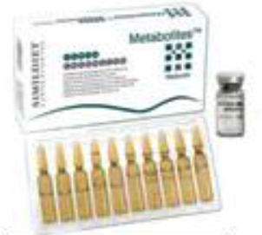
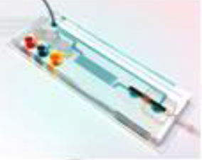
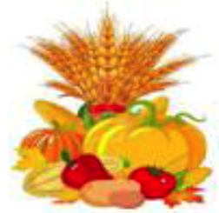
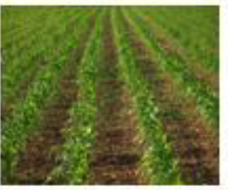
Molecular Farming – Genetic Transformation
Candidate gene
Structure gene
Plant Expression Vector
Introduction in the plant
Transgenic Plant
Metabolites
Extraction and Purification
Harvest
Plantation
Adapted from International Journal of Research in Biotechnology and Biochemistry (2014) 4(2): 23-30
Notes:
Behind any molecular farming project there is a need for genetic engineering. The plant has to be transformed with the gene encoding the protein of interest in order to produce the corresponding recombinant protein. After harvesting the plants, the proteins or metabolites of interest can be extracted, purified and be ready to commercialize

Slide 4

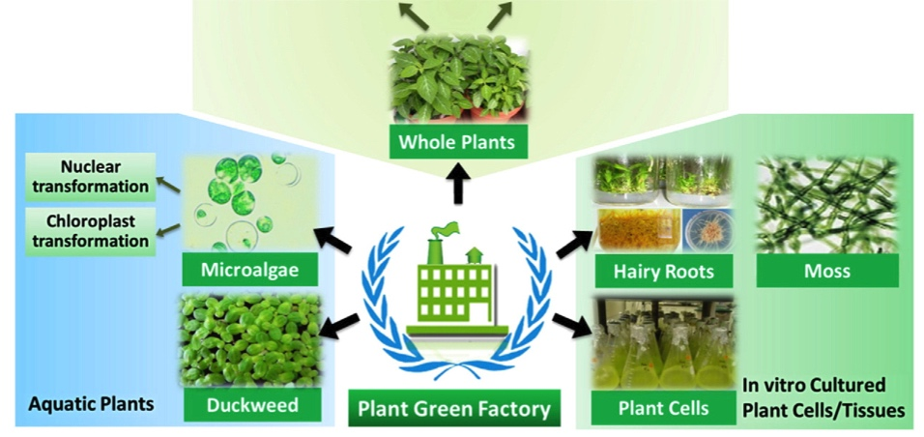
Molecular Farming Platforms
Expression in leaves
Expression in seeds
Plant virus-based
Expression vector-based
Nuclear transformation
Chloroplast transformation
Transient Expression
Stable Expression
Whole Plants
Nuclear transformation
Chloroplast transformation
Microalgae
Hairy Roots
Moss
In vitro Cultured Plant Cells/ Tissues
Aquatic Plants
Duckweed
Plant Green Factory
Plant Cells
Adapted from Biotechnology Advances (2012) 1171–1184
Notes:
There are many platforms that can be used as expression platforms in molecular farming, the best one to be used will very much depend on the protein to be expressed. The best system for one protein may not be appropriate for another one.

Slide 5
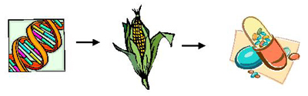
Why plant-based systems for molecular farming?
Plants:
are very flexible and can produce a wide range and diversity of proteins
are free of mammalian toxins and pathogens
can produce large amounts of biomass at low cost
are able to perform proper folding of proteins

Slide 6
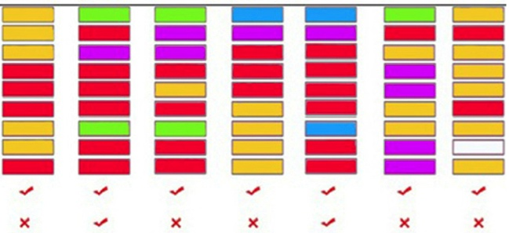
Comparison between production platforms
Plant cells
Transgenic Plants
Plant virus
Animal cells
Transgenic animals
Bacteria
Yeast
Overall cost
Scale up capacity
Production cost
Protein folding accuracy
Product quality
Protein yield
Storage cost
Safety
Public perception of risk
Production vehicle
Multimeric protein
Storage
-20ºC
RT
-20ºC
N₂
N₂
-20ºC
-20ºC
Glycosilation
Correct
Correct
Absent
Correct
Correct
Absent
Incorrect
Expensive
Low
High
Medium
Unknown
Cheap
Adapted from Curr. Issues Mol. Biol. (2016) 18: 21-42
Notes:
Plants have the best of two worlds as production platforms for expression of recombinant proteins:
- they are cheaper than the animal cell platforms and at the same time
- they can perform a better folding of the proteins than bacteria and yeast platforms.

Slide 7
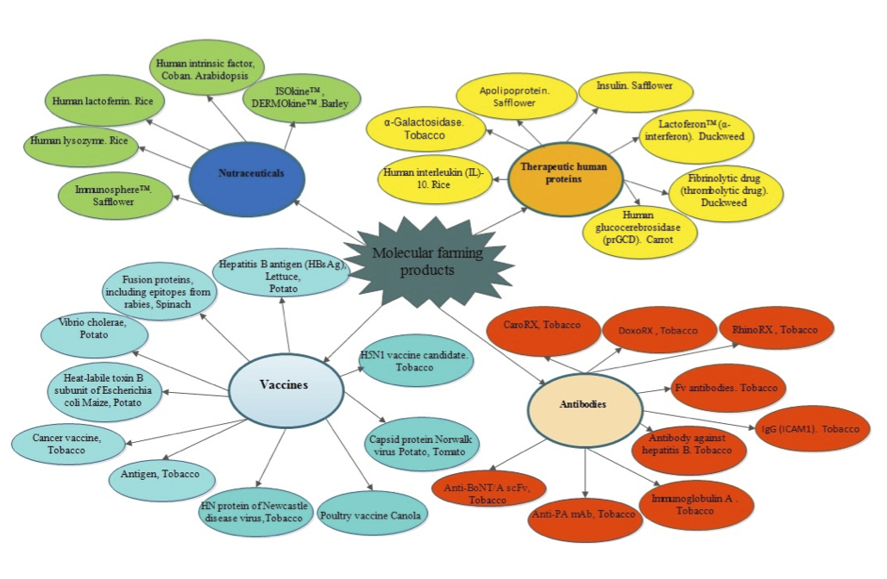
Molecular Farming Products
Nutraceuticals
Therapeutic human products
Molecular farming products
Vaccines
Antibodies
Adapted from Curr. Issues Mol. Biol. (2016) 18: 21-42

Slide 8
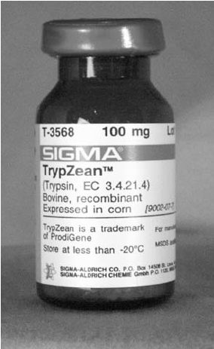
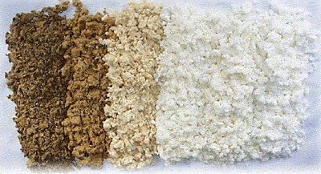
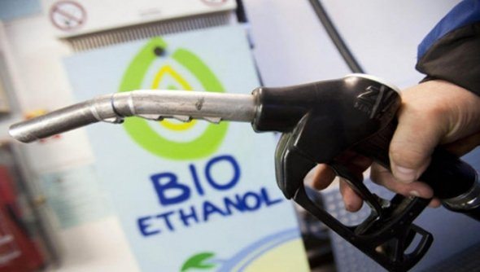
Real examples - Industrial Enzymes
Enzymes
Applications
TrypZean™
Avidin
β-Glucuronidase (GUS)
Enogen™
Laccase
Pharmaceutical
Diagnostic Kits
Diagnostic Kits
Bioethanol production
Paper bleaching

Slide 9
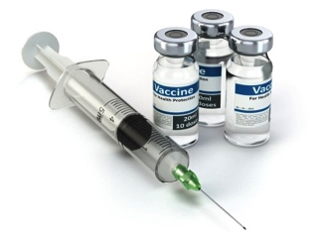
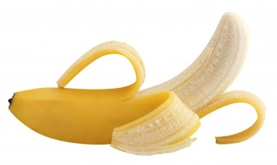
Real examples - Plant-based Vaccines
Imagine if instead of using this…
You could use this…
Pathogen or disease | Antigen | Plant | Expression system | Clinical trial | Reference
Enterotoxigenic E.coli | LTB | Potato and Maize | Transgenic | Phase I | Tacket et al., 1998, 2004
Norovirus | Capsid protein | Potato | Transgenic | Phase I | Tacket et al., 2000
Hepatite B virus | Viral major surface protein | Lettuce and Potato | Transgenic | Phase I | Kapusta et al., 1999 and Thanavala et al., 2005
Rabies virus | Glycoprotein and nucleoprotein | Spinach | Viral vector | Phase I | Yusibov et al., 2002
Influenza virus (H5N1; 2009 pandemic) | HA | Nicotina benthamiana | Launch vector | Phase I | Cummings et al, 2014
Cholera | CTB | Rice | Transgenic | Phase I | Nochi et al., 2009 and Yuki et al., 2013
Plant-based human vaccines in clinical trials
Safety – Don´t carry an alive pathogen (only the capsid protein)
Storage and delivery – Can be stored at room temperature and orally delivered, which is very important for developing countries
Adapted from Ther Adv Vaccines (2015), 1-16

Slide 10
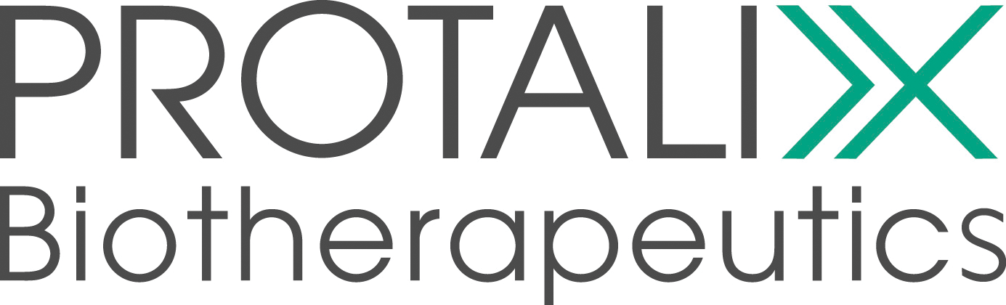
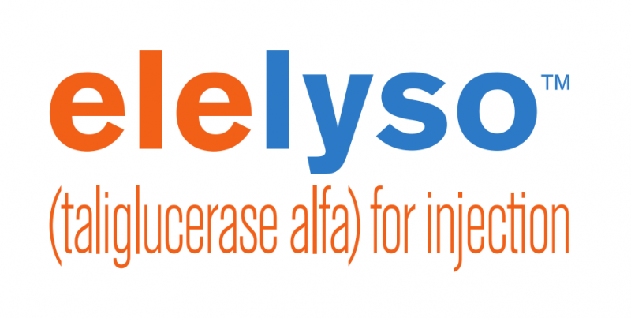
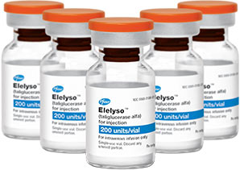
Real examples - Therapeutic Human Proteins
First plant-made pharmaceutical drug to be approved by the FDA
Treats Type I Gaucher disease
Produced on carrot cell suspension cultures
Opens a precedent that may revive the investors interest for molecular farming biotech companies

Slide 11
Why have so many companies failed?
Some companies arrived too early:
Regulatory barriers – Lack of proper legislation and regulation
Good manufacture practices – Too expensive to implement, too many different production platforms
Others arrived too late:
Biolex – Locteron production by Lemna minor
  α-Interferon to treat Hepatitis B and C
  They reached Phase III on clinical trials
  By the end of 2012 a new drug that cured hepatitis was released

Slide 12
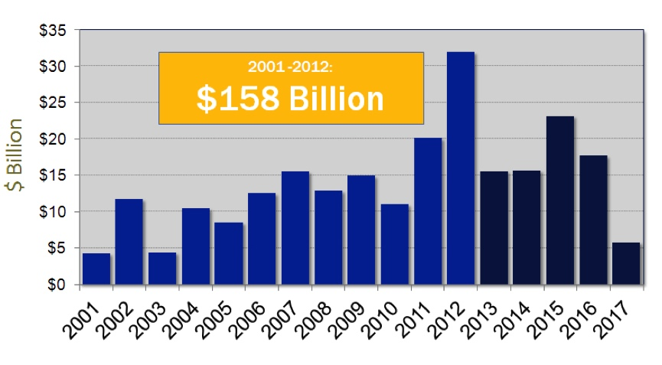
Future Opportunities
Patent Expiration Landscape
Most of the biggest blockbusters drugs patent will fall by 2016
Plant-based production can provide a rapid way to produce drugs at low cost

Slide 13
Recommended online information (beyond cited references)
http://sciencenordic.com/genetically-modified-tobacco-plants-medicine-ebola
http://www.sciencemag.org/news/2016/02/new-reports-highlight-long-term-risks-ebola-infection-limits-zmapp
https://the-gist.org/2011/03/molecular-farming
http://www.societyformolecularfarming.org

