Slide 1
Biofortification
- fighting the hidden hunger
Ana Margarida Rodrigues
“Plants for Life” International PhD Program – 2016
(course “Plant Biotechnology for Sustainability and Global Economy”)

Slide 2
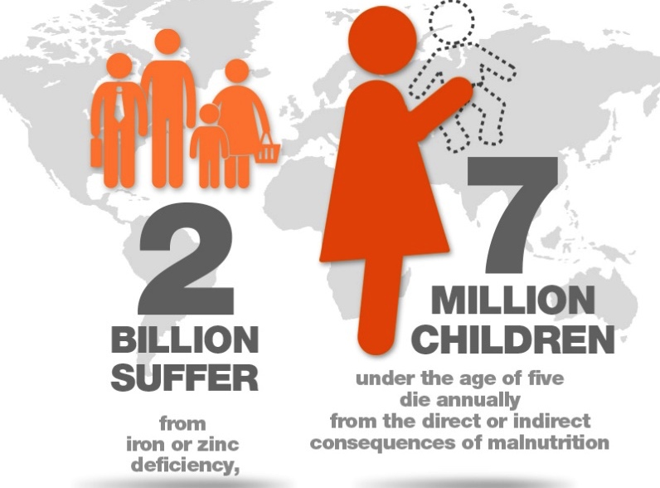
Hidden Hunger
Lack of critical micronutrients in the diet:
Iron
Zinc
Iodine
Vitamin A
Impairs mental and physical development of children and adolescents:
Lower IQ
Reduced productivity
Increased risk of illness
Stunting
Blindness
Notes:
Hidden hunger may be defined as the lack of critical micronutrients, like iron, zinc, iodine and vitamin A, in the diet.
Hidden hunger impairs the mental and physical development of children and adolescents and can result in: lower IQ, reduced productivity, increased risk of illness, stunting, blindness.
There is an estimation that 2 billion people, mostly in developing countries, suffer from this micronutrient malnutrition.
Factors that contribute to micronutrient deficiencies include poor diet, increased micronutrient needs during certain life stages, such as pregnancy and lactation, and health problems such as diseases, infections, or parasites.
Clinical signs of hidden hunger (e.g. night blindness due to vitamin A deficiency) usually only become visible once the deficiency level(s) become severe. That is why micronutrient deficiencies are often referred to as hidden hunger.

Slide 3
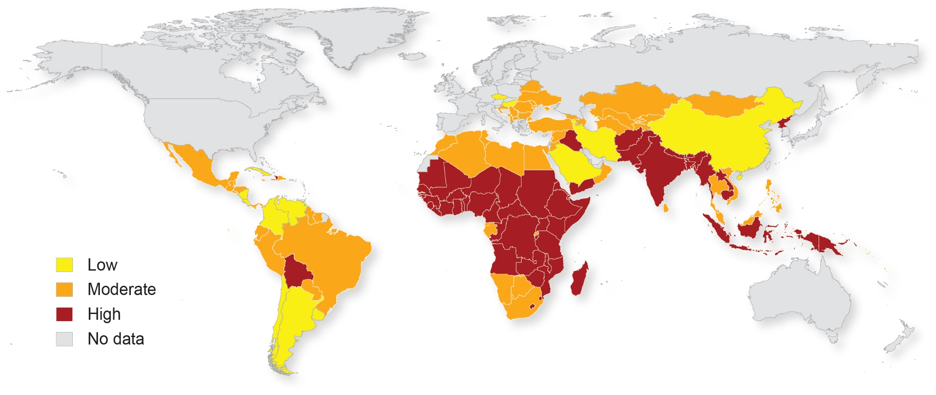
Hidden Hunger – Distribution
http://www.harvestplus.org
Severity of the most common micronutrient deficiencies (vitamin A, iron and zinc)
Notes:
Hidden hunger/micronutrient deficiencies are most common in developing countries.
Much of Africa south of the Sahara and the South Asian subcontinent are hotspots where the prevalence of hidden hunger is higher.
Micronutrient deficiencies, particularly iron and iodine deficiency, is also widespread in developed countries due to a persistent diet based on highly processed, energy-dense, micronutrient-poor foods and drinks, which lead to obesity and diet-related chronic diseases. However, in these higher monetary income countries, it’s easier to have access to fruits, vegetables, meat, dairy, and also to fortified processed foods.
Image shows low, medium, and high severity of the most common micronutrient deficiencies (vitamin A, iron, and zinc) worldwide among children under 5 prevalence data.
[Data from the World Health Organization (WHO), image from HarvestPlus]

Slide 4
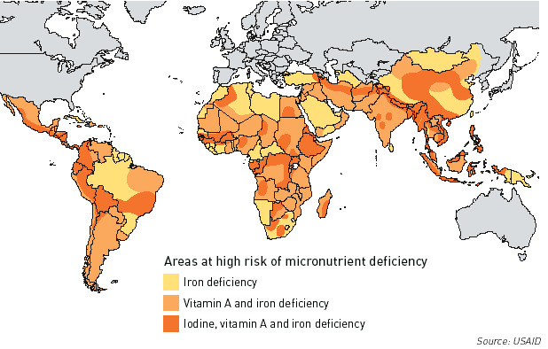
Hidden Hunger – Distribution
Combined micronutrient deficiencies widespread in developing countries
Notes:
Detailed information of combined micronutrient deficiencies widespread in developing countries.

Slide 5
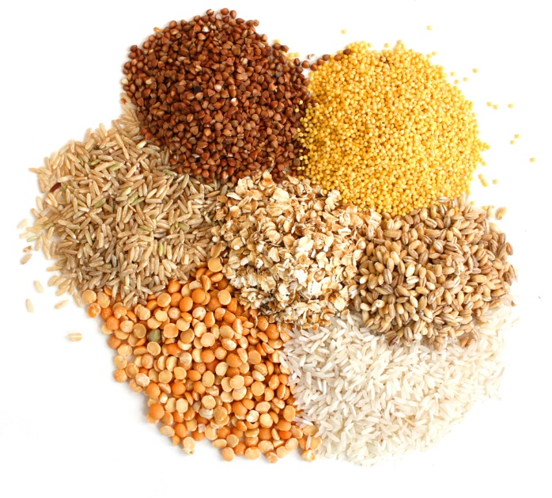
Biofortification
Low monetary resources
Lack of diversity in diet
Dependence on staple food
Breeding staple crops to have higher levels of essential micronutrients with selective breeding and biotechnology
Biofortification
Notes:
The low monetary resources in developing countries lead to a decrease of diversity in the food diet and causes a significant portion of the population to rely largely on the less expensive staple crops.
Staple food is poor in micronutrients so increasing the levels of these micronutrients by conventional selective breeding and/or modern biotechnology methods is one of the most effective ways to sustainably prevent hidden hunger. This process is called Biofortification.
Agriculture is the primary source of nutrients necessary for a healthy life, but agricultural policies and technologies have been focused on improving profitability at the farm and agroindustrial levels.
Combating hidden hunger in a changing climate will require breeding staple crops that are both resistant to climate variability and high in essential nutrients.

Slide 6
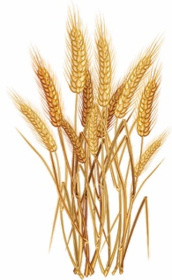
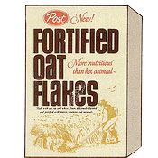
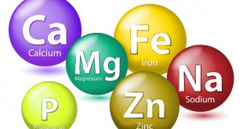
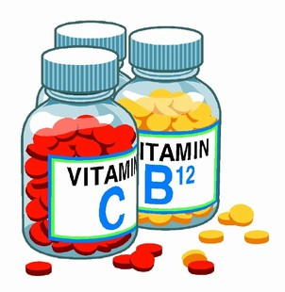
Biofortification vs. Fortification vs. Supplementation
Biofortification
and/or
In the crop/field
Selective breeding
Genetic modification (faster!)
Fortification
In the factory
Food processing
Supplementation
On the plate
Dietary supplements
Notes:
There are three ways to increase the micronutrient content on food diet.
Biofortification uses selective breeding and/or modern biotechnology methods. Conventional plant breeding involves parent lines with high vitamin or mineral levels that are crossed over several generations to produce plants with the desired nutrient and agronomic traits. Biotechnological genetic approaches, in which genes are manipulated or new genes inserted, are advantageous when the nutrient is not naturally found in a crop and greatly speeds up the breeding process. The goal is to directly improve the micronutrients found on a crop. Biofortification eliminates the need for a central distribution system and no additional intervention is needed. Biofortification is a cost-effective intervention, estimated to be less costly per life saved than supplementation.
Commercial food fortification, allows to add trace amounts of micronutrients to staple foods or condiments during large-scale processing. Fortification may be particularly effective for urban consumers, who have regular access to industrially processed foods, which is not the case in many rural areas and developing countries. Looking at a cereal box, it’s common to see the phrase “fortified with multiple vitamins and minerals,” meaning that those micronutrients have been added in during production.
Another simple way, also effective to urban consumers, is the consumption of dietary supplements, like vitamin A and iron-folate supplements.
More info on http://sitn.hms.harvard.edu/signal-to-noise-special-edition-gmos-and-our-food/

Slide 7
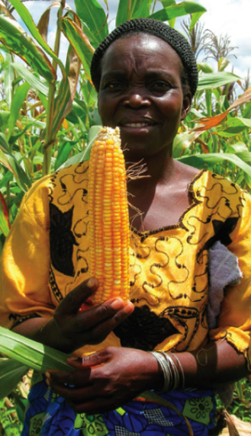
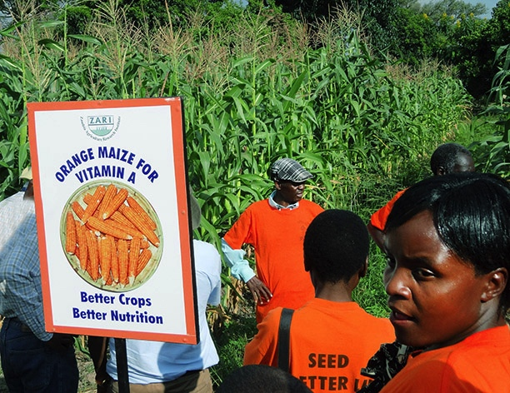
Biofortification Program Strategy
Crop improvement
Breeding bio- fortified crops
Nutrient retention & bioavailability studies
Seed production
Marketing & acceptance
Improved diet for target population
Setting targets
Population
Micronutrient
Environmental conditions
Notes:
HarvestPlus Program Strategy: Develop micronutrient dense staple crops using the best traditional breeding practices and modern biotechnology strategies to achieve pro vitamin A, iron, and zinc concentrations that can have measurable effects on nutritional status
For more details: http://www.harvestplus.org/content/harvestplus-impact-pathway

Slide 8
Biofortification – Who is growing what
Most common conventionally bred crops: maize, beans, rice, wheat…
www.harvestplus.org
Most common micronutrients deficiencies: vitamin A, iron and zinc
Notes:
Biofortification first targets rural areas where crops are produced. To date, only conventionally bred biofortified crops have been released and delivered to farmers. Biofortified crops that have been released so far include vitamin A orange sweet potato, vitamin A maize, vitamin A cassava, iron beans, iron pearl millet, zinc rice, and zinc wheat.

Slide 9
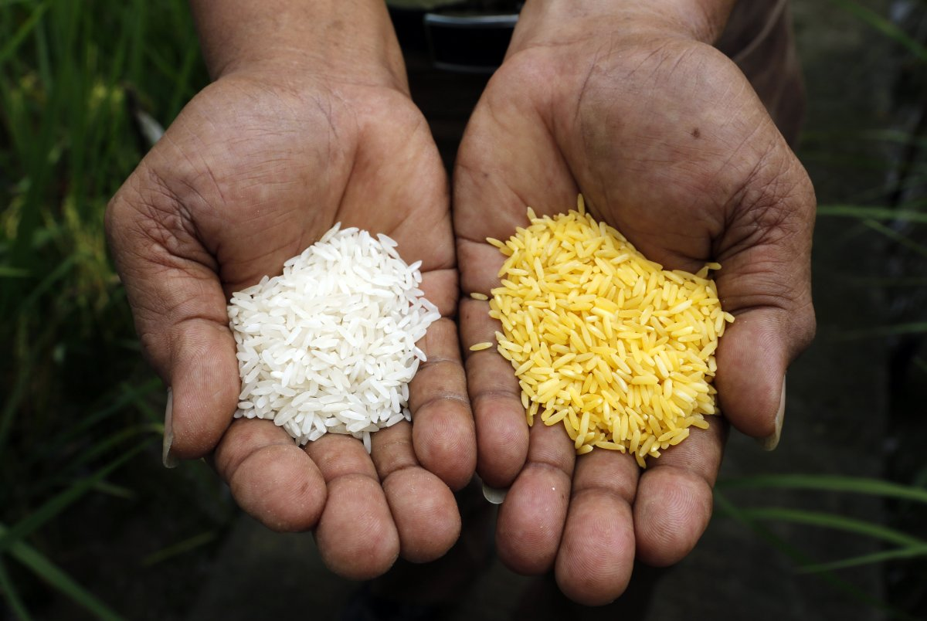
Proof of concept studies – Golden Rice, India
Crop produced through genetic engineering to biosynthesize β-carotene, a precursor of vitamin A
New way to address vitamin A deficiency
Successful production of Golden Rice 1 and improved Golden Rice 2 (produces up to 23 times more β-carotene)
Confirmed bioavailability: 72g/day is enough to avoid VAD
Studies show no risk to human health
Presented in 2000 and still not grown commercially in any country
Notes:
‘Proof of concept’ studies have been published using genetic engineering approaches to biofortify staple crops (e.g. high β‐carotene ‘golden rice’ grain). Vitamin A rich rice, commonly known as ‘golden rice’, contains the genes required to activate the biochemical pathway leading to β-carotene, a precursor of vitamin A.
The first breakthrough in the development of golden rice was obtained in 2000 and it is still not grown commercially in any country due to strict regulatory regime for genetic modified crops and acceptance issues (e.g. different crop colour), which goes beyond scientific motivations.
Rice, the world’s most important cereal crop for human consumption, is the food staple of more than 3 billion people in developing countries. Rice-based diets are a major cause of micronutrient deficiency.

Slide 10
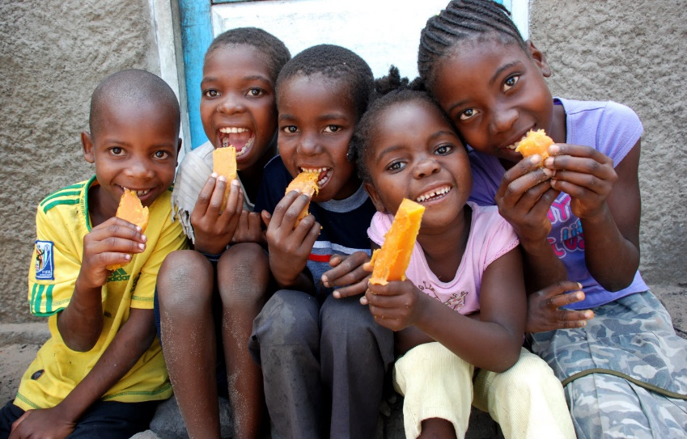
Case studies – Orange sweet potato, Mozambique
Crop produced through conventional breeding rich in β-carotene
HarvestPlus first micronutrient-rich crop released in 2007-9
Dissemination of orange sweet potato led to a vitamin A deficiency reduction from 50% to 12%
High rates of adoption and consumption
Notes:
HarvestPlus is a non-profit organization consisting of a global alliance of research institutions and implementing agencies that have come together to breed and disseminate biofortified crops for better nutrition, primarily using conventional breeding techniques for developing countries.
From 2007–09, HarvestPlus and its partners released their first micronutrient-rich crop, orange sweet potato, in Uganda and Mozambique, rich in beta-carotene, a precursor of vitamin A. In both countries, farmers adopted and substituted this new variety for their traditional white and yellow varieties that provided little vitamin A. Interventions delivering biofortified orange sweet potato resulted in up to a doubling of vitamin A intake for mothers and young children.

Slide 11
Proof of concept studies – Iron- and zinc-rich rice
Crop produced through genetic engineering with enhanced iron and zinc content
Iron deficiency anemia is the most widespread deficiency related to malnutrition
IRRI rice variety with up to 6- and 4-fold increase in iron and zinc content, respectively
Achieved goal of ~30% of average requirement for women/children
Increased iron storage and translocation from leaf to grain
Introduced genes are non-toxic and non-allergen
No loss in agronomic and quality traits
Confined Field Trials (2011-3), IRRI, Philippines
Notes:
Iron- and zinc-rich rice is another published proof of concept study from the International Rice Research Institute (IRRI) using genetic engineering to enhance iron and zinc content in rice crop. This is the first report on achieving iron and zinc biofortification nutrition targets in rice under field conditions. This achievement enables the future option to combine iron, zinc and vitamin A traits in rice grain. The combining of 3 micronutrients in one staple crop is extremely important for poverty-stricken populations where supplementation and food fortification strategies are not easily available.
Scientific data on http://www.nature.com/articles/srep19792

Slide 12
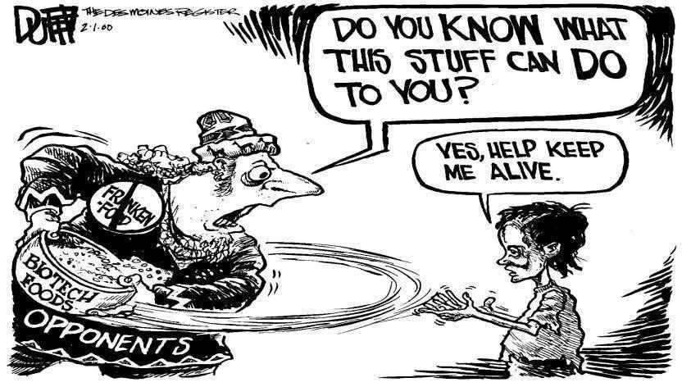
Proof of concept studies – Iron- and zinc-rich rice
Crop produced through genetic engineering with enhanced iron and zinc content
Confirmed in vitro bioavailability
Possible combination with vitamin A
Still under optimization
Notes:
Eliminating hidden hunger will not be easy. Challenges lie ahead. But if enough resources are allocated, the right policies developed, and the right investments made, these challenges can be overcome.

Slide 13
References
Harvest plus - www.harvestplus.org
The Golden Rice Project - www.goldenrice.org
C. Shekhar (2013) Hidden Hunger: Addressing Micronutrient Deficiencies Using Improved Crop Varieties, Chemistry & Biology, 20(11) 1305-1306
B. Brar, S. Jain, R.K. Jain (2015) Augmentation of Mineral and Protein Content in Rice (Oryza sativa L.), Rice Genomics and Genetics, 6(9) 1-9
P. Sharma, P. Aggarwal, A. Kaur (2016) Biofortification: A new approach to eradicate hidden hunger, Food Reviews International
I. Murgia, P. Arosio, D. Tarantino, C. Soave (2012) Biofortification for combating ‘hidden hunger’ for iron, Trends in Plant Science, 17(1) 47-55
U. Singh, C.S. Praharaj, S.S. Singh, N.P. Singh (2016) Biofortification of food crops. India: Springer India

Slide 14
Thank you
Mentored by Marta W. Vasconcelos, ESB-UCP.

