Slide 1




Biotech plants for environmental sustainability
- making a better world
Inês Matias Luís
“MolBioS PhD Program – 2016
(course “Plant Biotechnology for Sustainability and Global Economy”)

Slide 2
Most current agricultural practices lack environmental sustainability
Pesticides
Tillage
Fertilizers
Herbicides
Soil erosion and ecosystems contamination
Can we reduce their usage without decreasing crops’ yield?
Can we regenerate damaged ecosystems?
Biotech tools can help!
Notes:
Current intensive agricultural practices do not ensure environmental sustainability. To produce enough food to feed the increasing world population, higher amounts of pesticides, herbicides and fertilizers are being used. This rush to produce food is leading to soils erosion and ecosystems contamination, diminishing even more the available arable land per capita. Thus it is mandatory to stop these intensive practices without reducing the crops’ yield, and to do so some strategies have been developed using biotechnology tools. Moreover, biotechnology can be also used to recover damaged ecosystems. In this presentation we will introduce some biotechnological strategies to protect the environment in a sustainable manner.

Slide 3
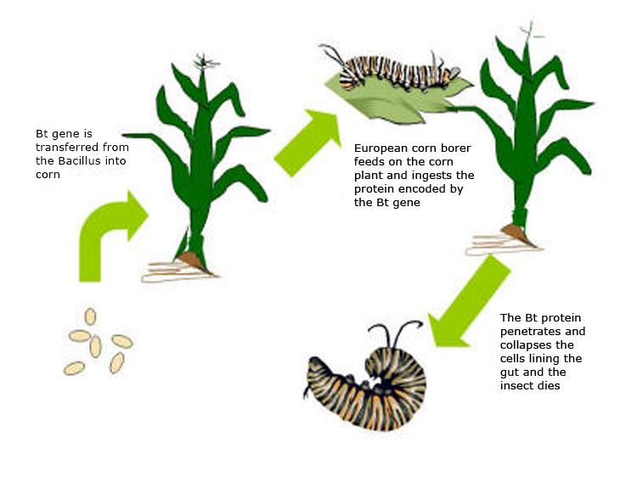
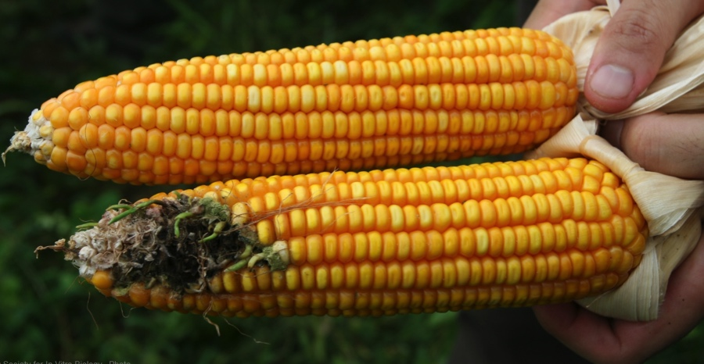
How to address the pesticide problem?
Bt Plants
(See talk #8 for further details)
Advantages
Reduce () pesticides use
   production costs
   environmental contamination
   farmers intoxication
 mycotoxins contamination (neurotoxic compounds produced by opportunistic fungi)
 crops’ yields
https://sites.google.com/site/btmaize/what-is-bt-maize
Bt-corn
Non-GMO
Notes:
One of the most well-succeeded biotech plants is Bt-corn. This modified corn addresses the pesticides problem, as explained in detail in talk number 8.
Briefly, Bt-corn produces a toxin (original from Bacillus thuringiensis) which is harmless to mammals. Bt toxin s lethal to corn borer, preventing the loss of entire corn fields when the stem borer insect attacks. Because stem borer-infested corn becomes easily attacked by opportunistic fungi, which contaminate grains producing very dangerous mycotoxins, avoiding corn borer infestations, not only reduces crop losses but also reduces health issues associated with mycotoxin contamination by those fungi.

Slide 4
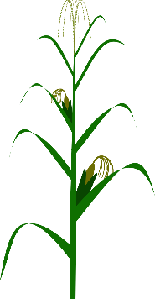
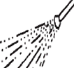
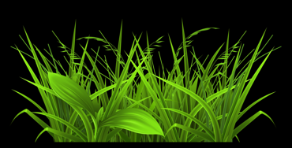
Herbicide tolerant plants
Roundup Ready Plants
(Glyphosate)
Advantages
Use of less persistent herbicides
Decrease chemical contamination
Use of “no-till” systems of agriculture
Glyphosate, friend or foe?
Has been used for decades as non-selective herbicide and not only for roundup ready plants;
According to the EFSA peer-review report:
  Solely glyphosate does not show carcinogenic effect

Slide 5
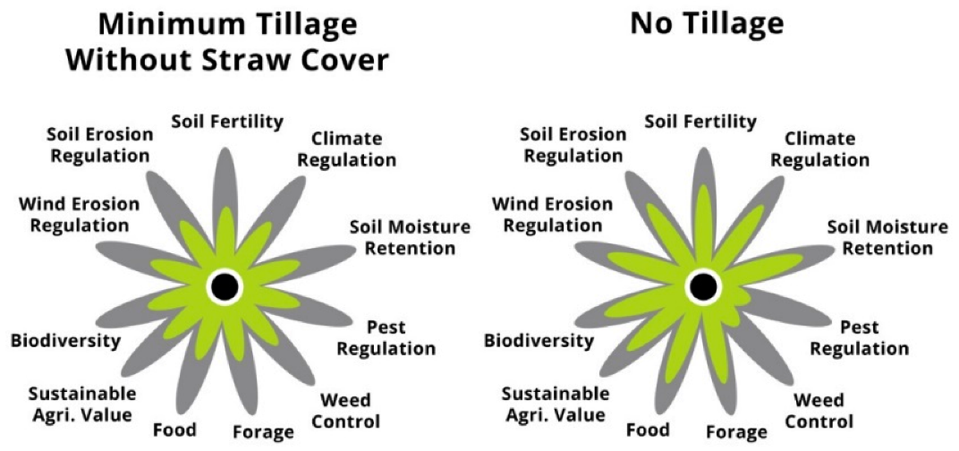

Relevance of no-tilling
Why “no-till” systems are better?
 costs for the farmer
 soil erosion
 retention of moisture in the soil
 humus content in the soil
Reduce fertilizers use
5
4
3
2
1
0
Sagie & Ramon, Land 2015, 4(4), 938-956

Slide 6
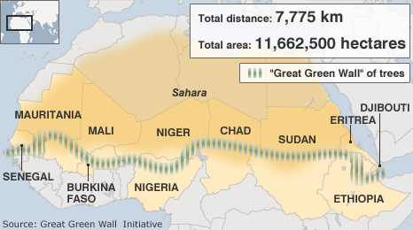
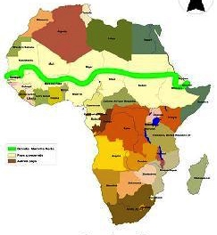
Plants can recover exhausted soils
The Great Green Wall initiative:
Intends to re-forest exhausted land
Is planting trees with economic and social interest (e.g. Acacia senegal, to produce the arabic gum)
http://www.atlasobscura.com/places/the-great-green-wall-of-africa
Biotech can help to:
Select and propagate the best trees
Identify markers for traits of interest, eg.:
High growth rate
Quality of gum arabic
Best water use-efficency
https://www.thegef.org/gef/great-green-wall

Slide 7
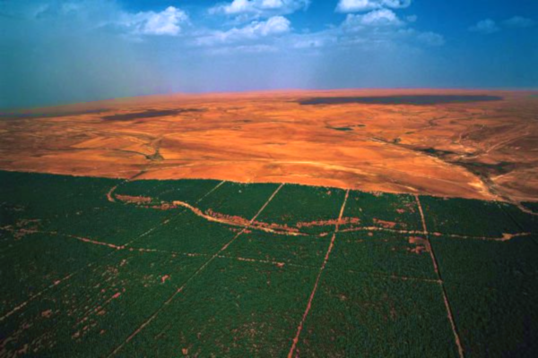
Plants can recover exhausted soils
The Great Green Wall
Ecosystem response:
Planted trees provide shade and other plants and dormant seeds started to flourish
http://www.sciencealert.com/africa-builds-great-green-wall-of-trees-to-improve-farmlands

Slide 8
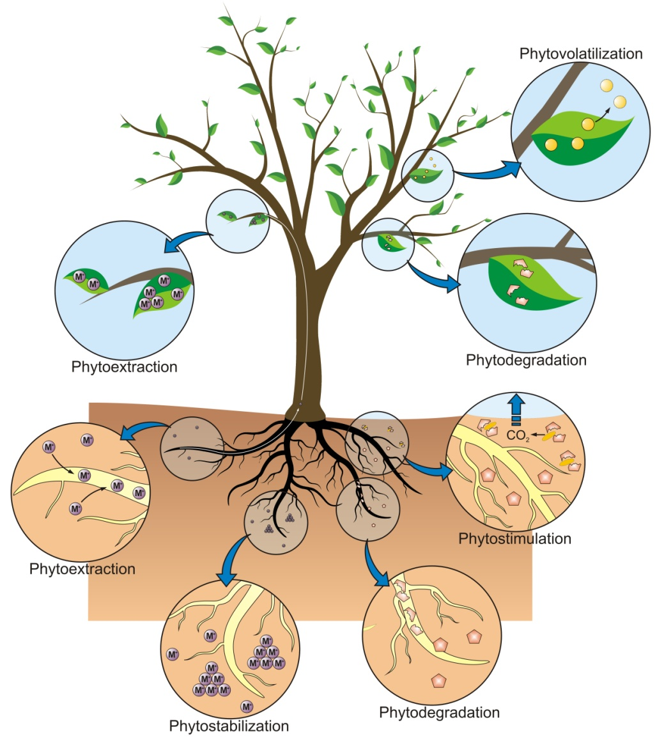
Plants can remove toxic compounds from the soil - phytoremediation
Some plants are able to extract and, in some cases also degrade pollutants.
e.g. Brassicaceae accumulate metals
Biotech challenges
Identify the molecular mechanisms that define a phytoremediator
Transfer phytoremediato properties to trees that:
  Grow fast
  Possess increased root systems
Environmental Risk Assessment of Soil Contamination, Edited by Maria C. Hernandez-Soriano, ISBN 978-953-51-1235-8

Slide 9
If you want to learn more about the topics
Tilman, et al., Agricultural sustainability and intensive production practices. Nature, 2002. 418(6898): p. 671-677.
http://www.gmo-compass.org/
http://www.efsa.europa.eu/sites/default/files/corporate_publications/files/efsaexplainsglyphosate151112en.pdf
López-Arredondo, et al., Biotechnology of nutrient uptake and assimilation in plants. The International journal of developmental biology, 2013. 57(6-7-8):595-610.
Phytoremediation: Management of Environmental Contaminants, Edited by Ansari, A.A., Gill, S.S., Gill, R., Lanza, G.R., Newman, L. , ISBN 978-3-319-10395-2
Notes:
http://www.gmo-compass.org/pdf/documents/Farmers_scientists_briefing_paper_EU_GMO_policies_%282012%29.pdf
http://www.efsa.europa.eu/en/efsajournal/pub/4302

Slide 10
Take-home message
Sustainable Agriculture can be achieved with the help of biotech plants
Moreover, biotech plants can help recover damaged and exhausted ecosystems
Notes:
http://www.gmo-compass.org/pdf/documents/Farmers_scientists_briefing_paper_EU_GMO_policies_%282012%29.pdf

