Slide 1



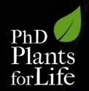
BT plants
- fighting insects with bacterial weapons
Luís Andrade
“Plants for Life” International PhD Program – 2016
(course “Plant Biotechnology for Sustainability and Global Economy”)

Slide 2
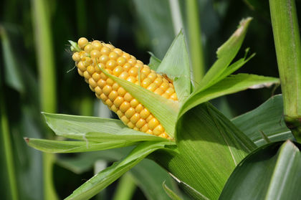
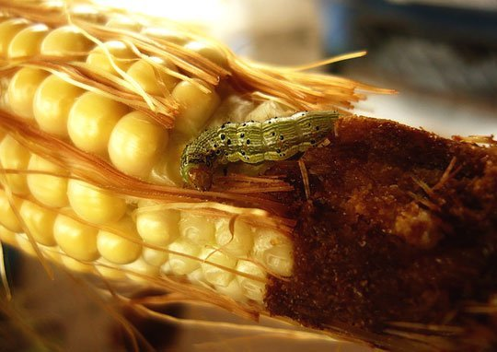
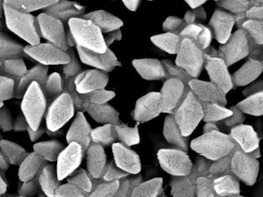
Problem: insects eat and damage plants
Bacillus thuringiensis (Bt) toxins
are used since 1930 as insecticides
Notes:
Ever since humans started farming they have shared part of their harvest with insects. Most corn growers rely on traditional crop protection practices to manage these insects, including cultural, biological or chemical (insecticide) methods or a balance of these methods that aims to minimize environmental impact. In the beginning of the 20th century a bacterium Bacillus thuringiensis (Bt) was discovered. Interestingly, these bacteria produce specific toxins (Bt toxins) active against certain insects, reason why they started being used as insecticides. Different strains produce different molecules with different specificities (affecting some insects and not others).

Slide 3
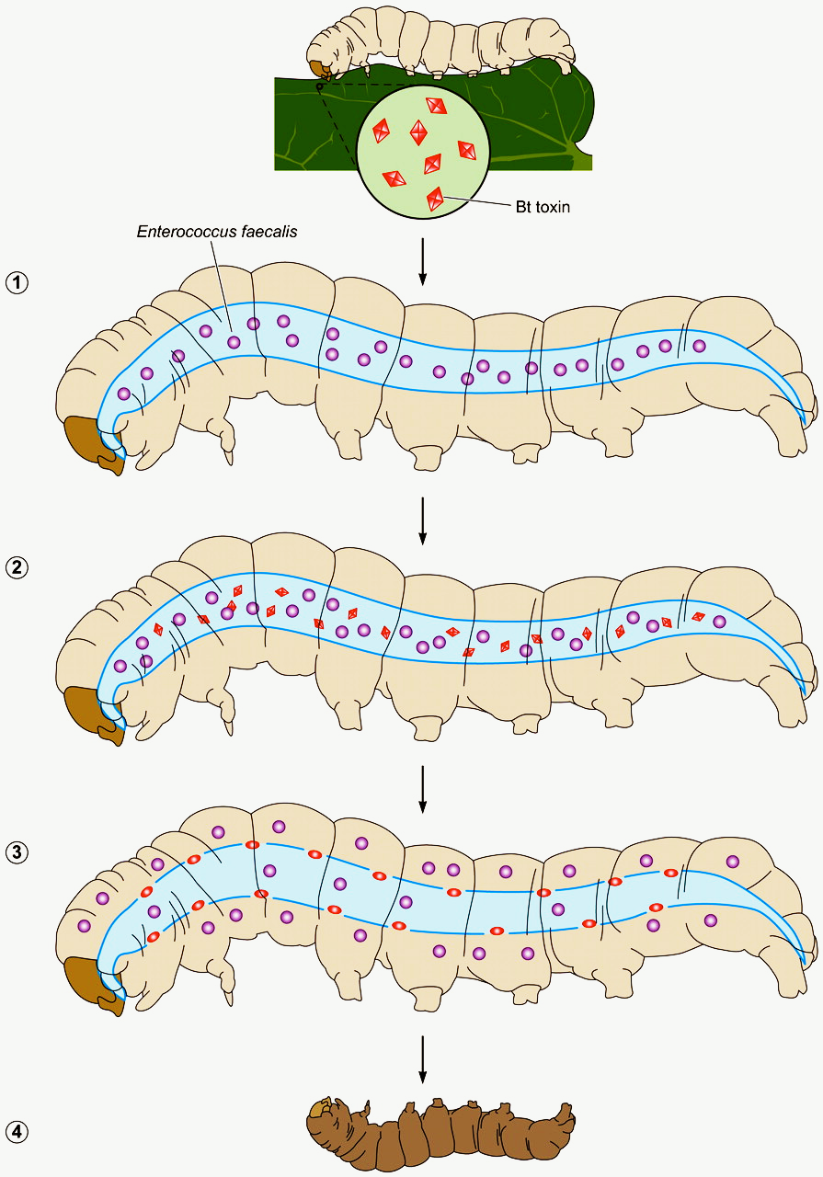


Acting mode of the Bt toxin
Larvae feed from leaves treated with Bt toxins
Bt toxin binds specifically to the insect midgut surface
Upon binding, the toxin inhibits nutrient absorption…
… it additionally, promotes the insect tissue infection by other bacteria present in the midgut
Notes:
When a larvae feeds from leaves treated with Bacillus thuringiensis, the toxins (active molecules) present in these bacteria are released upon hydrolization in the alcaline conditions of insect digestion. The released toxins bind to specific receptors present in the midgut surface of the larvae, thus affecting permeabilization and creating holes. The damaged midgut is unable to absorb nutrients and additionally can not prevent the release of contaminating bacteria to the lymph (thus infecting other tissues). Altogether, these factors lead to the death of the larvae.

Slide 4
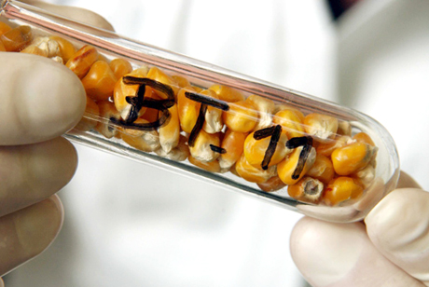
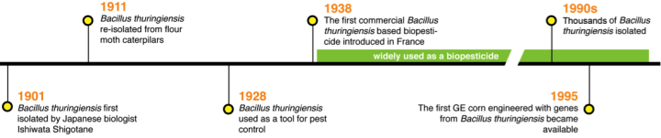

Production of GM Bt-plants
Notes:
The positive results of the application of Bacillus thuringiensis as insecticides led to the development of plants able to produce only the insect-specific toxin, thus avoiding to apply (through aspersion) the whole bacteria. The first genetically-engineered (GE) plants were introduced in the market in 1995.

Slide 5
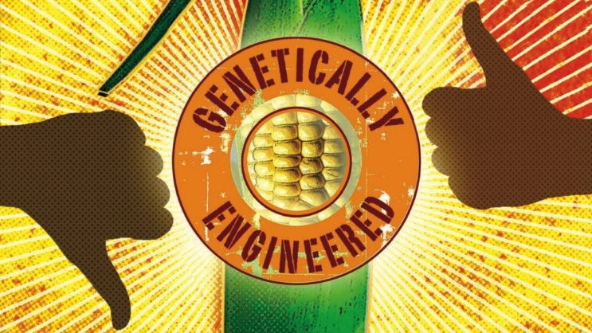
Are Bt plants creating new problems?
Claimed dangers
Bt toxins persist in the environment!
Fields of Bt plants show less diversity of insect species!
Studies showed gene transfer to wild varieties!
Target insects can develop a fast resistance to Bt toxins!
Bt toxins are toxic to humans!
Notes:
Despite the potential benefits of the development of GE plants able to produce Bt toxins, several concerns have been raised in the past years.

Slide 6
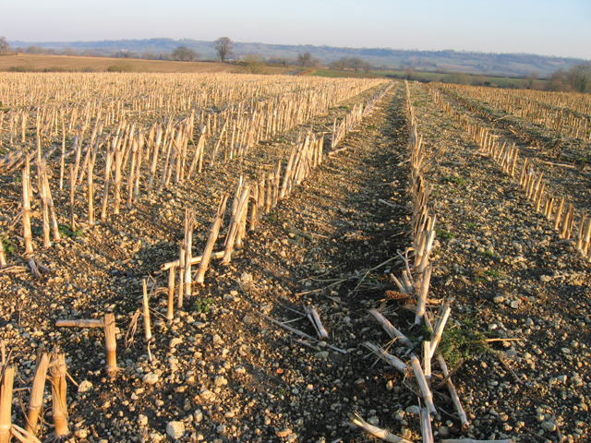
How half-truths can be misleading…
“Bt toxins persist in the environment!”
Bt toxins in soil are degraded within a few days
The soil used for 3 consecutive years of cultivation of Bt corn does not show accumulation
Bt toxins persist for a very short period of time in the environment!
Notes:
It is possible to state that Bt toxins persist in the environment. This is true, since every single molecule persists in the environment, BUT, this occurs for a certain period of time. We must know how much time it takes to degrade a compound in order to understand the possibility of its accumulation in the soil (thus knowing the chances of its concentration increasing over the years). Bt toxins (either applied externally or produced by Bt-plants) have a half life in the environment of less that 2 months, meaning that it takes less than 2 months for half of the Bt toxins to fully disappear from the soil. Additionally, in less than 1 year, every trace of the Bt toxins vanishes from the environment.
Interestingly, a study conducted after 3 years of sustained use of Bt corn demonstrated that Bt toxins does not persist in the environment, which is a clear indication of normal degradation of these toxins.

Slide 7

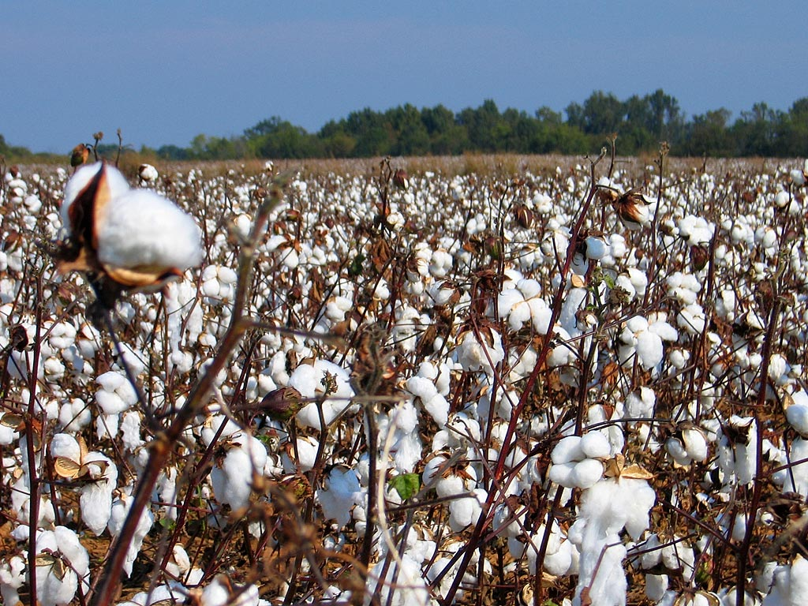
How half truths can be misleading
“Fields of Bt plants show less diversity of insect species!”
Specific Bt toxins decrease the abundance of either corn borer or bollworm and aphids
Studies show that neither monarch butterflies nor honeybees are affected by current Bt toxins
Fields of BT plants show less pest damages…
and increased insect biodiversity!
Notes:
Bt plants produce Bt toxins that act as insecticides against specific insect larvae. Because Bt toxins reduce the presence of corn borer, bollworm and aphids, it is expected that the diversity of these species will decrease. However, although the toxins are still not 100% specific, they are however, harmless to a number of non-target insects (opposite to the older, conventional, insecticides).
The concerns, a few years ago, regarding a serious decline in monarch butterflies (emblematic butterflies that migrate across USA) and honeybees (crucial for pollination in many agricultural systems) turned against BT-plants as the causal agents of such decline. However, scientific studies revealed that the reduction in monarch butterflies (that don’t feed on maize or cotton, which were the Bt-plants in the field) was instead due to the climatic conditions (“el niño”) while honeybees are not even susceptible to Bt toxins and the population decline was due to other factors like pollution.
Additionally, a decrease in plant pests resulted in less applications of broad-range toxics thus promoting a more sustainable environment with more ecological niches that in turn increase the biodiversity of the landscape.

Slide 8
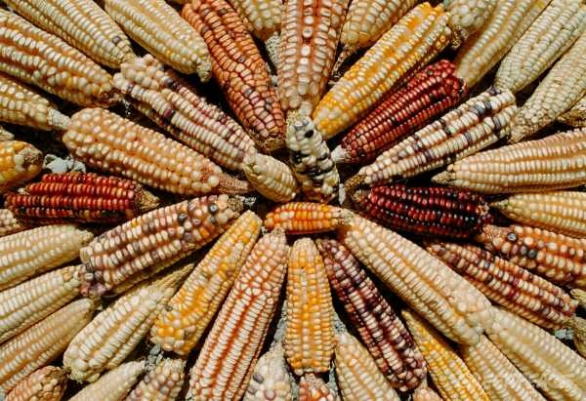
How half truths can be misleading
“Studies show gene transfer to wild varieties!”
In 2001, a study from a highly renowned scientific magazine (Nature) stated that transgenic material was transferred to wild corn landraces
However, in an unprecedented communication, Nature published
"the evidence available is not sufficient to justify the publication of
the original paper."
A study referring horizontal gene transfer
between GMO and non-GMO plants
was discredited!
Notes:
The possible transfer of genes responsible for the production of the Bt toxins to other varieties or species is one of the main concerns among the society. Therefore, when in 2001, a study was published in Nature scientific magazine, stating that genes from Bt plants had been identified in wild varieties in Mexico, the discussion about GM-food went hot in the media. However, one year later, after countless letters and data from the scientific community, Nature stated that "the evidence available was not sufficient to justify the publication of the original paper“! In fact, the data presented in the first article showed such a reduced presence of Bt-genes in the wild maize that it most likely represented laboratory contamination. Moreover, careful experimental repetitions using more reliable techniques demonstrated complete absence of Bt-genes in the wild corn plants.

Slide 9
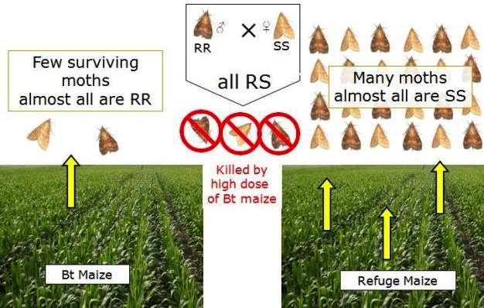
How half truths can be misleading
“Target insects can develop a fast resistance to BT toxins!”
Overuse of BT plants can produce pests resistant to BT toxins
High Bt toxin production and a refuge strategy, reduce this problem
Target insects develop fast resistance if the high dose /refuge strategy is not applied!
Notes:
Environmental pressure promotes fast mutation among species in order to adapt to the new conditions. Therefore, similarly to pesticide application, the insecticidal activity of Bt-plants can promote fast mutations among target organisms. Nonetheless, farmers are instructed to create refuge areas (areas where non-GM plants grow) to prevent these phenomena. By allowing insect development in the absence of environmental constrains, these insects will be available to mate with insects that may have mutated gaining resistance to Bt. However, the progeny of such crosses will still be unviable, thus diluting the mutation effect in the populations, and ending up in a much slower fixation of the detrimental mutations in the population, and reducing appearance of resistant insects.

Slide 10

How half truths can be misleading
“BT toxins are toxic to humans!”
Commercialized BT toxins are not harmful to humans
Starlink corn (a Bt plant variety approved only for animal feed) was wrongly commercialized for human consumption. However this had no damaging effects, as reported by EFSA
Bt plants for human consumption are not harmful to humans or other higher animals!
Notes:
Different strains of Bacillus thuringiensis produce different Bt toxins. Among those there are some that can be harmful to humans. However, only the toxins specific for insect pests are used and applied (and heavily monitored). Therefore, Bt plants only produce the toxins specific for insect pests and are not harmful to humans or other vertebrates.

Slide 11
The correct sentences should be:
BT toxins persist for a very short period of time in the environment!
Fields of Bt-plants show a decrease in damaging insects… and an increase in biodiversity!
A study referring gene transfer between GM corn and non-GM corn (wild plants) plants has been discredited!
Target insects develop fast resistance if the high dose / refuge strategy is not applied!
Bt plants for human consumption are
not harmful to humans!

Slide 12
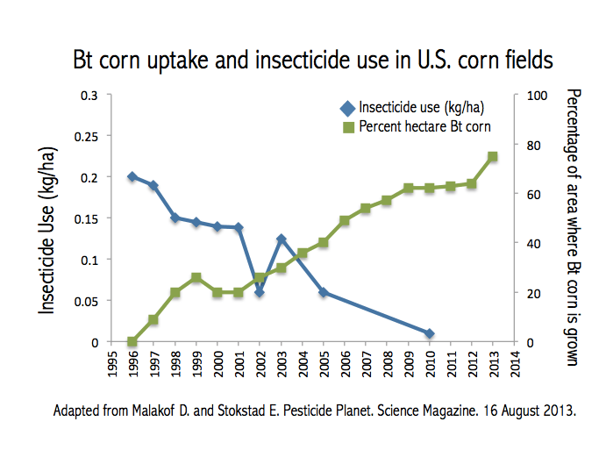
The cultivation of Bt plants is widely spread
Bt Plants | % USA | % World
Corn | 76 | 26
Cotton | 75 | 49
Soybean | 94 | 77
In USA, in the period of 1995-2010, the amount of pesticides used per acre of corn decreased by 99%, while insecticide use on cotton crops reduced approx. 95%.
Notes:
Bt plants have been used for the last 15 years and have been adopted very well by the farmers. In fact, 26, 49 and 77 % of the global production of corn, cotton and soybean, respectively, is from Bt plants. This resulted in a 99% reduction of the use of insecticides in the last 15 years in corn fields, and 95% in cotton fields (in the USA alone).
It is interesting to notice that with the increase of Bt plants, the application of insecticides with much broader range of targets, decreased to levels close to 0, which is a very relevant environmental improvement.

Slide 13
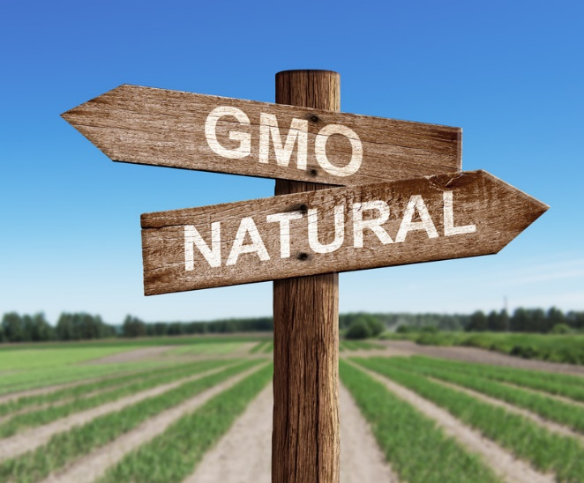
The final message
The Bt toxins are being used in agriculture for almost a century
Since the introduction of Bt plants, 20 years ago, there were no real environmental or health problems reported
The use of Bt plants promoted a striking decrease in insecticide use and in pest populations
?

Slide 14

Relevant scientific literature
More common questions regarding GE plants, including Bt plants:
Lemaux (2008): Genetically Engineered Plants and Foods: A Scientist’s Analysis of the Issues.
Degradation of Bt toxins in the environment:
Dubelman et al. (2005): Cry1Ab Protein Does Not Persist in Soil After 3 Years of Sustained Bt Corn Use.
Safety of Bt plants:
U.S. Environmental Protection Agency (2001): Bacillus thuringiensis (Bt) Plant-Incorporated Protectants.
Impact of Bt plants in monarch butterflies and honey bees:
Dively et al. (2004): Effects on monarch butterfly larvae after continuous exposure to Cry1Ab-expressing corn during anthesis.
Duan et al. (2008): A Meta-Analysis of Effects of Bt crops on honey bees.
Database of aproved GM crops, including Bt plants:
http://www.isaaa.org/gmapprovaldatabase/

