Slide 1
Engineering virus-resistance
- can we vaccinate a plant?
Ana Margarida Sampaio

Slide 2
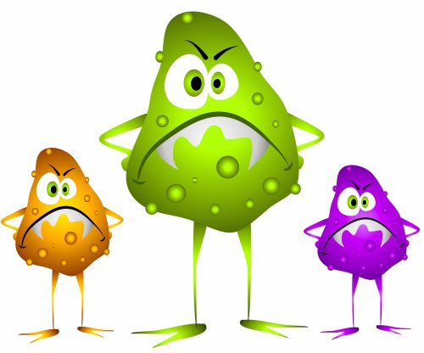
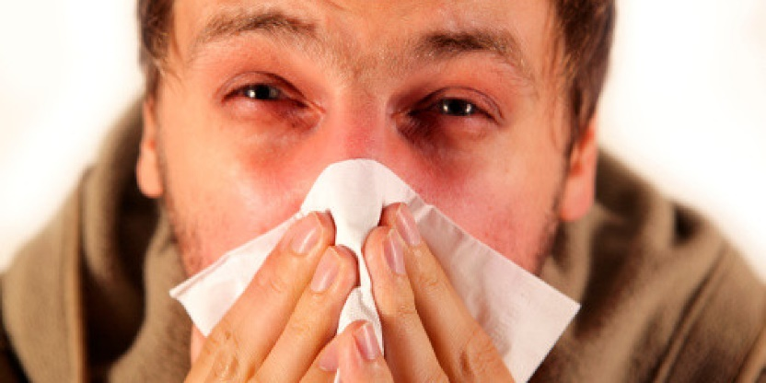
Virus concept
Influenza virus » Flu
A virus needs a host => to kill the virus we have to attack the host
Inactive
infectious agent
Alert for possible infection
Vaccination
Notes:
When we think about viruses, we immediately think about diseases like for example the influenza virus that causes flu.
One way to be protected against this type of virus is through vaccination.
Vaccination introduces a apart of an infectious agent (a part of the virus, like the coat protein, or the inactivated virus) to alert our body for a possible infection.
When the “real” virus comes, our body is already prepared to recognize it as a threat and will destroy it.

Slide 3
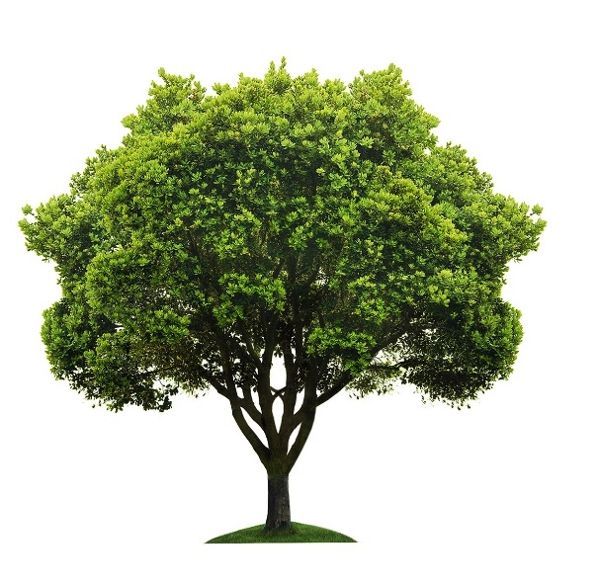
Viruses in plants
Viruses are hardly blocked by chemical application, always with strong damage for the plant.
Burn the infected area
Notes:
Viruses attack humans and other animals, but they also attack plants (although these are different viruses).
Viral infections cannot be directly controlled by chemical application (opposite to what happens with bacterial or fungal infections).
So when the plants are infected by viruses, in most cases the only solution is to burn down the infected area.
However, this does not ensure that the virus will not return later, as they can be transported by numerous vectors (eg.: insects).

Slide 4
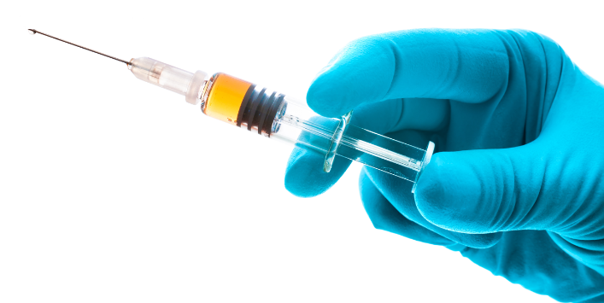
Humans vs Plants
If humans and animals can be protected from viruses through vaccination, why not plants?
Notes:
If the humans and the animals are vaccinated for protection against viral infections, can we do the same with plants?
Of course that each virus and each plant is different and needs personalized treatment but in the next slides, we show 2 examples of plant vaccination against viruses.

Slide 5
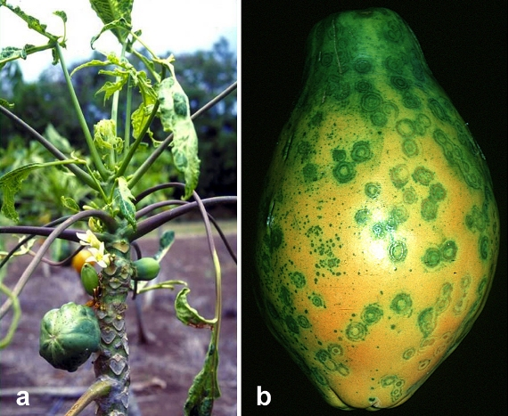
Hawaiian papaya and the Ringspot disease
Hawaii: US major papaya producer
1950: Papaya Ringspot Virus (PRSV) severe infection shows up
▼ 94 % production area (in 12 years)
▼22 million pounds (per year)
Notes:
Hawaii is the major papaya producer in USA and one of the major producer in the world. This production is an important factor for the development of the local economy and sustainability.
Although in the 1950 the papayas were still little affected by the Papaya Ringspot virus (known to be transmitted by different aphids), in only12 years, this virus infection resulted in a 94% decrease in papaya production area. The production area was shifted to other more protected regions, but by 1995 the production there also became impossible. Production losses reached 22 million pounds.

Slide 6
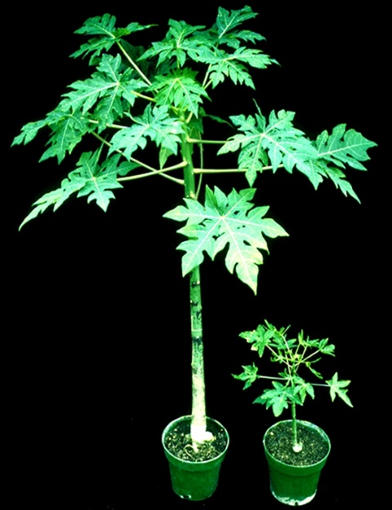
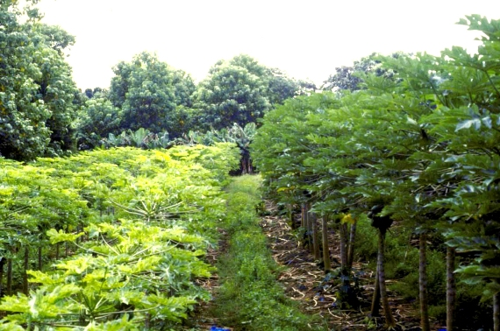
Hawaiian papaya acquired virus (PRSV) resistance
Solution (available in 1997)
Papayas expressing the coat protein gene of the virus (cpPRSV)
Notes:
To solve the disease problem improved papaya plants were developed. This was achieved through expression in papaya, of the coat protein gene of the pathogenic virus. With this vaccination, the plants acquired resistance to infection by this virus and by 1998 it was possible to recover the industrial production of papaya

Slide 7
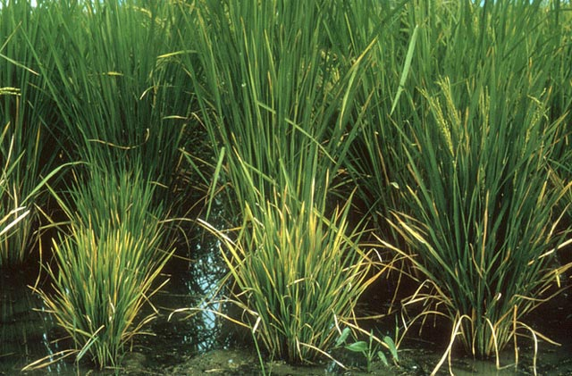
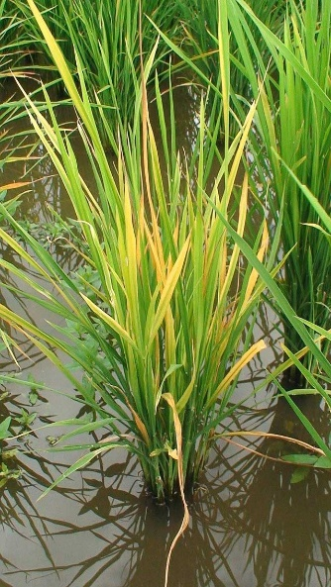
Asian rice and the Tungro disease
South Asia: major rice producer and consumer
Tungro disease is caused by two viruses:
Rice Tungro Bacilliform virus (RTBV),
Rice Tungro Spherical virus (RTSV)
▼ 199 000 ha
(1968-1994)
▼ 1 500 million dollars (per year)
Notes:
South Asia is by far the major rice producer and consumer in the world.
However around 1950 (1940 in Philippines) the rice fields were severely attacked by two very similar viruses: RTBV and RTSV which are the cause of the Tungro disease.
Tungro means: “degenerate growth” and it causes premature death of the plant.

Slide 8
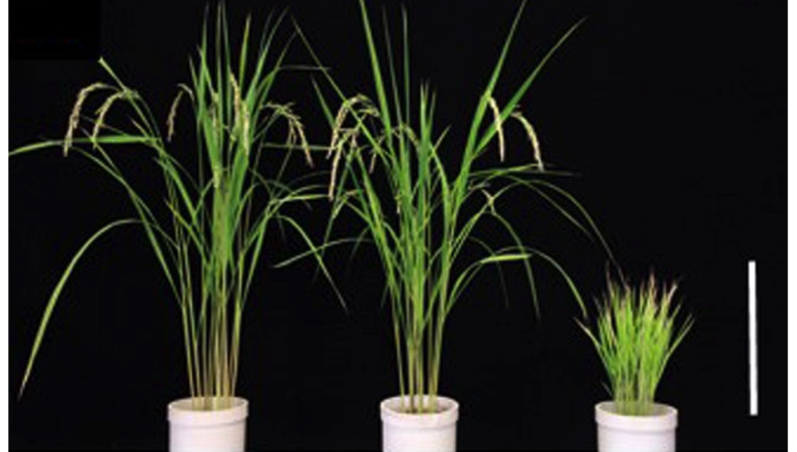
Asian rice with Tungro virus resistance
Solution
Rice expressing the coat protein of the two viruses (cpRTBV and cpRTSV)
Control
cpRTBV + cpRTSV
Non Treated
Non-Infected
Infected
Notes:
To solve this problem a new rice was developed: rice with the coat protein of the virus.
In the image we can see: 1st plant: healthy
2nd and 3th plants are both infected with the Tungro viruses, however the 2nd expresses the coat protein gene of both viruses and the 3rd doesn´t.
We can conclude that the introduction of the coat protein gene results in the production of plants that are resistant to this disease.

Slide 9
Other strategies for plant protection
Exploring plants’ defence strategies
Use plant genes that activate the natural resistance mechanisms
Use targeted gene silencing to block:
1. Virus recognition by the host plant
2. Virus replication
3. Virus propagation within the plant or across plants
Exploring Viral characteristics
Notes:
Other strategies can be used to fight against viral infections

Slide 10
Humans vs Plants
YES, plants can be vaccinated!
Notes:
We can conclude, that yes, we can vaccinate a plant and at the same time reduce the economic losses (associated viral diseases) thus improving our current agricultural system.

Slide 11
Interesting References
Bunawan H., Dusik L., Bunawan S.N., Amin N.M. (2014) Rice Tungro Disease: From Identification to Disease Control. World Applied Sciences Journal, 31(6): 1221-1226.
Gonsalves D. (1998) CONTROL OF PAPAYA RINGSPOT VIRUS IN PAPAYA: A Case Study. Annu. Rev. Phytopathol., 36: 41-437.
Gonsalves D., Suzuki J.Y., Tripathi S., Ferreira S.A. (2007) Papaya ringspot virus (Potyviridae). In: Mahy B.W.J. and van Regenmortel M.H.V. (Eds.), Encyclopedia of Virology, 5 vols. Elsevier Ltd, Oxford, UK.
Sivamani E., Huet H., Shen P., Ong C.A., Kochko A., Fauquet C., Beachy R.N. (1999) Rice plant (Oryza sativa L.) containing Rice tungro spherical virus (RTSV) coat protein transgenes are resistant to virus infection. Molecular Breeding, 5: 177-185.
http://www.apsnet.org/edcenter/intropp/lessons/viruses/Pages/PapayaRingspotvirus.aspx
https://www.youtube.com/watch?v=2G-yUuiqIZ0

