Slide 1
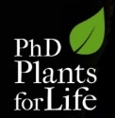
Empowering the “thirsty” plants
- ways for drought tolerance
In|es Modesto
“Plants for Life” International PhD Program – 2016
(course “Plant Biotechnology for Sustainability and Global Economy”)

Slide 2
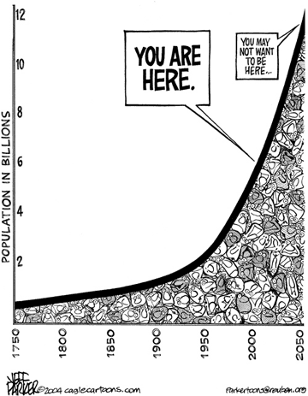
World Population Growth
Increasing food demand
Increasing water demand
Notes:
With the growing world population there has been a huge increase in food demand, but the water demand is also increasing dramatically, meaning that there is a higher and higher pressure on gobal water resources.

Slide 3
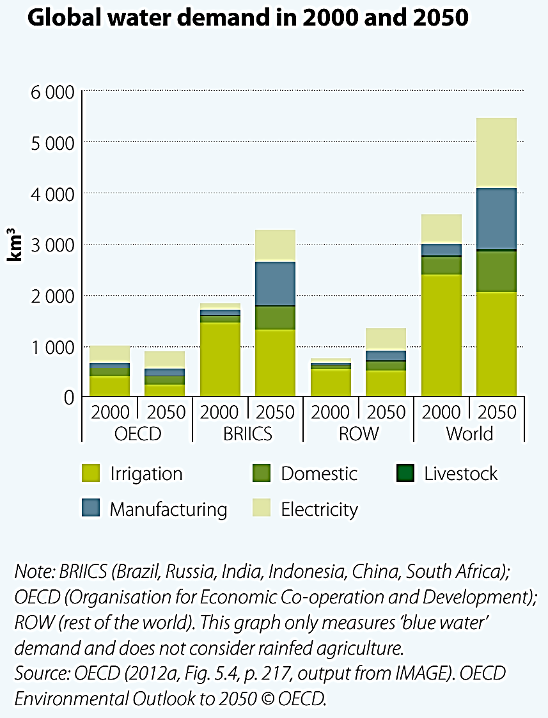
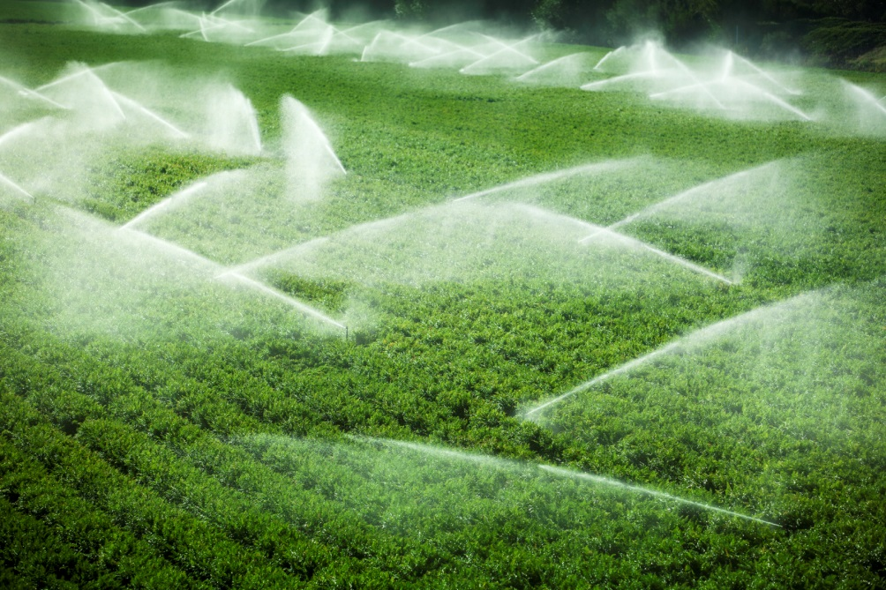
World Population Growth => Water demand
Less water available for agriculture
Notes:
Nowadays, most of the fresh water is used for agriculture (light green), but with the increasing popuplation and improved quality of life, it is expected that water will be more and more used for other purposes, such as manufacturing, electricity and domestic use, reducing water availability for agriculture.

Slide 4
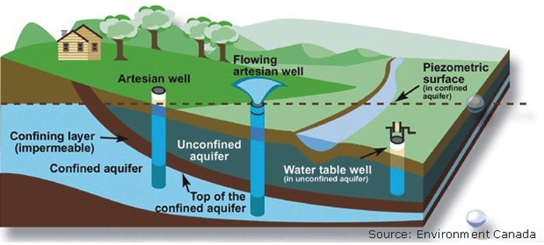
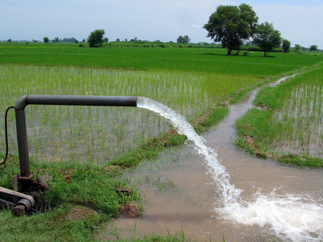
Groundwater – a vital source
30% of all liquid freshwater is groundwater (below the soil surface)
Groundwater is the main source of water in low income countries
This groundwater is highly exploited for agriculture, mainly in Asia (e.g. India, China)
In India, a new tube well is sunk every 6 seconds!
Notes:
30% of all liquid freshwater is below ground (groundwater), this being a vital source of drinking water for humans and livestock, mainly in low income countries.
Groundwater is being highly exploited for agriculture, mainly in countries like India and China.
Only to have an idea, in India a new tube well is sunk every 6 seconds to collect water.

Slide 5
Groundwater at risk
Less water available for agriculture
Water used for other purposes
Overexloitation
Water depletion
High population density
Water contamination
Notes:
The freshwater being increasingly used for purposes other than agriculture; the groundwater overexploitation (causing water stocks depletion); and the high population density (causing extreme levels of contamination with pollutants and human wastes), are leading to a serious decrease in the water available for agriculture.

Slide 6
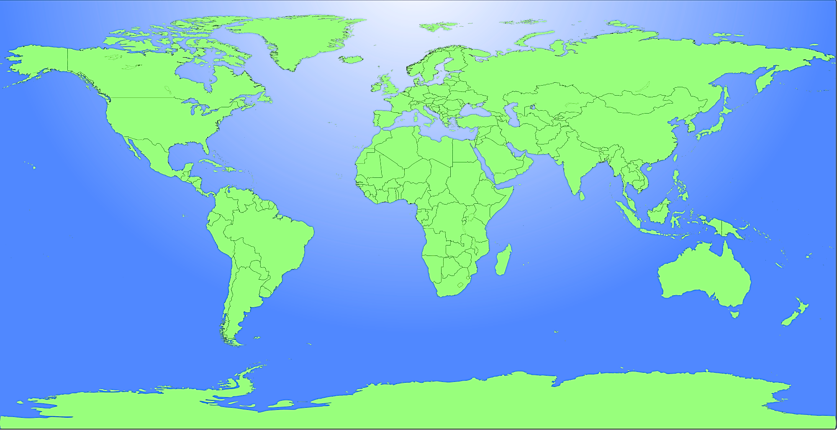
In large areas of the globe, agriculture is rainfed
75% in Near East and North Africa
65% in East Asia
95% in Sub-Saharan Africa
60% in South Asia
90% in Latin America
Notes:
Not all farmed fields are irrigated, and agriculture is still only rainfed in large areas of the world, mainly in developing countries.
For instance, in Sub-Saharan Africa, 95% of the agriculture is rainfed, in Latin America, 90%, in the Near East and North Africa, 75%, and so on.

Slide 7
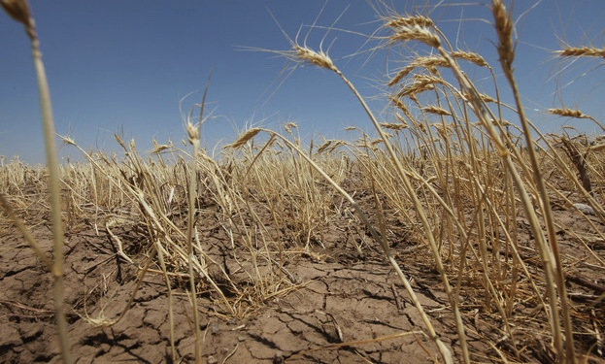
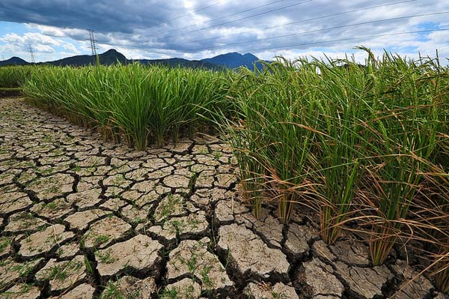
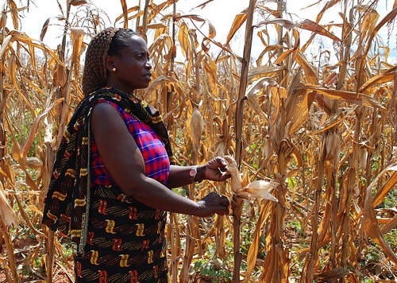
Rainfed agriculture
Very uncertain
Severely affected by climate change
Notes:
Rainfed agriculture is dependent on the weather and consequently is very uncertain.
Furthermore, it will be severely affected by climate change, as drought periods in the mentioned regions are expected to become longer, more frequent and more severe.

Slide 8
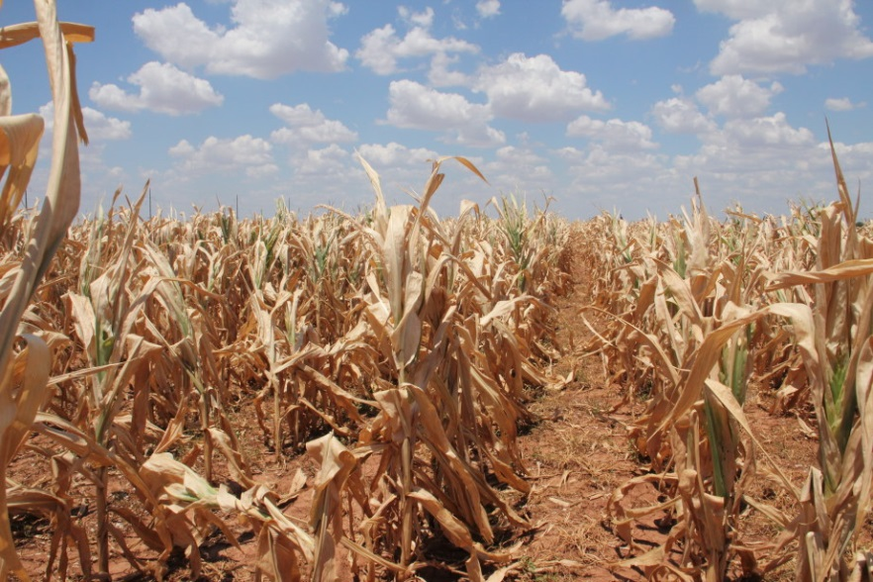
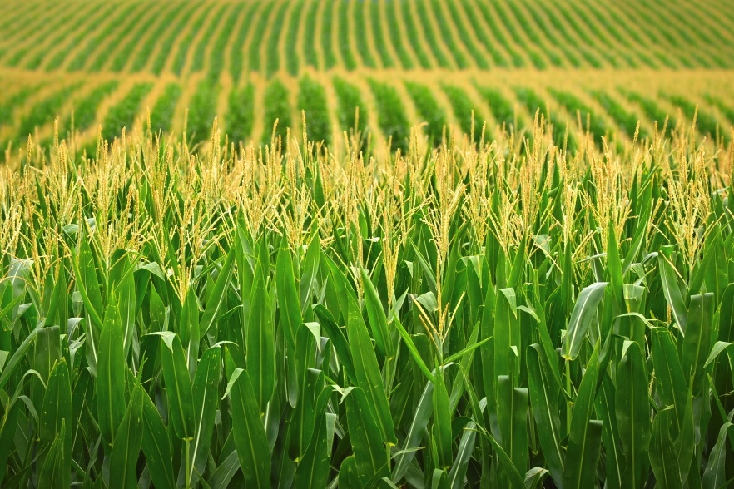
Challenges in agriculture
“More Crop per Drop”
Plants that use water more efficiently
Plants that can endure periods wihout water
Notes:
One of the major current challenges in agriculture is to produce “more crop per drop”, this is to produce more crop food with less water.
In order to do this, we need crops that are more efficient in the use of water and crops that can endure periods without water.

Slide 9
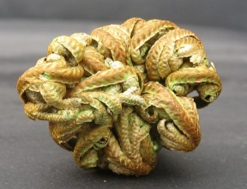
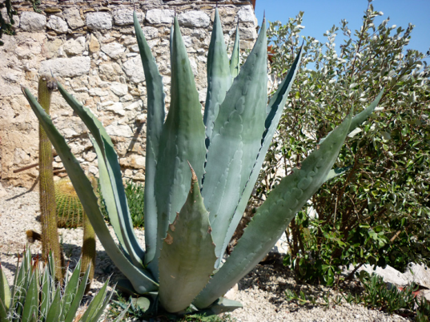
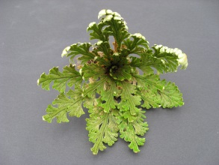
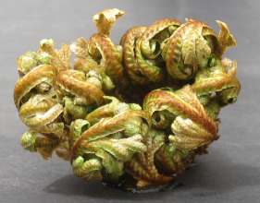
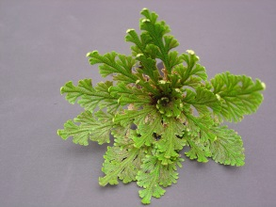
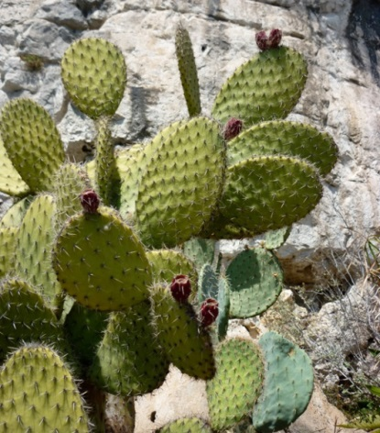
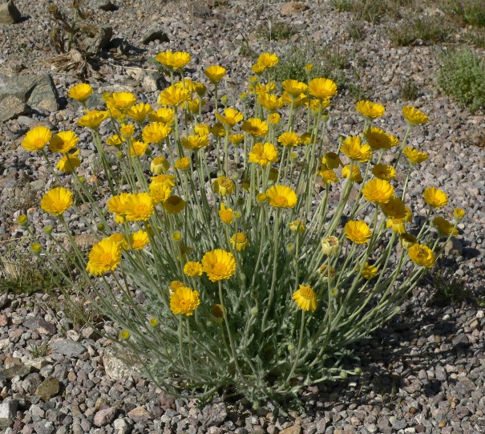
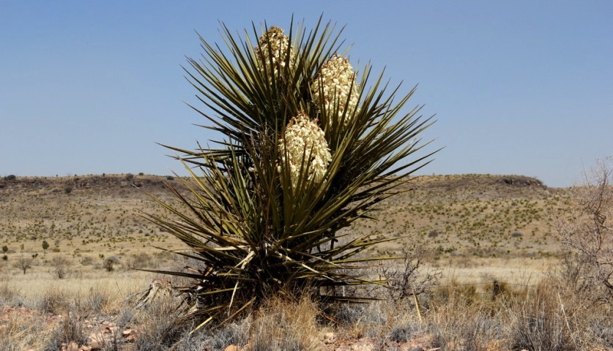
Most drought-tolerant plants are not crops
Agave
“resurrection plant”
Cactus
Torrey yucca
Desert marigolds
Notes:
There are many plants that are naturaly tolerant to drought, and some, such as the resurrection plants, can even withstant total desiccation and recover completely after being watered again.

Slide 10
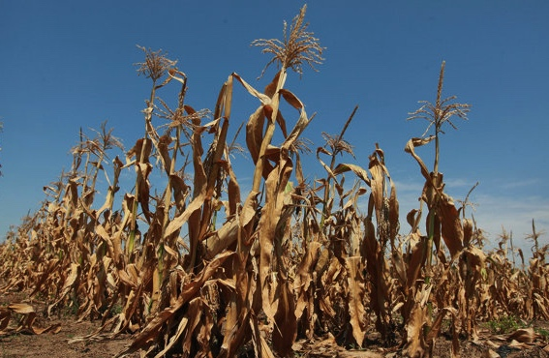
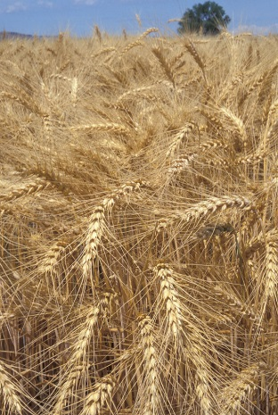
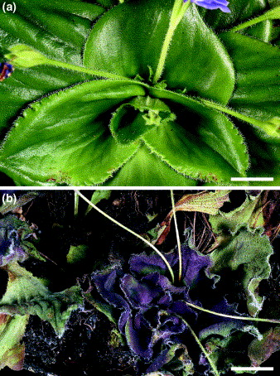
Diversity of mechanisms to avoid water shortage
Drought avoidance
Drought tolerance
Extensive root system
Early reproduction
Cellular protectants
Strategy
Increases
water uptake
Avoids late season water deficit
Avoid cell death under severe drought
Benefits
Notes:
Plants have different mechanisms to avoid water shortage, such as:
Developing an extensive root system to be able to reach water deeper in the ground , or having earlier reproduction to ensure seed set before the drought season arrives.
Producing cellular protectants that avoid cell damage under severe drought thus becoming able to tolerate drought.
It is important to study and understand these mechanisms in order to be able to transfer them to drought-sensitive crop plants, using plant biotechnology tools.

Slide 11
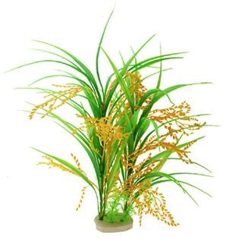
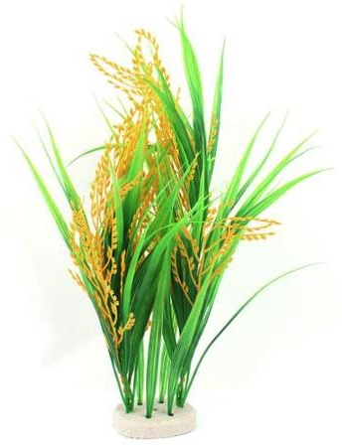
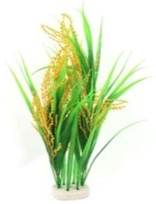
Biotechnology tools => searching for solutions - (1) Rice
Molecular Markers for tolerance (QTLs)
x
Drought-tolerant rice
Elite quality rice
x
Elite quality rice similarity
Select plants
…
Drought tolerance QTLs
Drought-tolerant elite rice
Steele et al. 2006, Theor. Appl. Genet. 112, 208-221
Notes:
Drought tolerance is a complex trait that is influenced by several genes.
We can detect these genes through molecular markers, such as QTLs. These QTLs are regions of the chromosomes linked to the trait of interest (in this case, the drought tolerance). QTLs may contain more than one gene contributing to the drought tolerance trait of the plant.
I will now give you an example of a rice variety improved for drought tolerance, using these QTL’s as a tool to indentify drought tolerance.
In a research study, a variety of Philippine rice was identified as being drought-tolerant and the QTL’s for drought tolerance were detected. To pass these trait of tolerance to an elite quality rice from India, we need to pass these QTL’s. This can be done by crossing both rice varieties. So they crossed the rice varieties. From the progeny of these cross, plants that were similar to the elite rice variety, but with the drought tolerance QTL’s, were selected and the rest were discarded. The selected plants were than crossed with the elite rice variety and the new progeny was selected the same way, and again crossed with the elite rice, and this was done several times, until they obtained a rice variety with the quality of the elite rice, but the drought resistance trait.

Slide 12
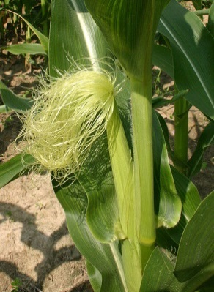
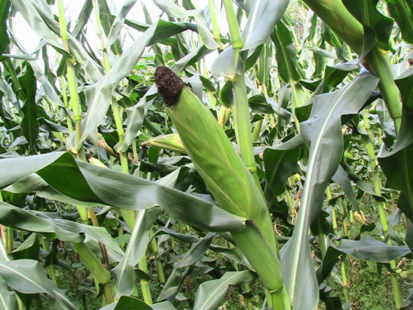
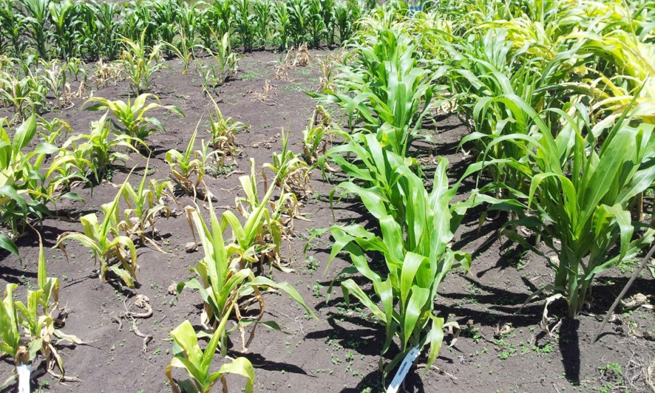
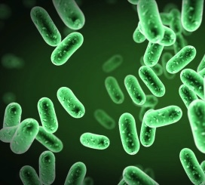
Biotechnology tools => searching for solutions - (2) Maize
Engineering trehalose biosynthesis
Trehalose
Protects from desiccation
Bacteria
where the
resistance
genes were found
“resurrection plant”, in drought (above) or watered
+ 31-123 % yield
Susceptible maize
Drought-tolerant maize
Nuccio et al. 2015, Nat. Biotechnol., 33: 8, 862-869
Notes:
Trehalose, a sugar compound that protects cells from desiccation damage, is present in several organisms such as bacteria and the resurrection plants, but in most plants it is present in very small amounts.
So in another example of an improvement of a crop variety using biotechnology tools, the genes of the trehalose biosynthetic pathway were transferred from rice to maize, using genetic engineering. The modified maize variety have increased trehalose content in flowers and in the developing cob. In this way, if drought occurs during flower formation, fertilization or seed development, yield is not affected. In fact, under drought conditions, this improved maize showed an increase in yield of 31-123%, as compared to the drought-susceptible original variety.

Slide 13
Take-home messages
Drought and water scarcity are serious threats for food security
We need drought-tolerant crops for rainfed regions
Plant biotechnology provides more tools for
crop improvement
Notes:
So, as we’ve seen, drought and water scarcity are serious threats for food security worldwide and we need drought-tolerant crops mainly for rainfed regions, which are precisely the regions where food scarcity is higher and the communities are poorer.
Plant Biotechnology can provide extremely important tools to develop improved crops.

Slide 14
Recommended References
http://www.iwmi.cgiar.org/
Sasson, Albert (2009) The Global Food Crisis: Causes, Prospects, Solutions. Agri-Bys
A Fita, A Rodrigues-Burruezo, M Boscaiu, J Prohens and O Vicente (2015) Breeding and Domesticating Crops Adapted to Drougth and Salinity: A New Paradigm for Increasing Food Production. Frontiers in Plant Science, 6: 978
RR Mir, M Zaman-Allah, N Sreenivasulu, R Trethowan and RK Varshney (2012) Integrated genomics, physiology and breeding approaches for improving drought tolerancein crops. Theoretical and Applied Genetics, 125: 625-645
M Ashraf (2010) Inducing drought tolerance in plants: Recent advances. Biotechnology Advances, 28: 169-183

Slide 15
TH NK YOU!

