Slide 1



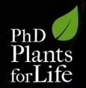
Plant Biotechnology for the XXIst cent.
- the socio-economic must
Bruno Peixoto
“Plants for Life” International PhD Program – 2016
(course “Plant Biotechnology for Sustainability and Global Economy”)
Notes:
“Plant Biotechnology for the 21st Century – The Socio-economic must”
(15-04-2016)

Slide 2
Plant Biotech and the XXIst Century Challenges
Overpopulation
Food Security
Environmental Sustainability
New Biomaterials
Compiled from Moshelion and Altman (2015)
Notes:
Three major challenges for the 21st Century include food security, environmental sustainability, and enough supply of materials (preferably environmentally sustainable, such as the biomaterials). These challenges derive from the excessive (and fast) population growth, and require quick solutions as we are running out of time.
There are however other challenges (such as socio-economic and political stability), that will not be considered here.
_____
Moshelion M., and Altman A. (2015) “Current challenges and future perspectives of plant and agricultural biotechnology” Trends in Biotechnology xx, 1-6. DOI: http://dx.doi.org/10.1016/j.tibtech.2015.03.001

Slide 3
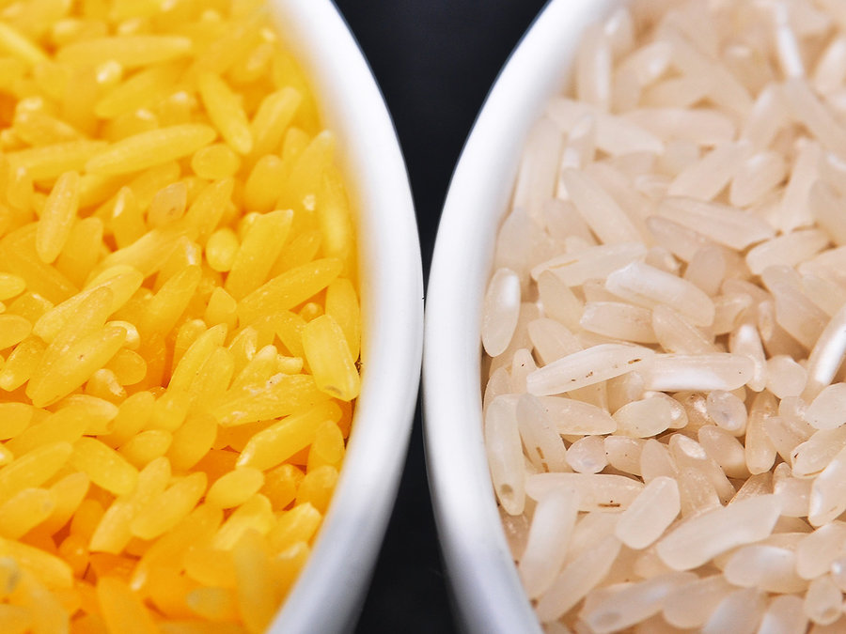
Can Biotech Food be Healthier?
Can a GM plant be consumed normally?
Can some GMOs produce healthier food? (Golden Rice)
Do GMOs destroy the livelihood of farmers?
Notes:
There are a lot of fears and concerns associated with genetic modification technology, particularly regarding GM (genetically modified) crops for food or feed.
The picture represents golden rice (left) and conventional rice (right) to show that biotechnology tools (and GM plants) may specifically address health issues and produce plants that are healthier than the original ones.
Golden rice is the typical example, but another example could be the iron-enriched rice (still under development).
Unfortunately, due to regulatory hurdles, most biofortification projects are still only based on conventional breeding techniques, which severely limits and delays the development of sufficiently improved varieties, with obvious limitation of the humanitarian aid that could be provided.
______
GMO = genetically modified organism

Slide 4

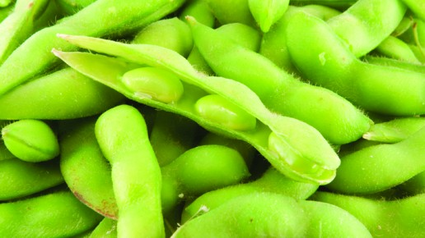

Biotech for Food – Facts and Figures
7 – 11% Yield Increase
Neutral Yield
Increase in Gross Values Resulted Mainly From:
Decreased Expenditure with Herbicides
Increased Plant Yields
Compiled from Brookes & Barfoot (2015)
Notes:
Another reality associated to biotech crops is that these bring certain qualities not originally present in the initial crop. Using genetically modified herbicide tolerant (HT) soybean as an example, we can see that since it was initially implemented in the USA (in 1996), this crop has brought an overall increase in yield of 7-11%, while simultaneously increasing the profitability of the crop for farmers.
HT soybean was only implemented in South Africa (since 2001), and its positive effects for producers is still increasing at present. This shows that both in the developed, as well as the developing world, this improved crop can improve the livelihood of farmers, by increasing their profit margins. It is interesting to note, that most of the increased profit comes from 2 different sources: (1) decreased expenditure with herbicides (due to less herbicide application), and (2) increased yields.
These margins, although prone to market-derived fluctuations, have always been positive for both countries.
______
Data was compiled from “GM crops: global socio-economic and environmental impacts 1996-2013” by Graham Brookes & Peter Barfoot (PG Economics Ltd, UK).

Slide 5

Plant Biotech and Environmental Issues...
What are the interplays between GMO and environment?
What are the effects in the developing world?
Can herbicide tolerance result in increased herbicide use?
Notes:
Many concerns regarding the environmental sustainability of HT crops have been raised. The #1 argument is that with increased herbicide tolerance, farmers will tend to employ higher amounts of herbicides (in this case, glyphosate), to ensure complete eradication of weeds. This raises two immediate concerns:
the increased glyphosate use would cause higher eco-damage, and
the excessive use of glyphosate would create incredible selective pressure on weeds, leading to the accelerated development of resistances.

Slide 6
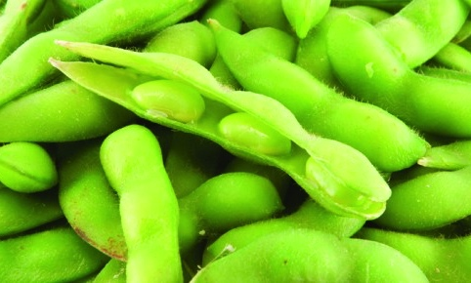
Plant Biotech Promotes Less Herbicide Use
% of reduction of farming impact (in USA)
from using herbicide tolerant (HT) soybeans
The USA now uses -1.62% Active Ingredients
South Africa shows a similar tendency of -1.2% Active Ingredient Use
Notes:
What was registered, however, was an overall reduction (although small) in the use of herbicide active ingredients (AI), as well as the soil Environmental Impact Quotient (EIQ) loading. The EIQ is (in an overly simplified manner) a value that is used to assess the toxicity level of a given pesticide [more in: http://www.nysipm.cornell.edu/publications/eiq/methods.asp].
The data show that since implementation in the USA (1996), the tendency has been to systematically decrease both AI and EIQ in farming lands. More recently, this trend has begun to invert, but it is still positive, with a reduction of 1.62% in the use of active ingredient.
For South Africa the available data is not so detailed, but we know that the current AI use is 1.2% lower than if standard soybean was employed.
These values may seem insignificant, but they make up to tons of herbicide.
_______
Data was compiled from “GM crops: global socio-economic and environmental impacts 1996-2013” by Graham Brookes & Peter Barfoot (PG Economics Ltd, UK).

Slide 7
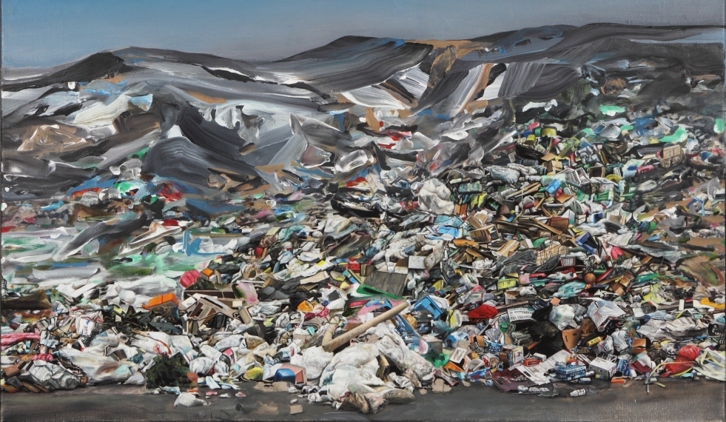
Plastics – a Global Crisis
Cheap, accessible materials
Biodegradability
Economic feasibility
Environmental sustainability
Painting by Marti Cormand (Monteray Bay Aquarium’s Ocean Travelers Plastics Gallery)
Notes:
Many technological developments had a negative impact for the global environment. For instance, the development of plastics although they are cheap, incredibly useful and widely employed materials, also had a dark side. That is their difficult and slow degradation, coupled to an explosive use, which quickly brought serious environmental problems at a world-wide level. Thus, the development of alternative materials (biodegradable) that can substitute the more problematic ones currently used is one of the current hot-topics. In order to ensure sustainability, bio-based polymers are the only possible alternative.
_________
Featured photo: New Deli, a landscape painting by artist Marti Cormand in Monterey Bay Aquarium’s Ocean Travelers Plastics Gallery.

Slide 8

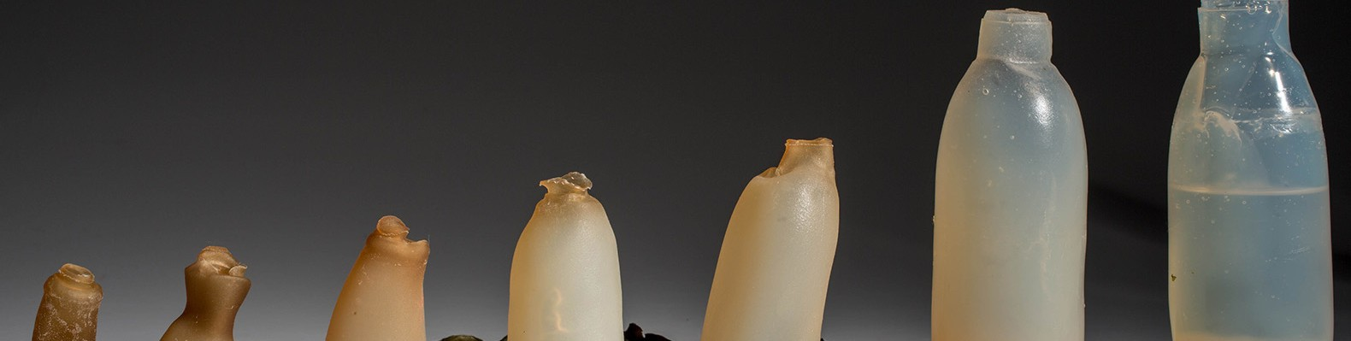
Plant Biotech and Bioplastics – the Future?
Biotechnology Can Help
(either using plants or microorganisms)!
Notes:
Bioplastics appeared as a possible solution. Basically, instead of using petrochemicals, biomaterials (such as corn starch) can be used. Currently this is still very little explored, as the production costs are high in comparison to conventional plastics, but some companies already exist around the world that produce bioplastic, as well as bioplastic-derived products. Biotechnology may help in advancing these novel materials in several ways, either by facilitating access to raw materials, or by allowing the production of novel biopolymers inside the plants, and could be another push towards making the technology more cost-effective.
Although plant left-over materials might be used for bioplastic production, considering that land accessibility for food production is scarce, other alternatives for large-scale bioplastic production, such as using microorganisms, may be a more economically-viable option.
_______
(represented on the slide is “Bioserie Toys”, a baby-toy producer - http://www.bioserie.com/index.html)

Slide 9
Take-Home Message
Increased
Yields
Reduced Herbicide and Pesticide Use
Novel Materials
Notes:
So to wrap it all up, plant biotechnology has been suffering all sorts of criticism, but as in the example given of GM HT soybean, we could see that its use has actually resulted in increased yields, as well as in reduced herbicide application (both in developed, as well as in developing economies). These effects have a measurable and substantial positive effect for the livelihood of farmers, and could be vastly spread if public awareness about these advantages would increase and if regulation becomes more logical.
Plant biotechnology may also open up new opportunities in other areas, such as biomaterials (bioplastics was an example), by reducing associated production costs, or by allowing cheaper production of novel biopolymer molecules.

Slide 10
In Summary…
Food security and nutrition
Environmental sustainability
New biomaterials
Plant Biotechnology
There are no magic bullets
Plant Biotechnology is an invaluable tool
Notes:
In summary, plant biotechnology has been around for a much longer time than most people realise, and was initially something as “simple” as the domestication of wild plant varieties for food production (i.e. “Agriculture”), or the clonal propagation of plants by grafting or cuttings. Nowadays, plant biotechnology has evolved tremendously, and has become much more powerful and controllable. Plant biotechnology is no magic-bullet, but is undeniably an incredibly powerful tool that might just help in our struggle against the biggest challenges that we are now facing – Food security and nutrition, environmental sustainability and the need for new materials, all in our current context of overpopulation and climate change.

Slide 11
If you wish to know more… (beyond the references already listed)
Some scientific publications…
Verma S.R. “Genetically Modified Plants: Public and Scientific Perceptions” (2013). ISRN Biotechnology Volume 2013. DOI: http://dx.doi.org/10.5402/2013/820671
…FAQs…
http://www.who.int/foodsafety/areas_work/food-technology/faq-genetically-modified-food/en/
…infographics…
http://croplife.org/biotech-crop-development/
…and YouTube/TED videos
https://www.youtube.com/watch?v=swpQz1TIMMM
https://www.youtube.com/watch?v=sH4bi60alZU
https://www.ted.com/talks/pamela_ronald_the_case_for_engineering_our_food#t-395547

