Slide 1




Biotech Plants
Two Different Visions and their Implications in Global Trading
Carlos Moreira
“Plants for Life” International PhD Program – 2017
(course “Plant Biotechnology for Sustainability and Global Economy”)

Slide 2
Plant Biotechnology
Biotechnology is the use of biological processes, organisms, or systems to obtain products intended to improve the quality of human life.
Plant
Biotechnology
Growth
Development
Yield
Food & Feed
Biochemicals
Pharmaceuticals
Biotic & Abiotic
Stress

Slide 3
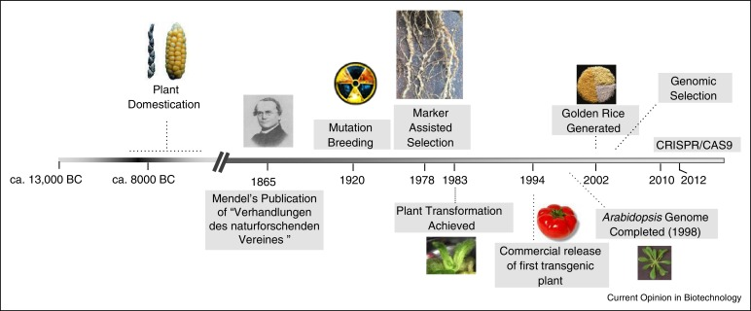
Evolution of Plant Biotechnology
Francis D. et al., 2017, Current Opinion in Biotechnology

Slide 4
Two different visions…
Commercially grown genetically engineered (GE) crops in 2015
The National Academy of Sciences - Genetically Engineered Crops: Experiences and Prospects

Slide 5
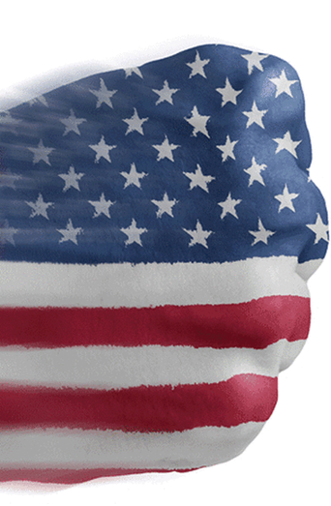
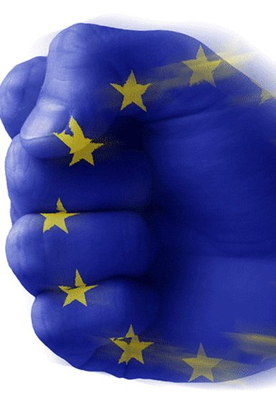
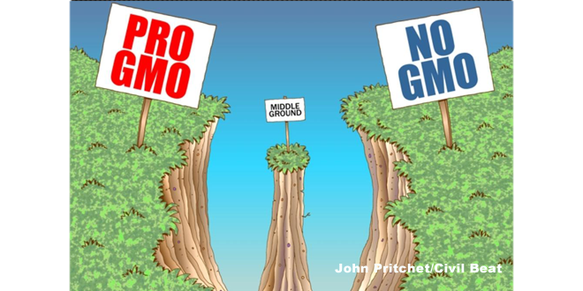
… lead to two different regulatory approaches
Food Supply
Environment Protection
Consumers Protection
Credible Regulation
Preventive
Precautionary

Slide 6

The preventive regulation
Product-based model
Risks and Benefits
Case by case / Step by step
Food Supply
Environment Protection
Consumers Protection
Credible Regulation
Preventive
Patterson L. and Josling T., 2002

Slide 7
The precautionary regulation
Process-based model
Antecipation of potential harm
Impact on ecosystems
Food Supply
Environment Protection
Consumers Protection
Credible Regulation
Precautionary
Patterson L. and Josling T., 2002

Slide 8
Are EU countries really GMO free?
Number of approved GM products in the EU, US, Brazil and Canada by 2011
NO
EuropaBio, 2011, Approvals of GMOs in the European Union

Slide 9
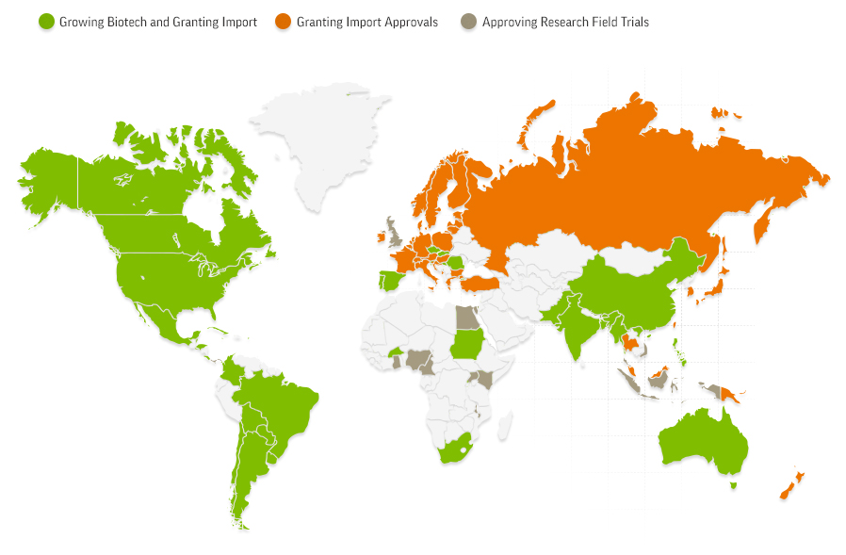
Impact on World Economy and Trading Market
GMOs were Grown, Imported and/or used in Field Trials in 70 countries In 2014
https://gmoanswers.com/ask/what-parts-world-andor-crops-gmos-effect-positive-way

Slide 10
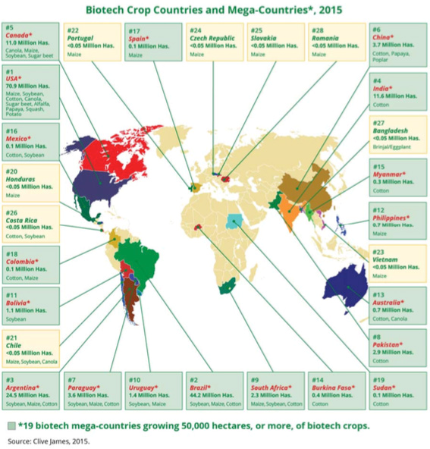
Impact on the World Trading Market
Europe
Portugal
<0,05 Million Has
Maize
USA
70,9 Million Has
Maize, Soybean, Cotton, Canola, Sugar beet, Alfalfa Papaya, Squash, Potato
Spain
0,1 Million Has
Maize
Czech Republic
<0,05 Million Has
Maize
Slovakia
<0,05 Million Has
Maize
Romania
<0,05 Million Has
Maize
Has = Hectares

Slide 11
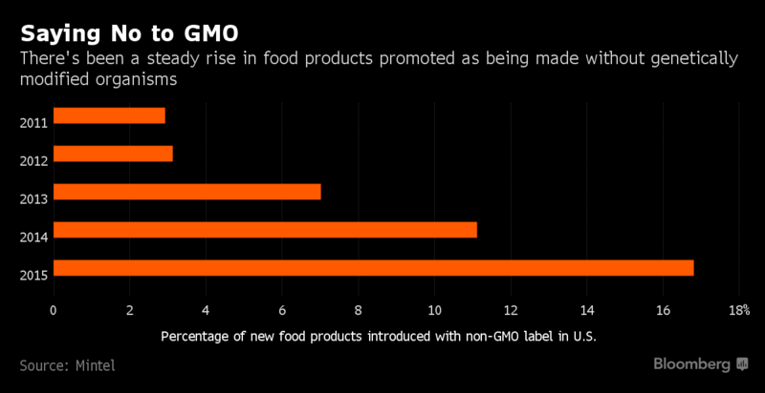
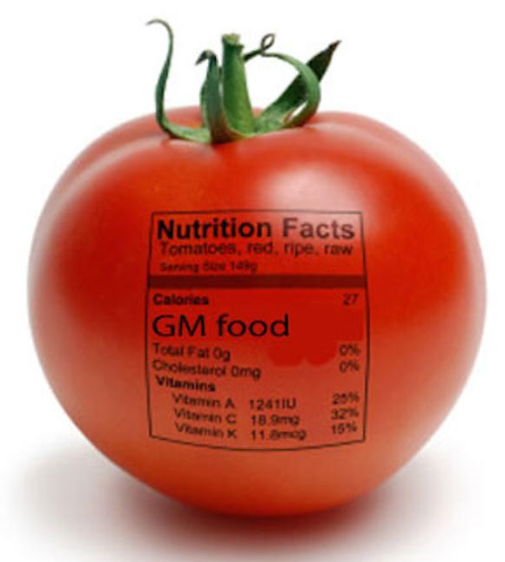

The future… U.S.
Increasing rejection of GMO’s
There has been a steady rise in food products promoted as being made without genetically modified organisms
GMO labeling
Result of the European Union position
Philipson M, Smyth, S. J., 2016, Journal of International Law and Trade Policy

Slide 12
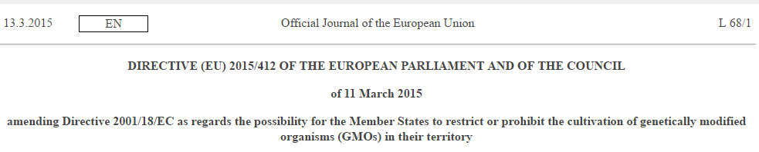
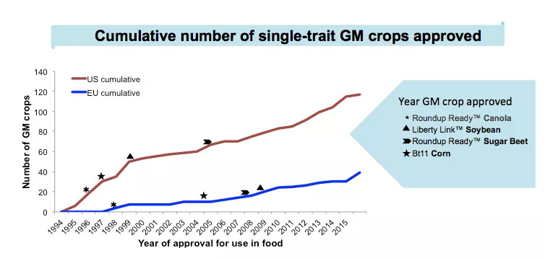
The future… E.U.
Result of the United States position
http://sitn.hms.harvard.edu/flash/2015/same-science-different-policies/

Slide 13
Final remarks
GM technology represents a huge advance in science and in our society;
Two very different visions led to two different regulatory mechanisms;
These different positions are impacting global economy;
Why are Europeans so mistrustful towards science and scientists in general, when compared to Americans?
Mad cow diseases
Could a mixture of both regulatory systems be the perfect solution?
(compromise)

Slide 14
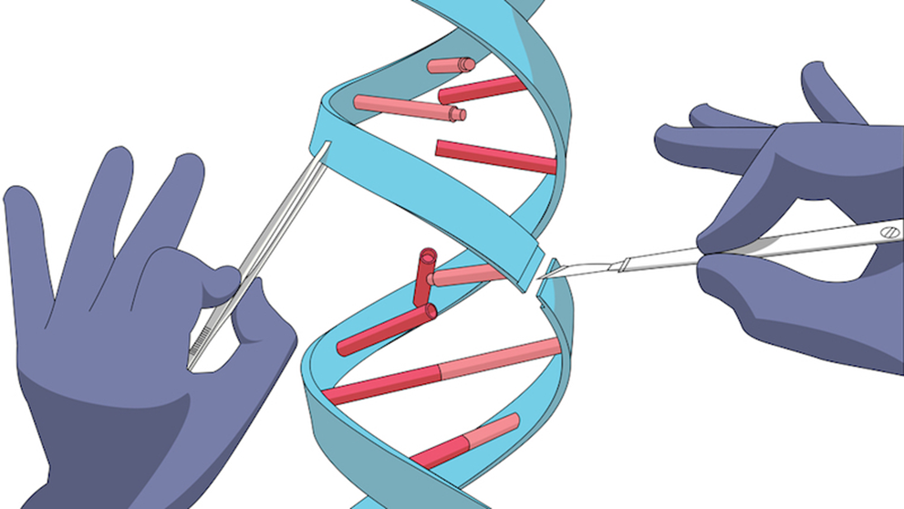


Slide 15
Bibliography
Genetically Engineered Crops: Experiences and Prospects, The National Academy of Sciences, The National Academies Press, 2016;
Philipson M. and Smyth S. J. (2016), The Legal and International Trade Implications of Regulatory Lags in GM Crop Approvals, Journal of International Law and Trade Policy;
Patterson, L. A. and Josling, T. (2002) Regulating biotechnology: comparing EU and US approaches. European Policy Papers;
Approvals of GMOs in the European Union, EuropaBio, 2011;
Directive (EU) 2015/412 of the European Parliament and of the Council of 11 March 2015, Official Journal of the European Union.

