Slide 1
Genome editing to breed better plants
Filipa Lopes
“Plants for Life” International PhD Program – 2017
(course “Plant Biotechnology for Sustainability and Global Economy”)

Slide 2
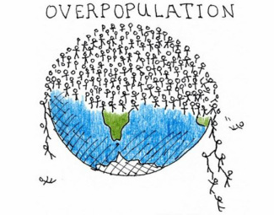
What is plant breeding?
Is the art and science of changing certain traits of plants over time in order to introduce desired characteristics

Slide 3
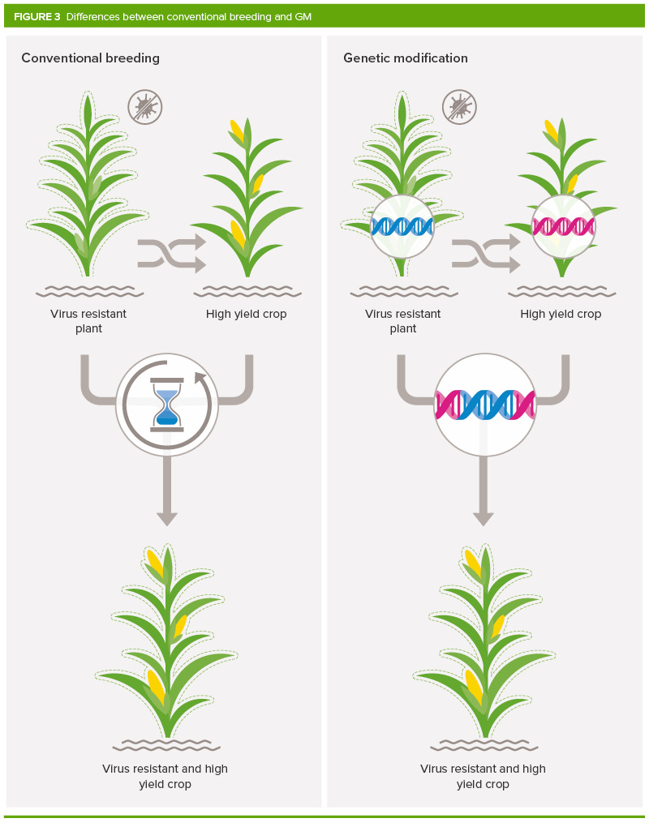
Conventional Breeding
Conventional Breeding:
Perform crosses between varieties or induce mutations
Selection
Grow future generations
Time and Precision?
New technologies arise!!
https://royalsociety.org/topics-policy/projects/gm-plants/how-does-gm-differ-from-conventional-plant-breeding/

Slide 4
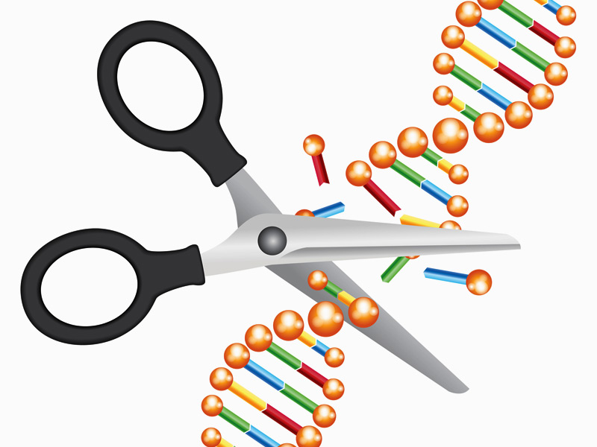
Genome Editing
Targeted interventions at the molecular level of DNA, deliberately to alter the structural or functional characteristics of organisms
Site-Directed Nucleases (SDN):
Zinc Finger
TALENs (transcription activator-like effector nucleases)
CRISPR/Cas9 systems (Clustered Regularly Interspaced Short Palindromic Repeats - associated protein-9 nuclease (Cas9))
…

Slide 5
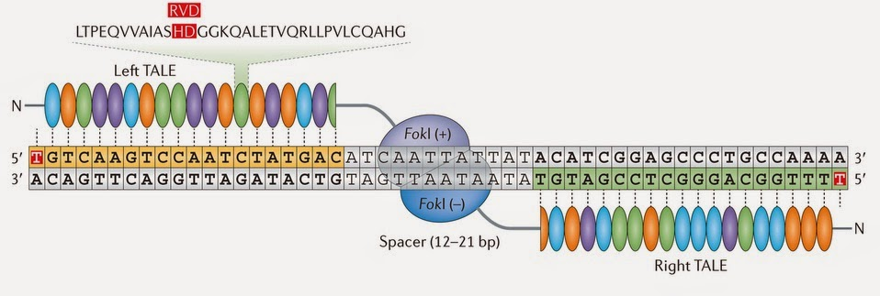
Quick overview around Zinc Fingers and TALENs
Zinc Fingers Nucleases (ZFNs):
DNA-binding zinc-finger motifs + an endonuclease FokI
Each module recognizes a nucleotide triplet
FokI endonuclease functions as a dimer
TALENs:
DNA-binding domain (amino acids repeats) + FokI endonuclease
Each amino acid recognizes one nucleotide of the target DNA sequence
FokI functions as a dimer
Kim, H., & Kim, J. S. (2014). A guide to genome engineering with programmable nucleases. Nature Reviews Genetics, 15(5), 321-334.

Slide 6
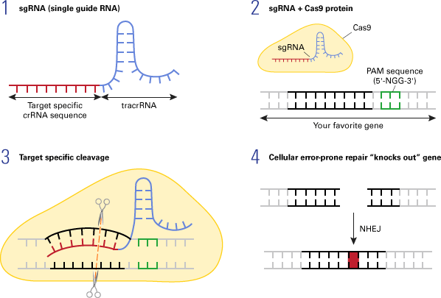
Genome Editing: CRISPR/Cas9 System
Single guide RNA (sgRNA) bound to a nuclease
Complex goes through DNA until finding a match
A conformational change activates the nuclease
Double stranded DNA is cleaved
DNA is repaired by the cell
http://www.clontech.com/US/Products/Genome_Editing/CRISPR_Cas9/Resources/About_CRISPR_Cas9

Slide 7
DNA Repair Mechanisms
DNA repair mechanisms, during which genome modifications occur:
Non-Homologous End Joining (NHEJ)
Produces a small insertion or deletion (without the use of exogenous DNA)
Homology-Directed Repair (HDR)
Can introduce a desired DNA sequence or gene into a targeted site
A mutation in the genome is induced by editing, deleting, inserting or replacing genes
Joung, J. Keith, and Jeffry D. Sander. "TALENs: a widely applicable technology for targeted genome editing." Nature reviews Molecular cell biology 14.1 (2013)

Slide 8
Genome editing to breed better plants
Plant breeding, has made enormous contributions to increased global food production, but …
There are limits…
Pros:
Precise in inserting the desired trait
Fast to obtain the final product
Can increase crop productivity and quality (e.g. producing resistant plants, biofortification, etc…)
Cons:
Random nature of gene insertions can have undesirable effects
Not favorable for making large concerted changes (e.g. adding an entire metabolic pathway)
Heavily Regulated
Genome Editing

Slide 9
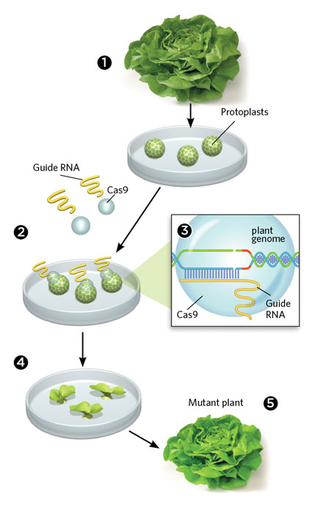
Genome editing to breed better plants
Site-directed modification for a new product
Reduce time to get the product
Reduce the number of plants involved
Introduce longer DNA sequences
http://www.the-scientist.com/?articles.view/articleNo/45155/title/Gene-Editing-Without-Foreign-DNA/

Slide 10
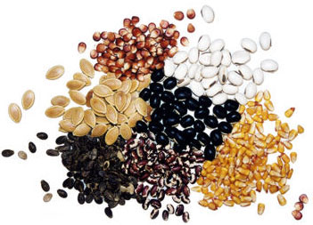
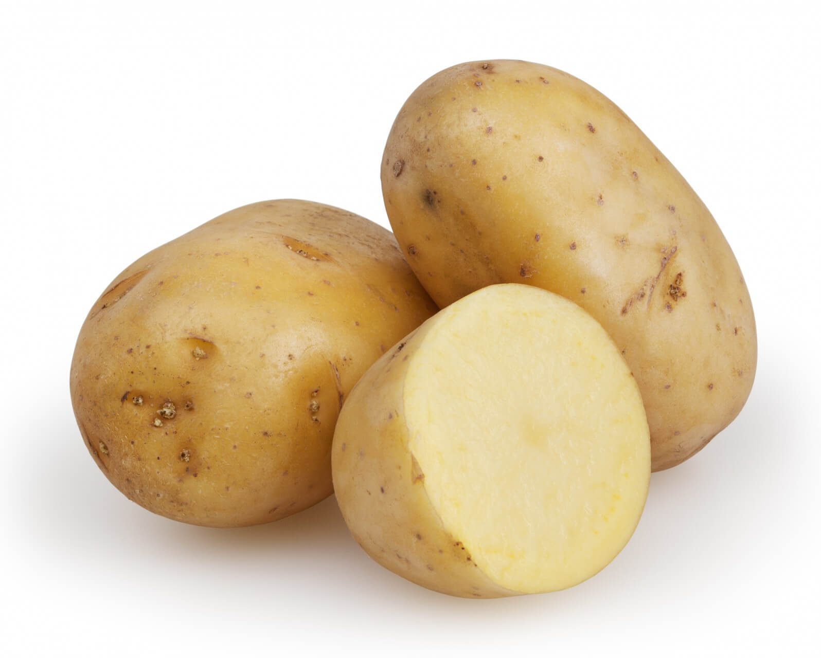
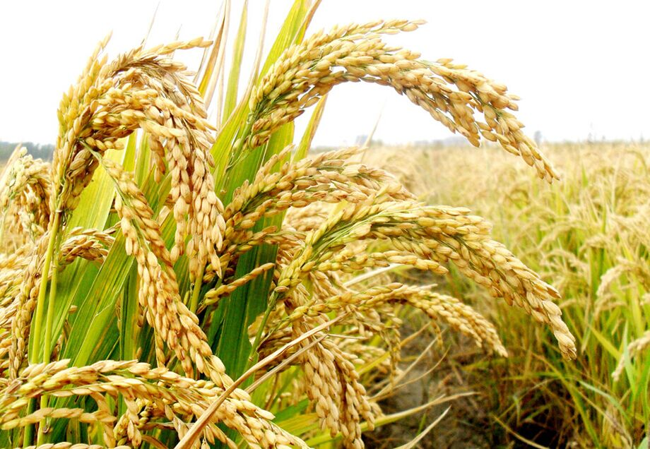
Genome Editing Applications
Research (eg: elucidate gene function)
Eliminate undesirable products that negatively impact food quality, storage, and processing
Accumulate metabolite of value (eg: fatty acids)
Simultaneously create mutations in multiple gene family members
Create varieties resistant to pest and diseases (eg: rice resistant to Xanthomonas oryzae)
Among many other…

Slide 11
Take home message…
Genome editing has a lot of potential to produce improved plants, but this potential can only be maximized when coupled with knowledge and experience

Slide 12
Thank you!

Slide 13
References
Genome editing: an ethical review, Nuffield Council on Bioethics (2016)
Sander, Jeffry D., and J. Keith Joung. "CRISPR-Cas systems for editing, regulating and targeting genomes." Nature biotechnology 32.4 (2014)
Joung, J. Keith, and Jeffry D. Sander. "TALENs: a widely applicable technology for targeted genome editing." Nature reviews Molecular cell biology 14.1 (2013): 49-55.
Araki, Motoko, and Tetsuya Ishii. "Towards social acceptance of plant breeding by genome editing." Trends in plant science 20.3 (2015).
Weeks, Donald P., Martin H. Spalding, and Bing Yang. "Use of designer nucleases for targeted gene and genome editing in plants." Plant biotechnology journal 14.2 (2016)
Kim, Hyongbum, and Jin-Soo Kim. "A guide to genome engineering with programmable nucleases." Nature Reviews Genetics 15.5 (2014).
Videos:
hgps://www.youtube.com/watch?v=2pp17E4E-O8

