Slide 1




Genetically Modified Trees for Industrial Purposes: How can we best use them?
Stefano Nones
“Plants for Life” International PhD Program – 2017
(course “Plant Biotechnology for Sustainability and Global Economy”)

Slide 2

Outline
21st Century forest challenges and the genetically modified (GM) trees
Most desired GM tree characteristics
Lignin
Applications in industry
Forest GM trees cultivation

Slide 3
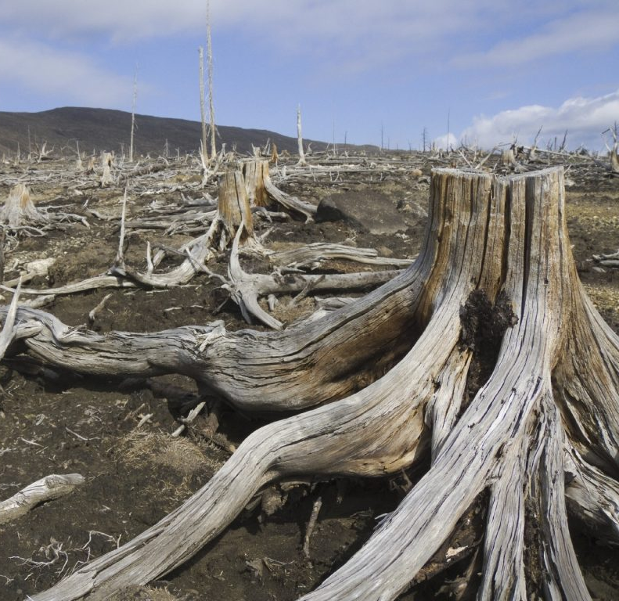
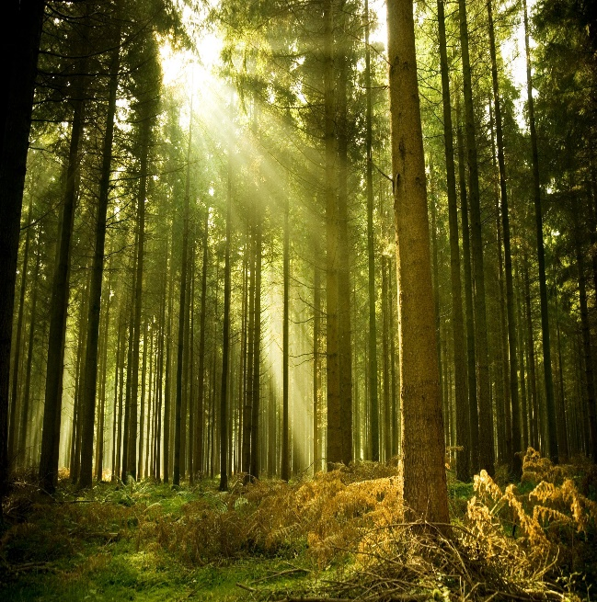

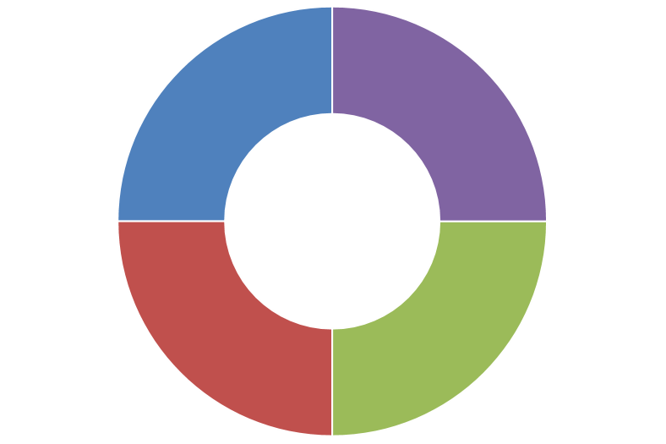
XXI Century forest challenges
Growing anthropogenic threats to native
forests
Urgent needs for new biofuels
and biomaterials
GM Trees
20 years of trials
Conservation
Substantial
impacts of climate change on forest
health
Growing demand for forest
products
GM trees production
Walter et al., 2010

Slide 4

Most desired GM trees characteristics
+ 20% growth rate
Fast growth and improved wood quality
Biomass
Lignin modifications
Tolerance to environmental stresses
Resistance to biotic stresses
Phytoremediation
GM eucalypts (Brazil, 2015)
Detoxification of mercury, benzene, chloroform
Poplars (2007)
Walter et al., 2010; Strauss et al., 2015

Slide 5
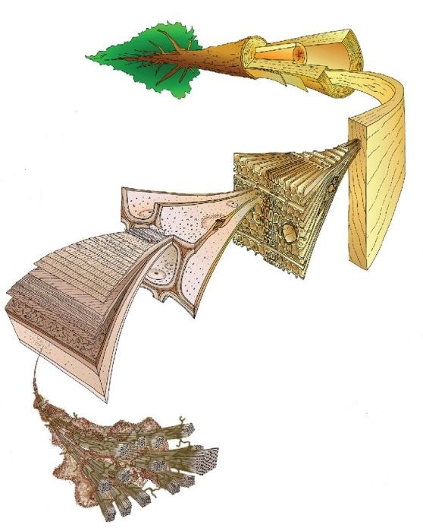




Application in industry: Lignin
Second most abundant natural substance in the world
Heavily glued to cellulose in the cell wall, providing mechanical strength to the plant
Lignin transformation
e.g. in paper industry
Adapted from Graichen et al., 2016

Slide 6
Application in industry: Lignin
Lignin structure:
Organic polymer
Some
target genes
CAD, F5H,
COMT
Biochemical pathways
Shikimate, PPP and lignin specific pathway
(See Annex 2-4)

Slide 7

Lignin: striking industrial application…how?
Successfully modified lignin in pine, producing biomass with retained fiber properties but easier to be processed (New Zealand, 2015)
Expression of F5H and COMT from hardwood species leading to the incorporation of syringyl units, typical of those species
New bio-based products and materials with functionalities not provided by existing petroleum-based options
Graichen et al., 2016

Slide 8
Lignin: applications in industry
Bioaromatics from lignin (obtained from (hydrogeno)lysis)
Yields (79% w/w)
Processed into new bio-based materials
Lignin-rich bioadhesives
100% bio-based
Avoiding the use of petrochemicals employed so far in synthetic adhesives
Greichen et al., 2016

Slide 9
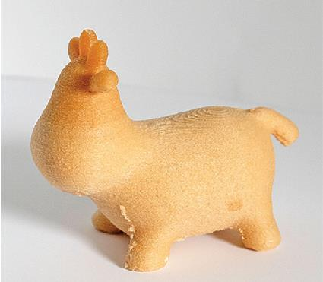
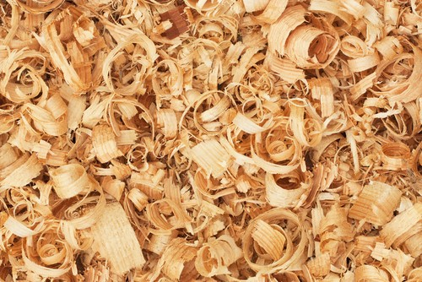
Lignin: applications in industry
Bio-based materials for 3D printing
Do it yourself public and schools; open source softwares
Forest residues incorporated into bioplastic materials
Alternative to ABS thermoplastic
Reducing costs
Add value to waste
Better properties of 3D biocomposites
ABS= Acrylonitrile butadiene styrene (e.g. Lego®)
Adapted from Graichen et al., 2016

Slide 10
Lignin: applications in industry
Lignin-based nanofibers (e.g. for batteries)
Low-cost; renewable bio-based feedstock; avoiding emission of toxic gases
Supercritical extraction of chemicals and compounds
Carbohydrates, soluble
lignins, terpenes, resin acids, soluble tannins, and suberins
Avoiding solvents use
Graichen et al., 2016

Slide 11





GM forestry tree plantations: Facts and Figures
Deregulation process for freeze-tolerant tropical eucalyptus
Since 2003 crops of 2 types of Bt poplars: 1.4 million plants on an area of 300-500 Ha
Since 2015 crops of only one type of GM eucalyptus
GM jatropha plants development:
1.4 Ha
Large areas of monocultures are risky options
www.map-library.com; Marusiak, 2012, http://www.eco-business.com; Walter et al., 2010; Strauss et al., 2015; Hong et al., 2016;
Notes:
Last but not least, this slide shows the actual scenario of GM forestry tree plantations around the world.

Slide 12


Slide 13
References
Walter C, Fladung M, Boerjan W. The 20-year environmental safety record of GM trees. Nature biotechnology. 2010 Jul 1;28(7):656-8.
Castellanos-Hernández OA, Rodríguez-Sahagún A, Acevedo-Hernández GJ, Herrera-Estrella LR. Genetic transformation of forest trees. INTECH Open Access Publisher; 2011.
Cesarino I, Araújo P, Domingues Júnior AP, Mazzafera P. An overview of lignin metabolism and its effect on biomass recalcitrance. Brazilian Journal of Botany. 2012; 35(4): 303-11.
Strauss SH, Costanza A, Séguin A. Genetically engineered trees: paralysis from good intentions. Science. 2015 Aug 21;349(6250):794-5.
Graichen FH, Grigsby WJ, Hill SJ, Raymond LG, Sanglard M, Smith DA, Thorlby GJ, Torr KM, Warnes JM. Yes, we can make money out of lignin and other bio-based resources. Industrial Crops and Products. 2016 Nov 10.

Slide 14
References
Hong Y, Bhatnagar S, Chandrasekharan S. Biotechnology of Tropical Tree Crops. InPlant Tissue Culture: Propagation, Conservation and Crop Improvement 2016 (pp. 245-295). Springer Singapore.
Kazana V, Tsourgiannis L, Iakovoglou V, Stamatiou C, Kazaklis A, Koutsona P, Raptis D, Boutsimea A, Šijačić-Nikolić M, Vettori C, Fladung M. Approaches and Tools for a Socio-economic Assessment of GM Forest Tree Crops: Factors for Consideration in Cost–Benefit Analyses. InBiosafety of Forest Transgenic Trees 2016 (pp. 209-221). Springer Netherlands.
Pilate G, Allona I, Boerjan W, Déjardin A, Fladung M, Gallardo F, Häggman H, Jansson S, Van Acker R, Halpin C. Lessons from 25 Years of GM Tree Field Trials in Europe and Prospects for the Future. InBiosafety of Forest Transgenic Trees 2016 (pp. 67-100). Springer Netherlands.

Slide 15
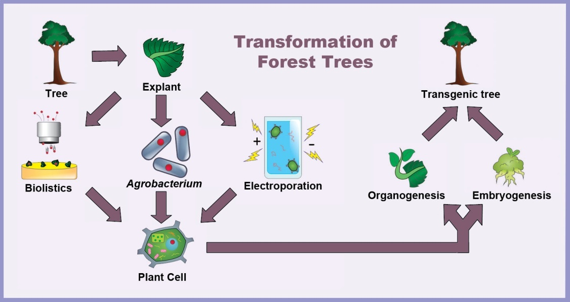
Annex 1: Three strategies for GM trees production
Castellanos-Hernández et al., 2011

Slide 16
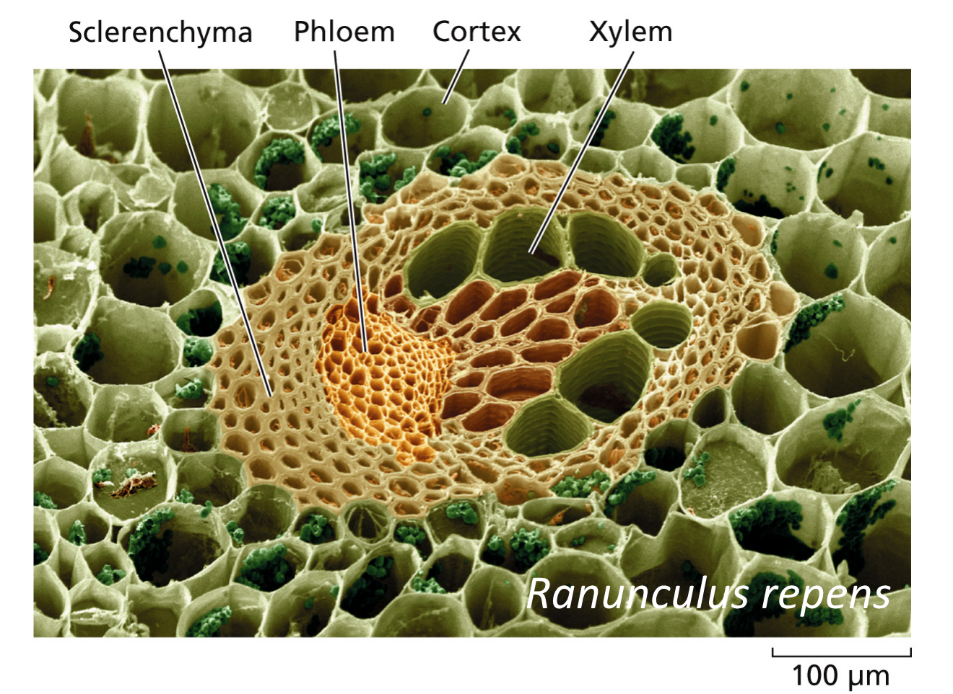
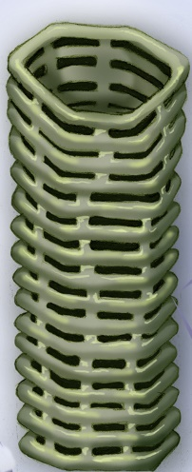
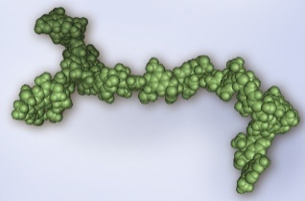

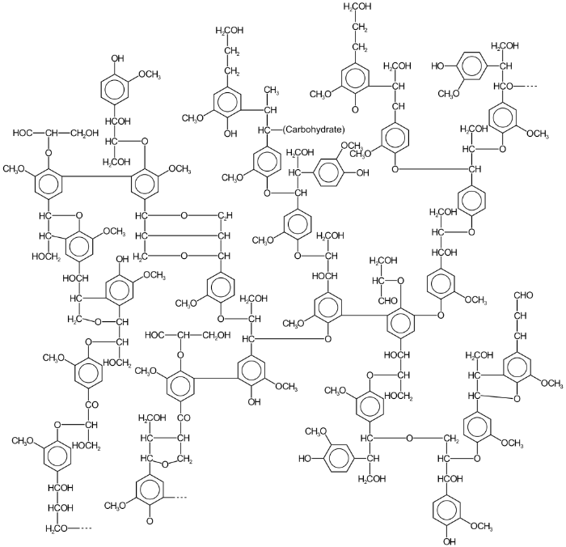
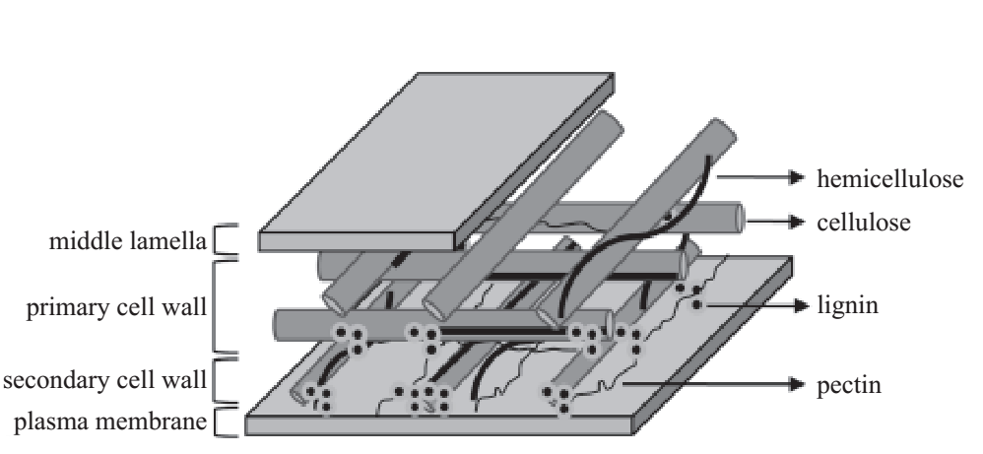
Annex 2: Lignin at tissue, cell and molecular level
Lignin
Cellulose
Xylem cell
1
2
Lignin
3
4
Adapted from: 1. Psmicrographs; 2. Courtesy: National Science Foundation; 3. Cesarino et al., 2012; 4. Glazer et al., 1995

Slide 17
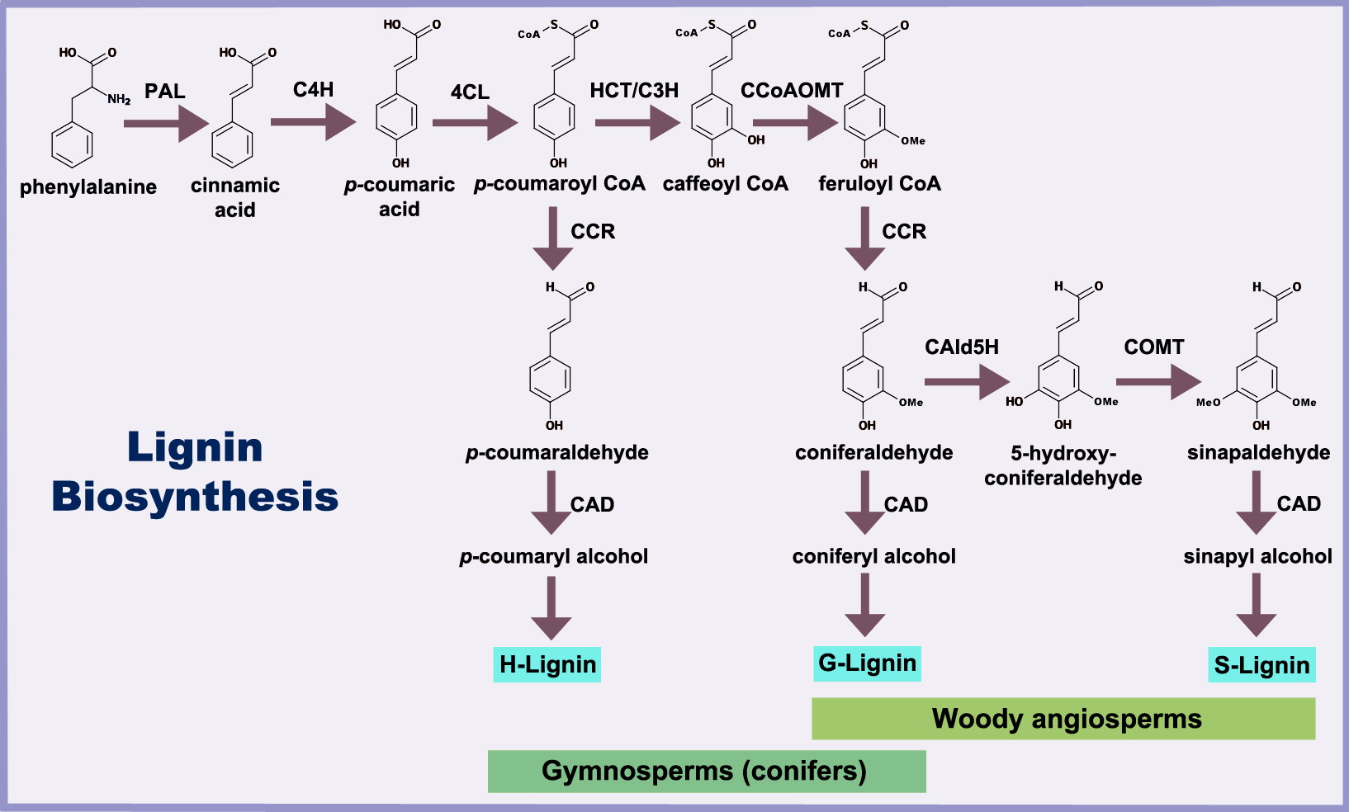
Annex 3: Pathway and key genes
F5H
Castellanos-Hernández et al., 2011

Slide 18
Annex 4: Some target genes (CAD, F5H)
Down-regulation of cinnamyl alcohol dehydrogenase (CAD)
Improved wood quality for chemical pulping
Overexpression of Ferrulate- 5- hydroxylase
(F5H)
Less condensed lignin
Improved lignin extractability/bleaching
Fiber quality remains the same
Hong et al., 2016

