Slide 1
Intellectual Property in Plant Biotechnology
Davide Martins
“Plants for Life” International PhD Program – 2017
(course “Plant Biotechnology for Sustainability and Global Economy”)
Notes:
1

Slide 2
Advances in Plant Biotechnology
Tissue Culture Techniques
Examples:
Molecular Pharming
Plant Biotechnology
Genome Editing Techniques
New Crop Varieties
Notes:
2

Slide 3
What is Intellectual Property?
“Creations of the mind, such as inventions; literary and artistic works; designs; and symbols, images…”
World Intellectual Property organization.
Protection of Intellectual Property (IP):
Intended to protect and reward inventors
Recover investment, generate income, fund R&D
Notes:
3

Slide 4
Why is it important to protect IP?
Attract investment to stimulate risky research
Encourage agriculture innovation
Yield
% PVP
Delivering
better-performing products to farmers
Nassem et al., (2005)
Notes:
4

Slide 5
Milestones in IP protection
1930
US Plant Patent Act
1961
Plant Breeder’s Rights (UPOV Convention)
1970
US Plant Variety Protection Act
1973
European Patent Convention excluding “plants varieties” (Art 53, b)
1980
U.S Supreme Court decision makes living organism patentable
2002/2003
European Patent Office grants patent on plants obtained through conventional breeding (EP1069819; EP1211926)
Notes:
5

Slide 6
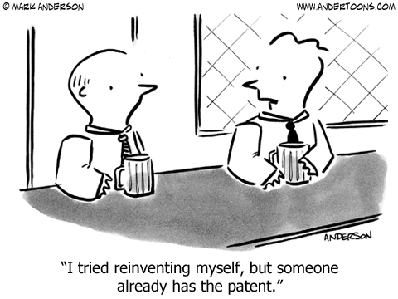
Means of protecting IP
Forms of intellectual property protection:
Patents
Novelty; Inventiveness; Applicability; Utility
Trade Secret
Plant Breeders’ Rights
New; Distinctiveness; Uniformity;
Stability
Notes:
6

Slide 7
What is the scope of IPR?
Maximize social welfare
PROTECTION
ACCESS
As an incentive for innovation
To knowledge and improved technologies
Notes:
7

Slide 8
At what cost?
Increased gap between developed and developing countries
Higher costs to access protected innovations
Restricted access to improved germplasms
Interfere with sharing of knowledge in the scientific community
Slow down scientific progress and collaboration opportunities
Notes:
8

Slide 9
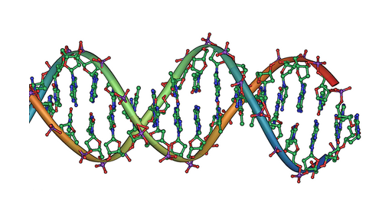
Case studies…
Genome editing technologies that revolutionize DNA manipulation:
Zing-Fingers (Sangamo BioSciences)
TALEN (Univ. of Minnesota and Iowa Univ. Research Foundation)
CRISPR/Cas9 (in court)
ODM (CibusTM)
(see “Genome Editing” presentation for further information)
Notes:
9

Slide 10
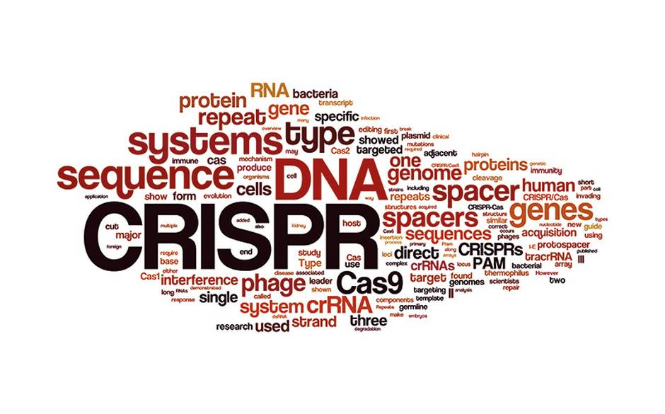
CRISPR Patent- Court Battle
Who was the first to invent?
First to apply for patent
(Univ. California)
First to win patent in 2014
(Broad Institute in Cambridge, Massachusetts)
VS.
Decision further complicated by the change in U.S patent system from “first-to-invent” to “first-inventor-to-file” (2013)
Notes:
10

Slide 11
Useful References…
https://ec.europa.eu/food/plant/plant_property_rights_en
http://www.fao.org/docrep/007/y5714e/y5714e03.htm
https://www.epo.org/law-practice/legal-texts/html/epc/1973/e/ar53.html
SMITH, S. Intellectual property protection for plant varieties in the 21st century. Crop science, 2008, 48.4: 1277-1290.
SECHLEY, A., SCHROEDER, H. Intellectual property protection of plant biotechnology inventions. TRENDS in Biotechnology, 2002, 20.11: 456-461.
FLECK, B., BALDOCK, C. Intellectual property protection for plant-related inventions in Europe. Nature Reviews Genetics, 2003, 4.10: 834-838.
Notes:
11

