Slide 1
Plant Biotechnology in Africa
- an emerging trend?
Rui Martins
“Plants for Life” International PhD Program – 2017
(course “Plant Biotechnology for Sustainability and Global Economy”)

Slide 2
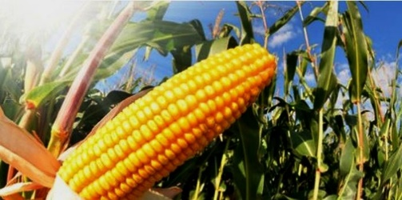
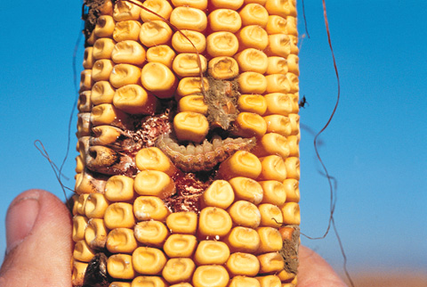
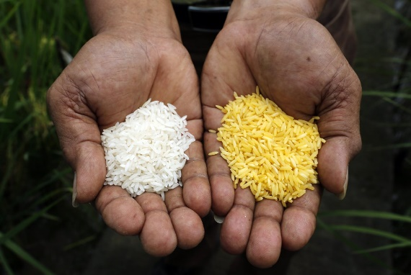
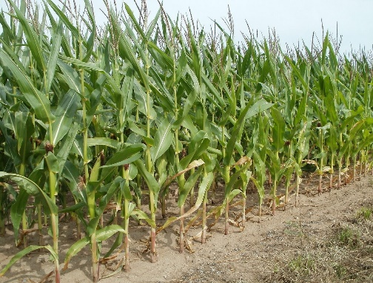
Plant Biotechnology
In vitro culture
Genomic analysis
Plant biotechnology
Genetic engeneering
New breeding techniques (genome editing)
Increasing plant yield
Resistance to pests/insecticides
Resistance to herbicides
Biofortification

Slide 3
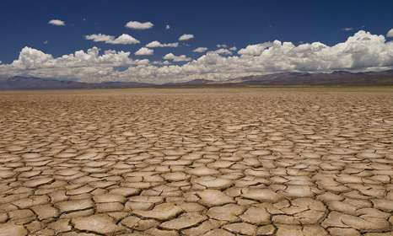
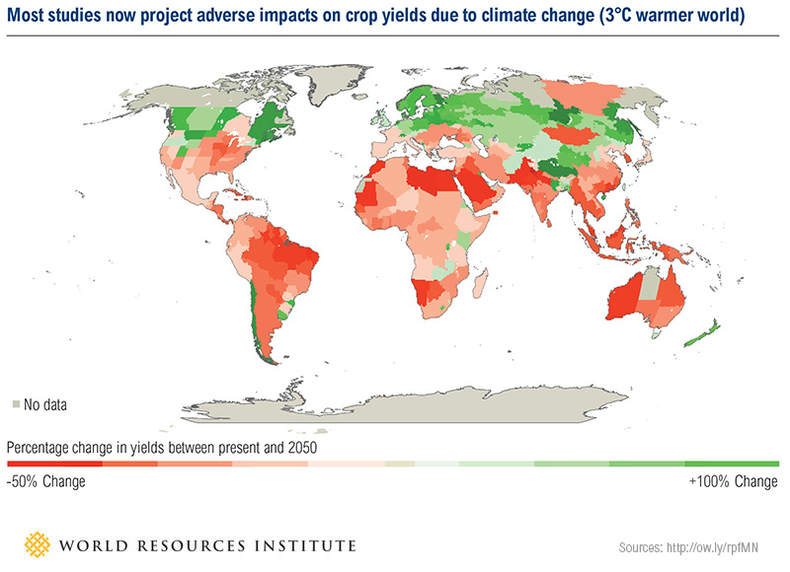
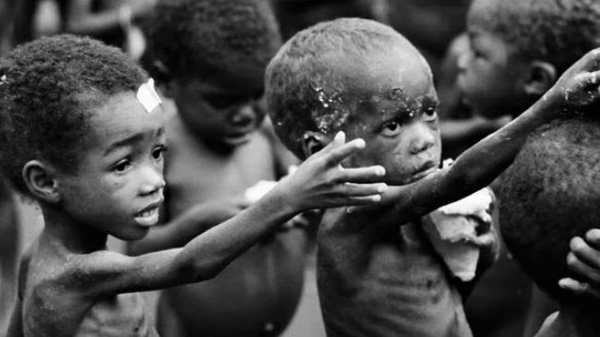
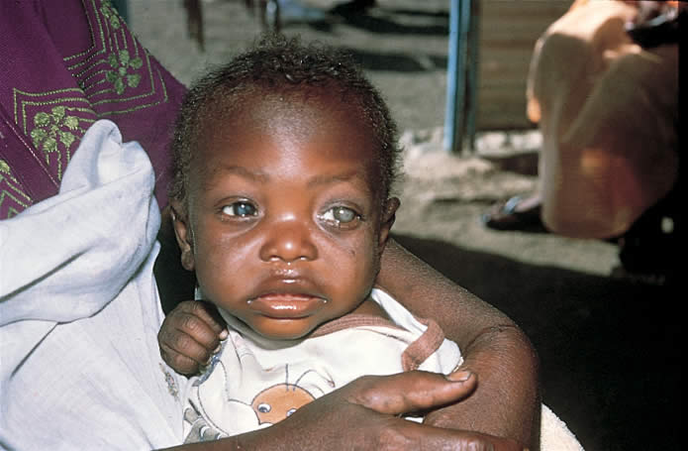
Africa
Current problems...
Desertification
Insufficient food production
malnutrition
In 2050...

Slide 4
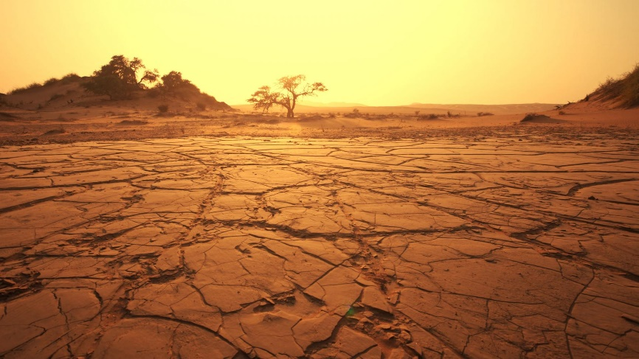
Africa – Genetically modified (GM) crop perspective
Nowadays…
Only South Africa, Egypt, Burkina Faso and Sudan grow GM crops commercially
Most recently, extreme high temperatures cause severe drought
Currently, Tanzania, Malawi and Uganda approved field trials of GM crops

Slide 5
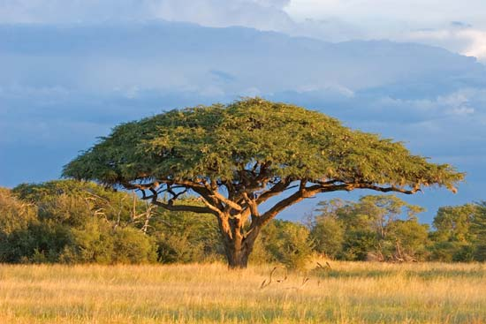
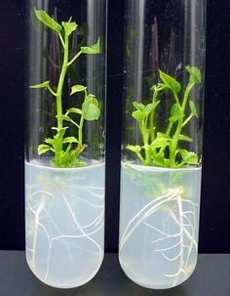
Great Green Wall Project
Fight against desertification and climate change effects
8000 km of a tree wall!
Plant Biotechnology contribution:
Selection of varieties
Micropropagation
Great Green Wall
Countries involved
Other countries
Dia & Duponnois (2013)

Slide 6
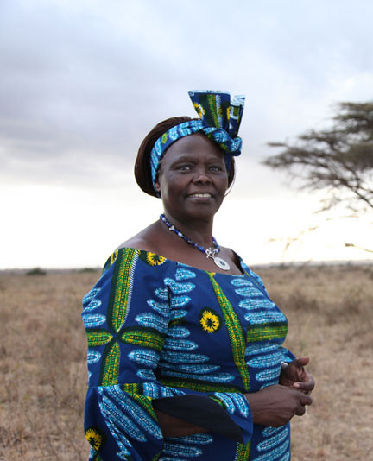
Green Belt Movement - Kenya
Wangeri Maathai – Nobel Peace Prize 2004
(1st woman to get a PhD degree in central and oriental Africa)
Founder of the Green Belt Movement (51 million trees in Kenya)
Promote environmental conservation
Build climate resilience
Social impact

Slide 7
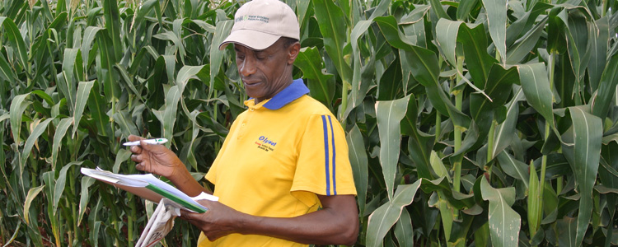
Water Efficient Maize for Africa (WEMA)
Genetically modified hybrid maize
More than 300 million Africans depend on corn as their main food
- Conventional breeding, marker-assisted breeding and genetic engineering
- Varieties and drought-resistance transgenes donated by Monsanto

Slide 8
Biofortified beans in Rwanda - Iron
Iron deficiency is very common in African countries..
Biofortified beans by conventional methods
More Iron content, better yield and drought tolerance

Slide 9
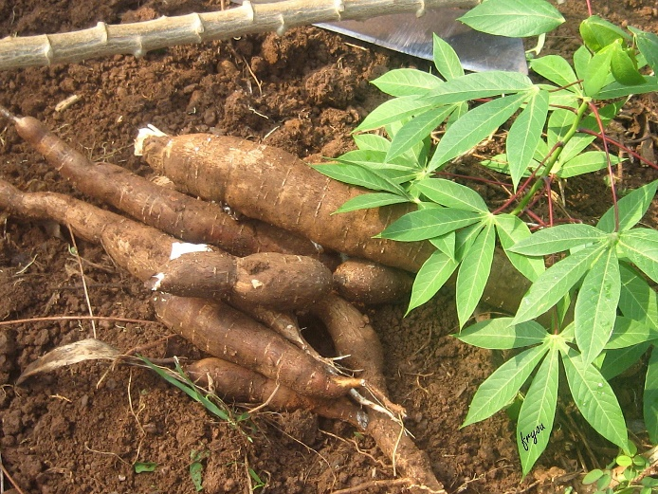
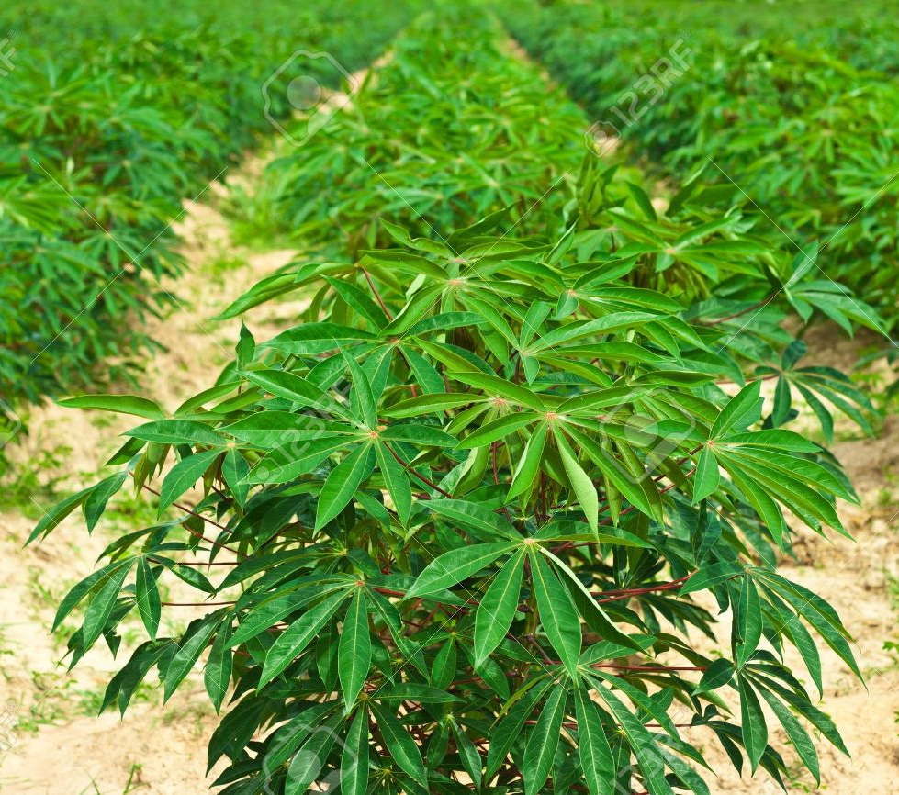
Cassava
Fourth largest source of calories in the world
Africa is the 3th largest world producer
Main problems: Viral and Bacterial diseases; nutritional needs
Possible solutions:
Biotech strategies and conventional methods
Traits: Virus resistance, Bacterial resistance,
β-carotene biofortification, Iron biofortification, etc...

Slide 10
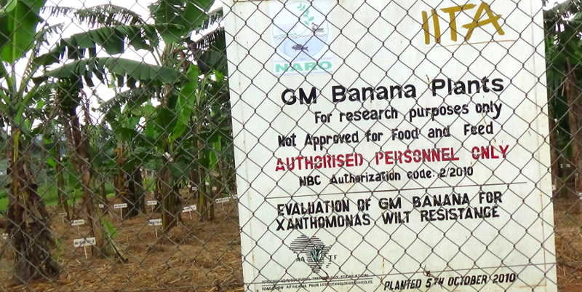
Other examples
Field trials
(BT => insect resistance)
Bt cowpea
GM banana resistance to Bunchy Top virus
GM banana with bacterial Wilt resistance
Bt maize
Others …

Slide 11
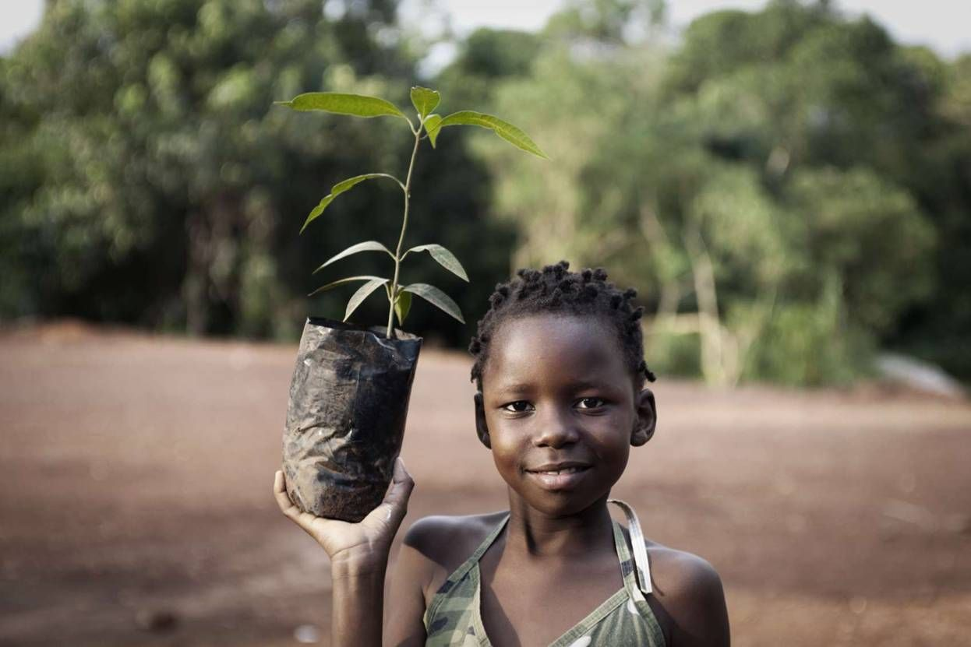
Take home message…
Plant Biotechnology plays an important role in African food production and may be considered in parallel with good and coherent agricultural policies and practices
The use of Biotechnology resources is a desirable approach to Africa’s present and future food and social problems
Further expectations for the New Breeding Technologies
Thank you for your attention!

Slide 12
References
www.sciencemag.org
http://wema.aatf-africa.org
http://www.greenbeltmovement.org
http://www.harvestplus.org
Chavarriaga-Aguirre, P., Brand, A., Medina, A., Prías, M., Escobar, R., Martinez, J., et al. (2016). The potential of using biotechnology to improve cassava: a review. In Vitro Cellular & Developmental Biology-Plant, 52(5), 461-478..
Dia, A., & Duponnois, R. (2013). Le projet majeur africain de la Grande Muraille Verte: concepts et mise en œuvre. IRD Editions.
Chambers, J. A., Zambrano, P., Falck-Zepeda, J. B., Gruère, G. P., Sengupta, D., & Hokanson, K. (2014). GM agricultural technologies for Africa: A state of affairs. Intl Food Policy Res Inst.

