Slide 1




Plant Biotechnology and Plant Breeder’s Rights :
- What is fair and needed?
Pedro Carvalho
“Plants for Life” International PhD Program – 2017
(course “Plant Biotechnology for Sustainability and Global Economy”)

Slide 2
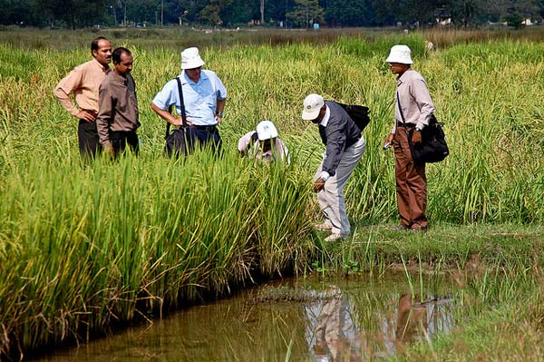
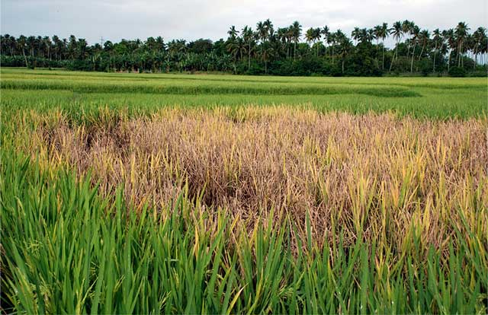
Plant Breeder’s Rights – why?
Allow the breeder’s to have a return of the investment
Protect the Breeder’s work
Stimulate development of new varieties
www.irri.org
Notes:
The necessity for the Plant Breeder’s Rights is to ensure that the Breeder’s can be compensated by the input in developing, not only financial but also time and effort;
Since varieties can be easily copied the necessity to protect them is even larger;
Giving something back to the people that do this work will stimulate the development of new varieties.

Slide 3

Plant Breeder’s Rights – what is it?
Exclusive commercial rights for a registered variety of plant
Intellectual property (IP) such as patents, trademarks and designs
Protects plant breeders and gives them a commercial monopoly for a period of time (EU 25-30 years/PT 15-20 years)
www.geneticliteracyproject.org
Notes:
They are a type of intellectual property(IP), within IP we can also find patents, trademarks or designs;
In EU they can be awarded for 25 year or 30 , if the variety is from a woody species, in Portugal the times are 15 or 20 years.

Slide 4
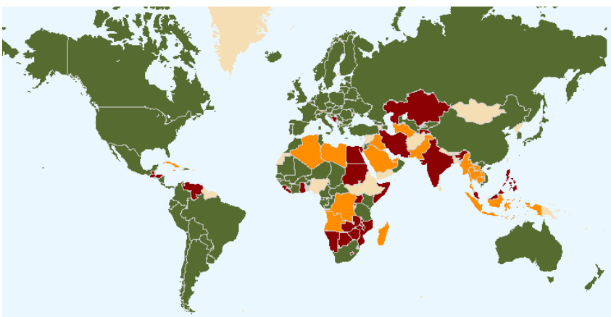

International Union for the Protection of New Varieties of Plants (UPOV)
Intergovernmental organization based in Geneva, Switzerland;
The mission of UPOV is to provide and promote an effective system of plant variety protection, with the aim of encouraging the development of new varieties of plants, for the benefit of society.
www.upov.int
Notes:
UPOV was established in 1961 by the International Convention for the Protection of New Varieties of Plants (the “UPOV Convention”).
The mission of UPOV is to provide and promote an effective system of plant variety protection, with the aim of encouraging the development of new varieties of plants, for the benefit of society.
Most countries and intergovernmental organizations which have introduced a plant variety protection (PVP) system have chosen to base their system on the UPOV Convention in order to provide an effective, internationally recognized system
Green->member; Brown->Initiated procedure; Orange->Have contacted the Union

Slide 5
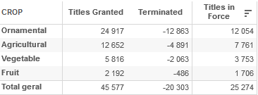
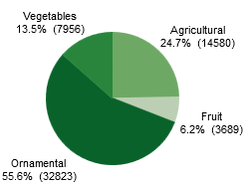


Community Plant Variety Office (CPVO)
Type of crops
# varieties
terminated
still active
European Union agency responsible for implementing a system for the protection of plant varieties.
Foster innovation in plant varieties by high quality processing of applications
In Portugal: responsibility Direção Geral de Alimentação e Veterinária (DGAV)
Number of applications
www.cpvo.europa.eu
www.medvet.dgav.pt
Notes:
A system for the protection of plant variety rights has been established by the European Commission legislation.
The system allows intellectual property rights, valid throughout the European Union, to be granted for plant varieties.
The Community Plant Variety Office (CPVO) implements and applies this scheme. The CPVO has been operating since 27 April 1995
The legal basis for the Community plant variety system is found in Council Regulation (EC) No 2100/94.

Slide 6
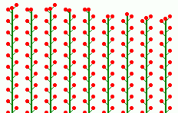

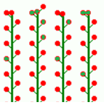
Plant Breeder’s Rights – requirements
Uniformity
New (commercial novelty)
Distinct (clearly different)
Uniform (homogeneous)
Stable (unchanged)
Stability
Propagation
Notes:
In EU regulation the requirements are defined as:
New-A variety shall be deemed to be new if, at the date of application determined pursuant to Article 51, variety
constituents or harvested material of the variety have not been sold or otherwise disposed of to others, by or with the
consent of the breeder within the meaning of Article 11, for purposes of exploitation of the variety:
(a) earlier than one year before the abovementioned date, within the territory of the Community;
(b) earlier than four years or, in the case of trees or of vines, earlier than six years before the said date, outside the
territory of the Community
Distinct-A variety shall be deemed to be distinct if it is clearly distinguishable by reference to the expression of the
characteristics that results from a particular genotype or combination of genotypes, from any other variety whose
existence is a matter of common knowledge on the date of application
Uniform-A variety shall be deemed to be uniform if, subject to the variation that may be expected from the particular features
of its propagation, it is sufficiently uniform in the expression of those characteristics which are included in the
examination for distinctness, as well as any others used for the variety description.
Stable-A variety shall be deemed to be stable if the expression of the characteristics which are included in the examination
for distinctness as well as any others used for the variety description, remain unchanged after repeated propagation
or, in the case of a particular cycle of propagation, at the end of each such cycle.

Slide 7

Plant Breeder’s Rights – when does it apply?
(Re)Production (multiplication)
Limit/control the propagation by others
Offering for sale
Selling (or other marketing)
Exporting from the Community
Importing to the Community
Stocking for any of the purposes mentioned
Notes:
The holder of Plant Breeder’s Rights can use they right in the situations mentioned.
This can mean:
limit the (Re)Production (multiplication);
Limit/control the propagation by others
When the variety is offered for sale by others or used in any marketing event or strategy

Slide 8
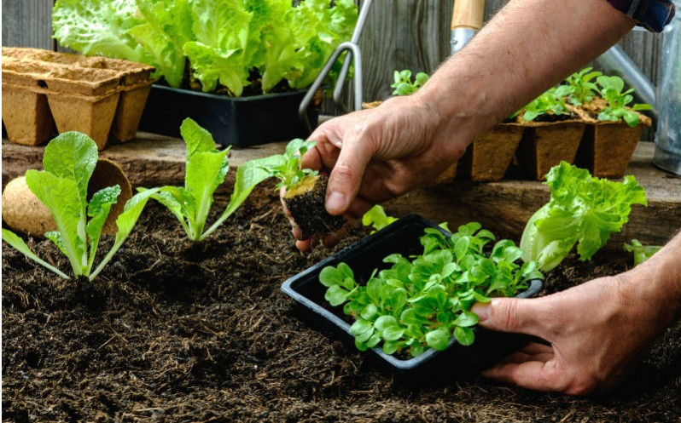
Plant Breeder’s Rights – when doesn’t it apply?
When the purposes are:
    private and non-commercial application
    only for experimental use
    for breeding
Discovering and developing other varieties
Notes:
This differences are fundamental in distinguishing Plant Breeder Rights from Utility Patents

Slide 9

Biotechnology – what is it?
Broad discipline in which biological processes, organisms, cells or cellular components are exploited to develop new products or technologies
www.vdu.lt

Slide 10
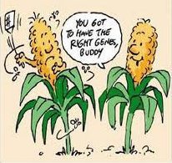


Plant Breeder’s Rights and Biotechnology
The UPOV Convention (1991) does not limit the technology used to breed a new variety
A trait, a chemical or another substance as well as a plant breeding technology cannot be defined as a variety→ Excluded from Plant Breeder’s Rights
Notes:
The variety can be obtained by any technique (conventional breeding, genetic modification, new breeding techniques) and still be viable for the request of Plant Breeder’s Rights.
The only thing that can be protected by a Plant Breeder’s Rights are plant varieties and no their traits, chemicals produced or the techniques used to produce them (other types of Intellectual properties are used in this cases)

Slide 11
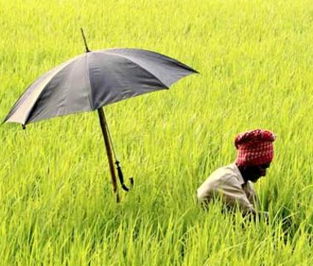

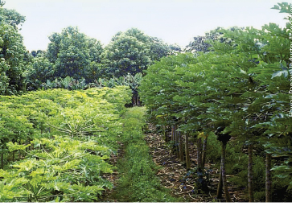
Advantages of Plant Breeder’s Rights
Protecting the Breeder’s work
Allowing for a return of investment and fostering further development
Dealing with varieties and not techniques/traits
Improved varieties are crucial to address new challenges ahead
ipeyeblog.com/word-cloud-plant-breeders-bill-of-ghana/

Slide 12
Bibliography
Websites:
  UPOV: www.upvo.int
  CPVO: www.cpvo.europa.eu
  Australian Government: www.ipaustralia.gov.au/plant-breeders-rights
  EPSO: www.epsoweb.org/file/2036
Books:
  Rimmer, Matthew. Intellectual property and biotechnology: biological inventions. Edward Elgar Publishing, 2008.

