Slide 1




Micropropagation
Using micro techniques for large scale plant propagation
Sara Tedesco
“Plants for Life” International PhD Program – 2017
(course “Plant Biotechnology for Sustainability and Global Economy”)

Slide 2
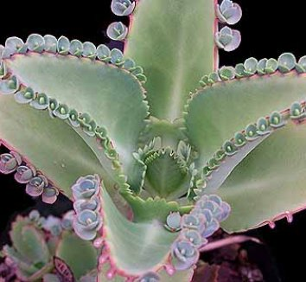


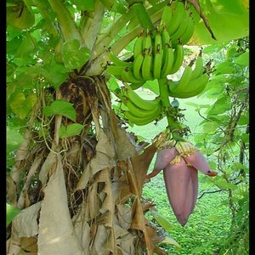

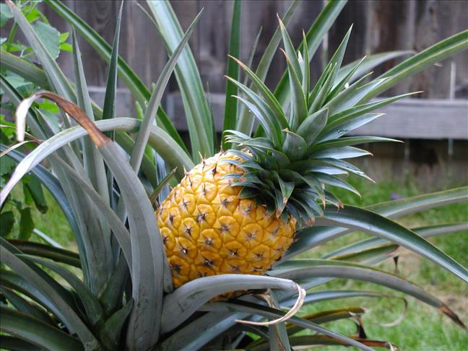





What do all these plants have in common?
They reproduce vegetatively
Kalanchoe d.
Potatoes
Olive tree
Vegetative propagation is a form of asexual reproduction in plants, by which new organisms (clones) arise without need of sexual reproduction
carrots
bananas
Pineapple
Strawberries
Apple tree
Asparagus
Roses
Sugar cane

Slide 3


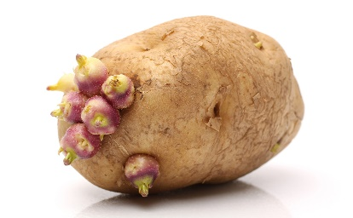
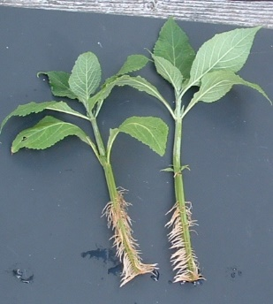
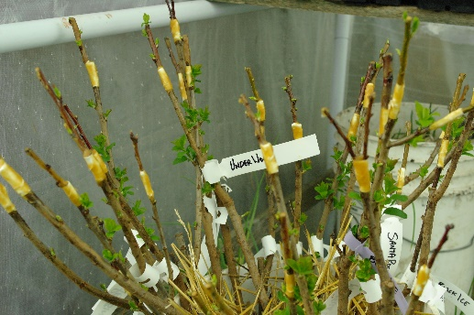
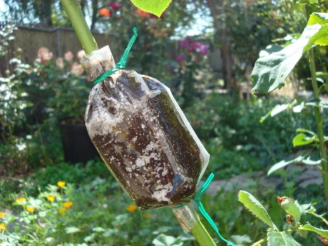
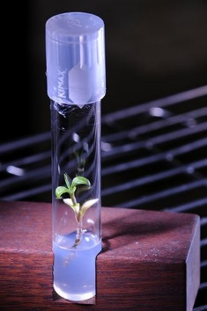
Types of vegetative propagation
Natural vegetative propagation typically involves structural modifications of plant organs
Rhizomes - ginger
Bulbs - onion
Tubers - potato
Success rates and difficulty of propagation vary a lot among plants.
  Several man-made strategies used
Salvia stem cutting
Prunus grafts
(Air) Layering rose
Orchid micropropagation

Slide 4
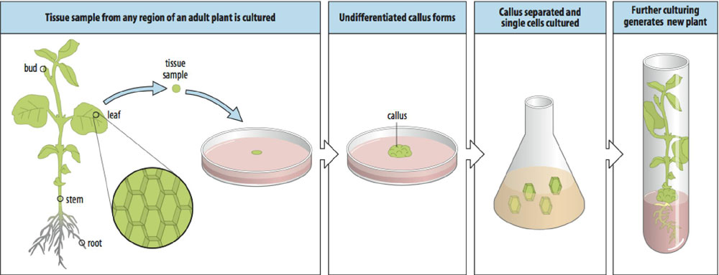
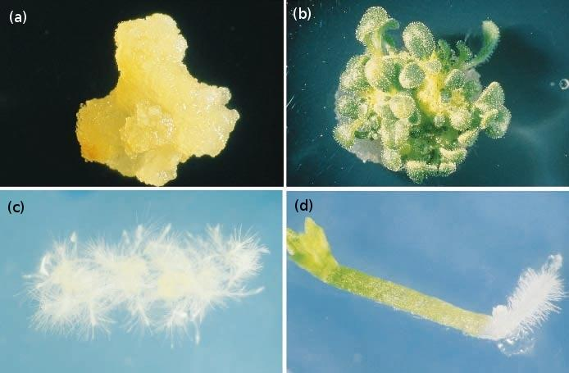
Micropropagation implies Totipotency
Totipotency
The inherent potentiality of a plant cell (even a mature differentiated cell ) to give rise to a whole plant
Dedifferentiation (a)
Redifferentiation (b-d)
(http://plantsinaction.science.uq.edu.au/edition1)

Slide 5
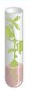
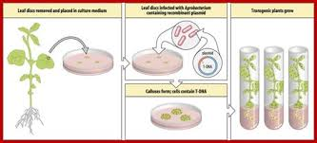
Micropropagation by plant tissue culture
Plant tissue culture in vitro cultivation of plants, seeds, plant parts (tissues, organs, embryos, single cells, protoplasts) on nutrient media under aseptic conditions.
Organogenesis
Differentiated cells
Plant hormones are added to the culture medium to help regulate growth and development
Callus cells
Embryogenesis
Preformed meristem
Bud proliferation

Slide 6
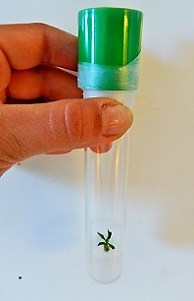
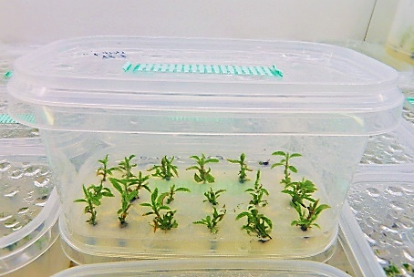
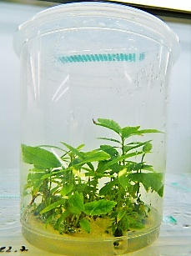
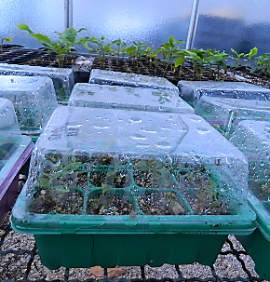
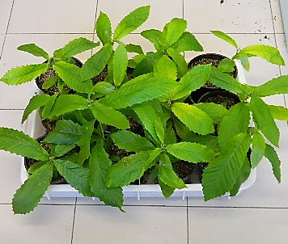
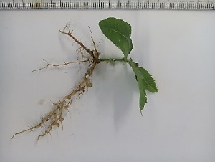
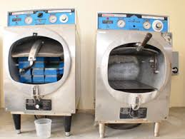
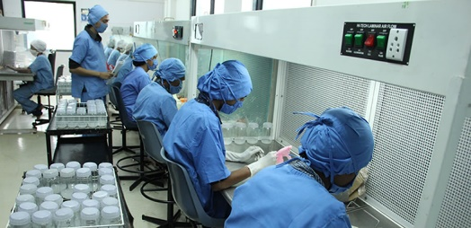
One example - Chestnut Micropropagation
The initial explant is usually a bud (meristem)
In vitro stages
In/ex vitro
Ex vitro stages
Establishment
Multiplication
Elongation
Rooting
Acclimatization
Simplified flow-chart of the Chestnut micropropagation at INIAV
Ensure asepsy
Autoclaves for media and instruments sterilization
Laminar flow chambers for plant transfer to different media

Slide 7


Micropropagation: large-scale propagation
mainly used for commercial purpose
High multiplication rate in a small space (milions of plants/year)
Speed international transport (no quarantene)
Important tool for breeding
no trait and no selection has value if it can not be propagated
Micropropagation
Improved plant
Farmers

Slide 8

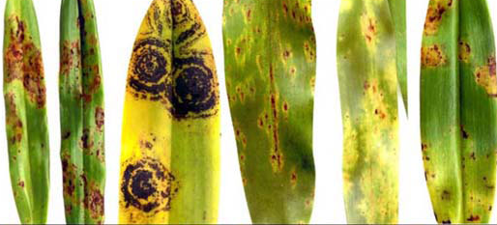
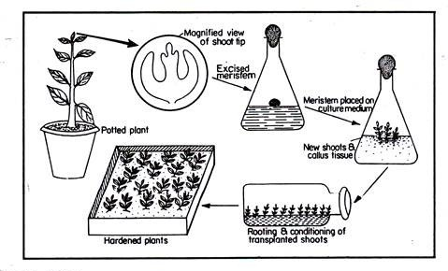
Applications - Virus / disease eradication
There is NO commercially available treatment to cure virus infected plants.
Apical meristems are almost virus-free
(they lack a vascular system )
It is possible to produce disease free plants by Shoot tip culture
culture of terminal (0.1-1.0mm) portion of a shoot comprising the meristem (0.05 -0.1) together with primordial and developing leaves and adjacent stem tissue.

Slide 9
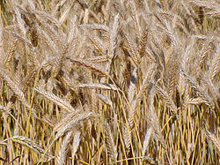
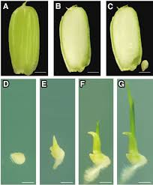
Applications - Embryo rescue
Embryo rescue plays an important role in breeding
It gives a chance of survival to embryos produced from wide crosses by nourishing them
Embryos are manually excised and placed immediately onto a culture medium to support survival and growth
Also used to: overcome seed dormancy (shortening breeding cycle), assess seed viability
Embryo rescue in rice
to speed up breeding
Ohnishi A. et al. 2011
Triticale (Wheat X Rye) Embryo rescued from embryo-endosperm incompatibility

Slide 10
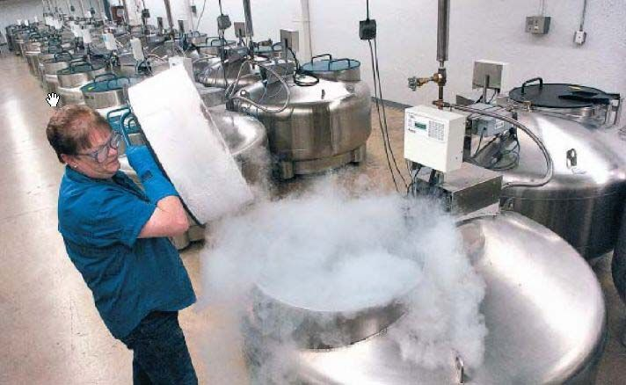
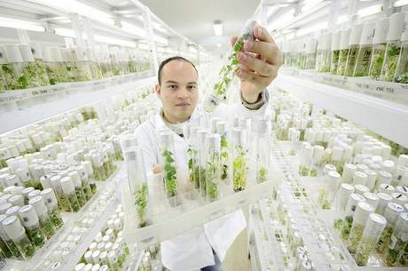
Applications - Germplasm conservation
Germplasm => collection of crop species and relatives
Genetic erosion - decline in genetic variability due to agricultural selection
NEED to conserve germplasm important sources of genetic variability
In vitro system is extremely suitable for germplasm conservation
CRYOPRESERVATION – “Preservation in the frozen state”
Plant material is maintained at -196ºC – cells in inactive state
SLOW GROWTH METHOD
Growing processes are reduced to a minimum combining different factors
liquid nitrogen tank, USDA ARS
tropical forages conserved in vitro at CIAT gene bank in Colombia

Slide 11
Advantages & disadvantages of micropropagation
Advantages
Disadvantages
High propagation rates and uniformity
Disease and virus-free plants
Enable embryo rescue of remote crosses
Speed international exchange of plant material
Easier handling of plant material and operations
In vitro plants can be readily usable or stocked for the future
Relatively high investment required
Not all plants can be micropropagated
Contaminations can cause high losses
Genetic variability may occur
Micropropagation is a useful tool to propagate true-to-type plants
It can be used for diferent purposes
Its adoption always depend on the plant species and the objective

Slide 12




Slide 13
Some useful references
Chawala H.S.2009. Introduction to plant biotechnology, third Ed.
Hartmann H.T. & Kester's D.E. 2011. Plant Propagation: Principles and Practices 8th Ed.
Ikeuchi M. et al. 2016. REVIEW - Plant regeneration: cellular origins and molecular mechanisms
Development 143 (9), 1442-1451. doi: 10.1242/dev.134668
Thorpe T. 2012. History of plant tissue culture.
Methods in Molecular biology 877:9-27. doi: 10.1007/978-1-61779-818-4_2
Totipotency: Meaning, Expression and Importance | Plant Tissue Culture
http://www.biologydiscussion.com/plant-tissues/totipotency/totipotency-meaning-expression-and-importance-plant-tissue-culture/14641
Plant Development
http://www.mun.ca/biology/desmid/brian/BIOL3530/DB_06/DBNPlant.html

