Slide 1
GM Plants and health issues
- a subject of concern?
Chandra Shekhar Misra
“Plants for Life” International PhD Program – 2016
(course “Plant Biotechnology for Sustainability and Global Economy”)

Slide 2
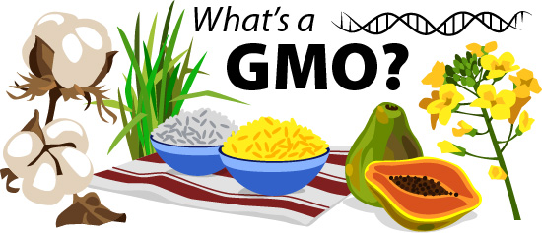
What are GM crops?
A crop modified in the lab (through genetic engineering) to improve a specific trait by importing genetic material from another species.
Can it lead to the production of toxic molecules???
Notes:
By definition a genetically modified organism is an organism carrying genetic material altered using genetic engineering techniques, but in most cases it is assumed that this necessarily implies importing genes from different species.
The most common fear about GM (genetically modified) crops is that the genetic modification could lead to the production of toxic molecules harmful to animals and human beings, although several studies prove otherwise, as briefly detailed in the next few slides.

Slide 3
Some Benefits of GM crops
Herbicide Tolerance
Insect resistance
Yield increase
Genetically modified crops
Virus tolerance
Nutrient enhancement
Stress resistance
Notes:
Some benefits of GM crops are these indicated. However, there are others, such as the use of GM crops for production of biopharmaceuticals. For instance, potatoes have been modified to produce edible vaccines against E. coli which causes diarrhea. But this kind of research is still emerging and needs further investigation to come to market. These strategies would be beneficial for cheaper and easier distribution of vaccines specially in developing countries.

Slide 4
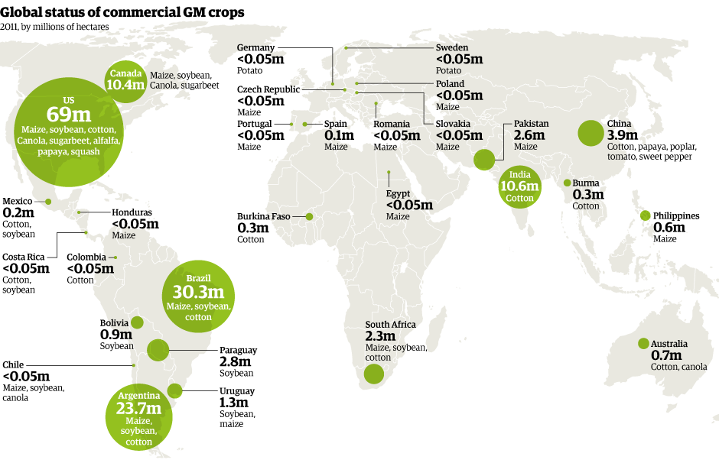
GM crops are widely grown and consumed!!
http://www.theguardian.com/environment/graphic/2012/feb/09/gm-crops-world-2011-map
Notes:
Additional relevant information can be found at:
http://isaaablog.blogspot.pt/2013/05/the-2012-global-status-of.html
http://www.europabio.org/news/map-global-status-commercialized-gm-crops

Slide 5
So… What’s the fuss all about?
Are GM plants unnatural?
GM plants may contains foreign genes (eg.: from bacteria, animal, ...)
Can GM plants spread out of control in the environment?
Is GM technology unethical?
Are corporate interests dominating GM technology?
Is GM regulation enough to ensure safety?
Emotional fears
Lack of knowledge about Science and Conventional food systems
Economic and political interests
Ideological and religious perspectives
Concerns about GM plants should be based on scientific grounds
Notes:
Science based concern must arise from experiments demonstrating health and environment-related issues. Other concerns may exist (eg.: related to ethical, socio-economic, or political agendas) but these should not be claimed as scientifically-based.

Slide 6
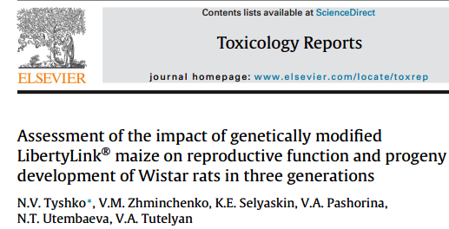
Are there actually any health concerns?
Panchin & Tuzhikov, Critical Reviews in Biotechnology, 2016
Tyshko et al., Toxicology Reports , 2014
Notes:
These are some of the recent studies that show GM crops are not a health hazard. The studies that show they have potential health effects lack substantial scientific evidence which does not validate their claims about the GM crops. Neverthless, more studies are desirable to support that GM crops do not pose any serious health effects.

Slide 7
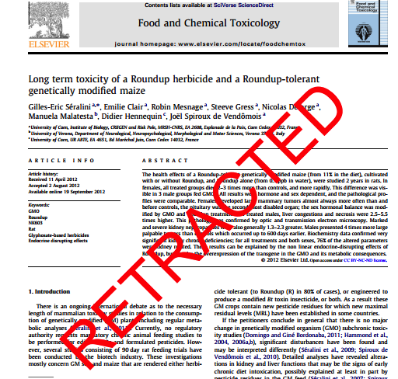
Are there actually any health concerns?
No statistical proof !
The strain of rat used was prone to develop tumours (a strain spe-cifically used to test pharmaceu-ticals against cancer) thereby not allowing proper conclusions about putative toxicity of GM crops
‘‘extraordinary claims require extraordinary evidence’’
--- Carl Sagan

Slide 8
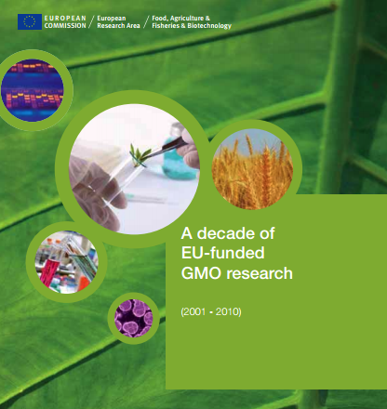
Are there actually any health concerns?
1783 articles on
GMO biosafety
No credible evidence of
harm to health
(or environment - see talk #7)
50 projects, > 400 research groups
→ “biotechnology, and in particular GMOs, are not per se more risky than, e.g. conventional plant breeding technologies”
Notes:
https://ec.europa.eu/research/biosociety/pdf/a_decade_of_eu-funded_gmo_research.pdf

Slide 9
Some Myths about GM plants busted!!
Is foreign DNA safe to eat?
DNA is digested in mouth and gut
This happens with all our food
Could they get into gut bacteria?
Horizontal gene transfer is not common in bacteria (and bacteria don’t select for transgenes!!!)
Could they contain new toxins?
GM plants are the best analyzed/scrutinized plants that come to market
Could antibiotic resistance genes get into people?
No! DNA is broken down in digestive tract
Could they cause allergies?
Most food allergies ≈ 6 proteins
100.000 Proteins in plants
Allergenic potential is monitored
Notes:
Some Myths about GM plants health concerns
Is “foreign” DNA safe to eat?- Plant and animal foods have DNA, and we eat is everyday. We also always eat DNA from bacteria and viruses that exist in our foods.
Could “foreign” DNA get into gut bacteria?- Numerous factors limit the transfer, such as the uptake, and stabilization of plant DNA by bacteria. No experimental evidence was found of this transfer.-
Could GM plants have unexpected alterations in their nutritional composition? - They are actually better analyzed/ scrutinized than conventional plants.
Could “foreign” DNA be transferred to people?- DNA is broken down in our digestive tracts. If this was a problem it would be also valid for all other genes that we eat in our food.
Could GM plants be allergic/ toxic?-Most food allergies originate from half a dozen proteins. There are about 100.000 proteins in plants. GMO potential allergenicity/toxicity is fully assessed before commercialization.

Slide 10
Conclusions
There are NO documented adverse health effects from eating GM foods
A specific technology should NOT be the trigger for regulatory assessment
All breeding techniques lead to DNA changes and carry some risk
All concerns about GM plants should be based on scientific proof
Nothing is Risk-FREE
Notes:
=> As far as GM crops are concerned, nobody can say they are risk-free, but the same is true for any crop produced through conventional breeding techniques... none is risk-free!
=> The insertion of a gene encoding a desired trait can not be the sole criterium for stringent regulatory assessment.
=> All claims, positive or negative should be based on scientific grounds and not politically or financially motivated.

Slide 11
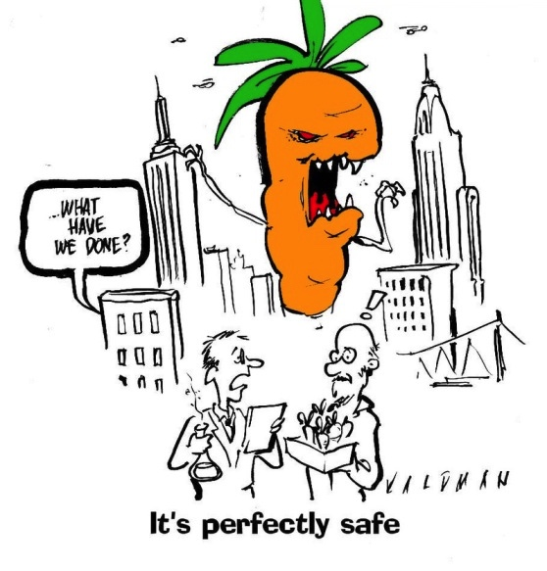
Conclusions
Are approved GM Plants
safe to eat?
An approved GM plant is no more likely to cause a problem than the equivalent non-GM plant!!

Slide 12
Bibliography
Panchin, A. Y., & Tuzhikov, A. I. (2016). Published GMO studies find no evidence of harm when corrected for multiple comparisons. Critical reviews in biotechnology, 1-5.
Tyshko, N. V., Zhminchenko, V. M., Selyaskin, K. E., Pashorina, V. A., Utembaeva, N. T., & Tutelyan, V. A. (2014). Assessment of the impact of genetically modified LibertyLink® maize on reproductive function and progeny development of Wistar rats in three generations. Toxicology Reports, 1, 330-340.
http://www.theguardian.com/environment/graphic/2012/feb/09/gm-crops-world-2011-map
https://ec.europa.eu/research/biosociety/pdf/a_decade_of_eu-funded_gmo_research.pdf
Further Reading :
http://connectusfund.org/27-big-advantages-and-disadvantages-of-genetically-modified-foods
http://cera-gmc.org/GMCropDatabase
http://biotechbenefits.croplife.org/ (Highly Recommended)

Slide 13
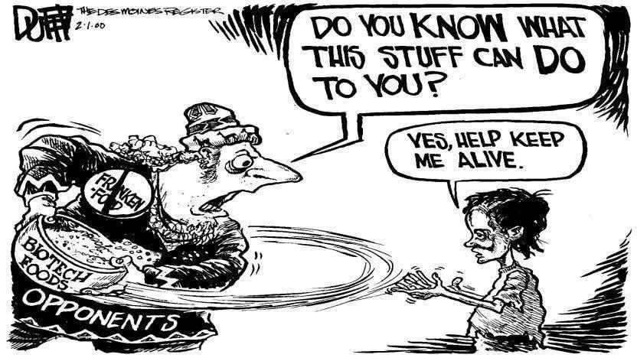
It’s a global world…
Thank You!!

